Slide 1

New instruments under development at Wrocław SPD, SRC
RESPECT Rosja, FIAN
SphinX-NG, GSFC

Slide 2
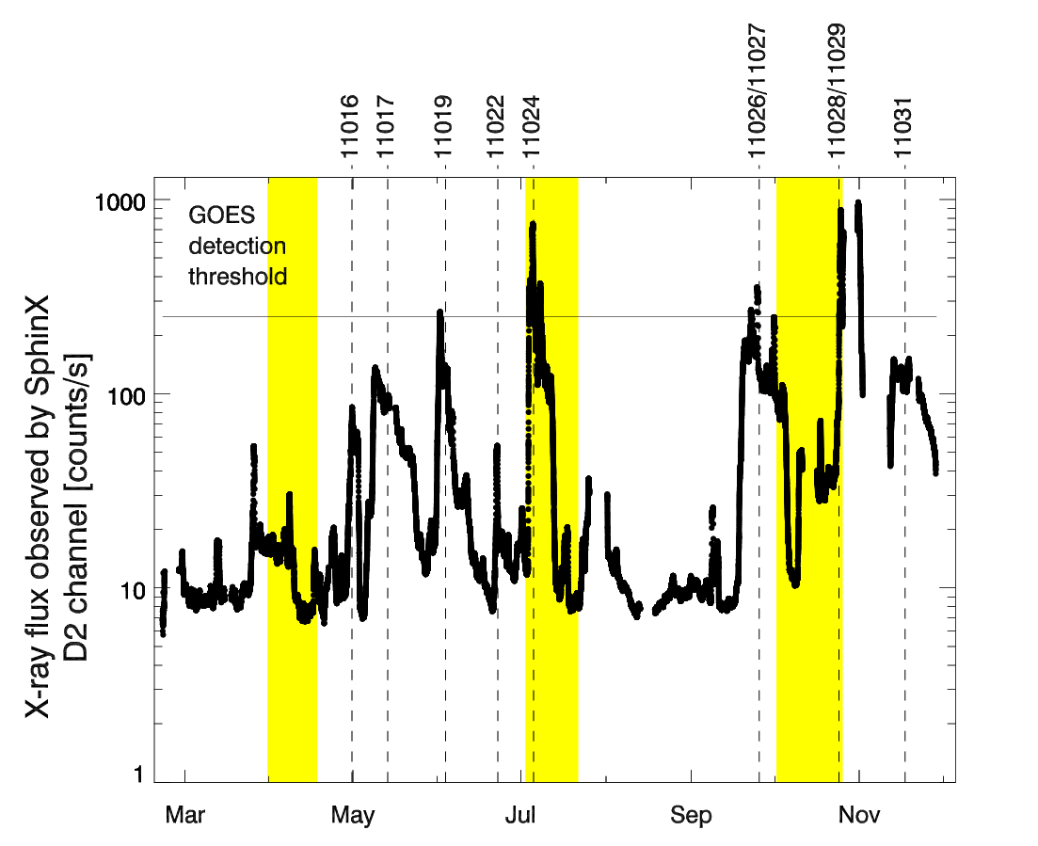
SphinX heritage (PIN diode detectors)
There is a lower limit for solar X-ray flux of the Sun in the energy range
E > 1 keV
~5 × 10⁻¹⁰ W/m²
No measurements after November 2009 ☹
^{Only full-Sun spectra}

Slide 3
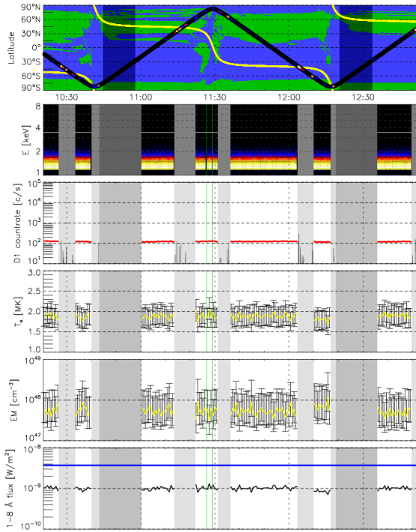
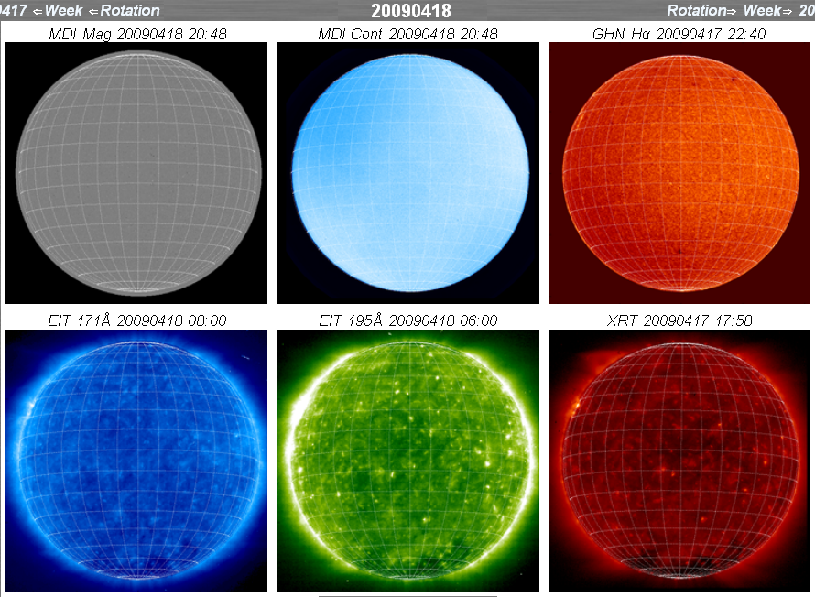
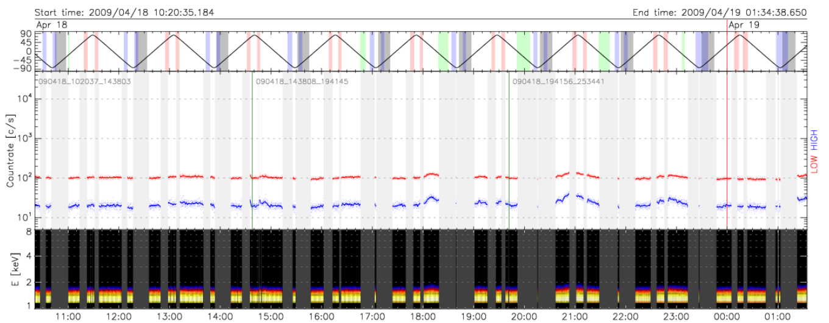
Behaviour when no AR is present example 18 April 2009
Gaps due to S/C nights,
Polar ovals’ and SAA particles
Detector temperature below -22C!
~12 hours
Multi-T once a minute

Slide 4
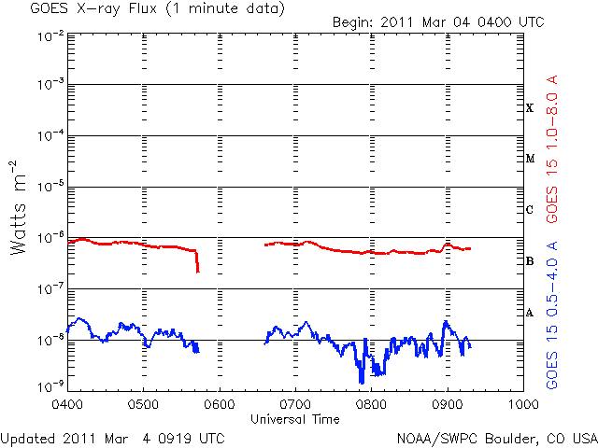
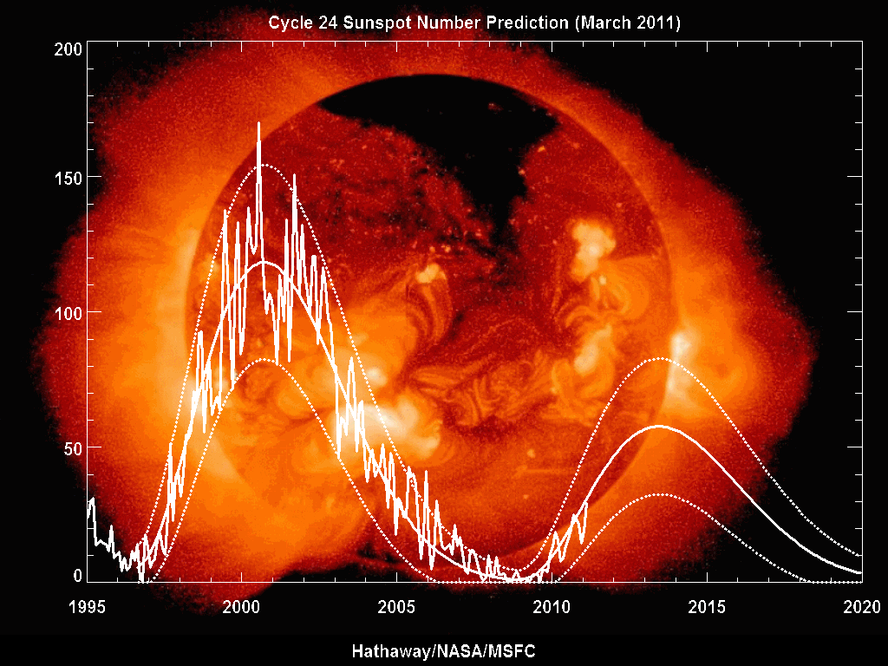
Expected future solar activity http://solarscience.msfc.nasa.gov/images/ssn_predict_l.gif
Not very reliable at low levels

Slide 5
Advance spectral and high-time measurements of solar spectra in the energy range 1- 15 keV
Study variability of the X-ray Sun with sensitivity 100-1000 x GOES→ T & EM v short (0.1s) & long (hours) timescales
Allow for medium-angular-resolution imaging in this range – resolve individual AR spectral & time components → study AR energy balance – i.e the thermal component

Slide 6
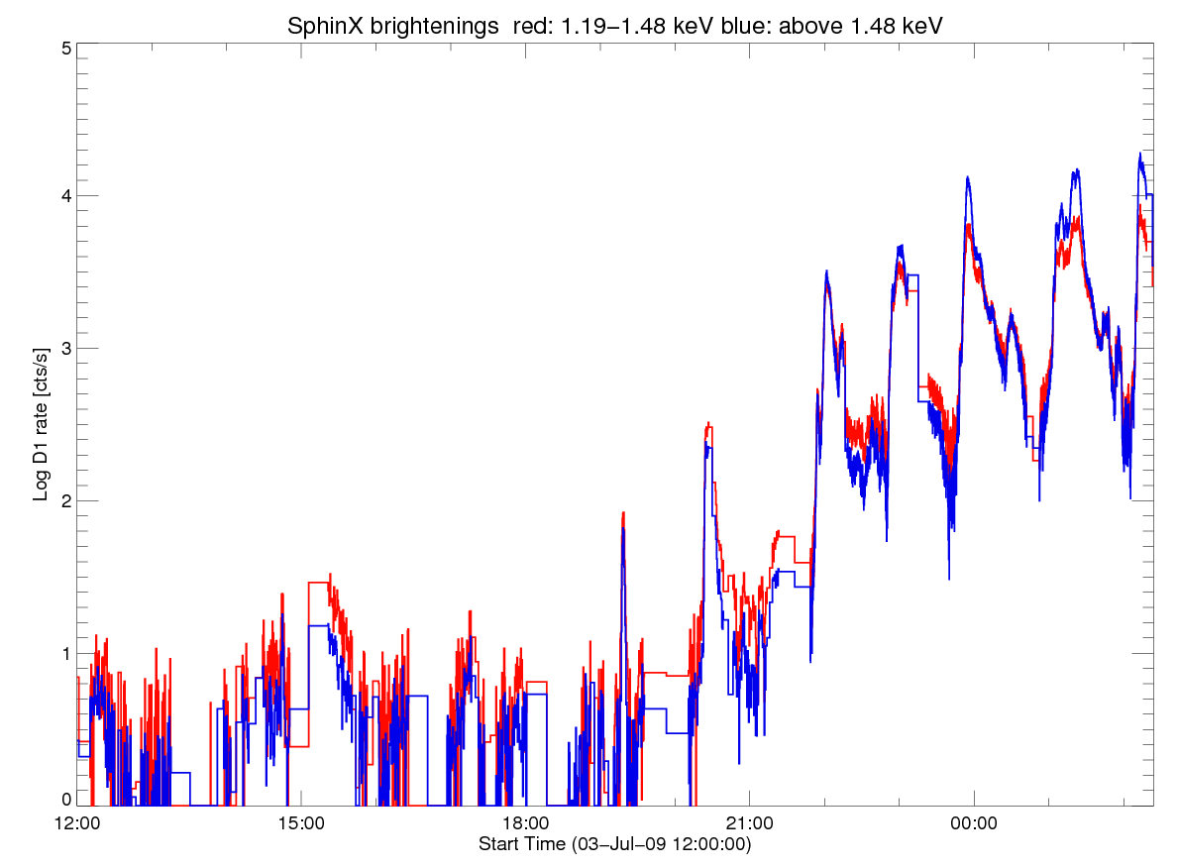
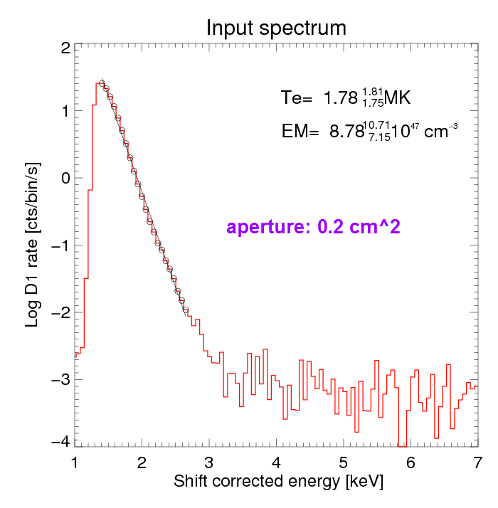
Lone AR 11024 studies in progress (BS, MS, Harvard)
Variability in timescales 1 s ÷ days
GOES sensitivity threshold

Slide 7
Typical flux values for non-active Sun
Be 12 µ thicknes filter,
0.5 mm thickness Si crystal (absorber)
~10 cts/s/mm²
1-few cm² in order to collect few thousands cts in 1s necessary → reveal spectra at few keV
Classical detectors: 300eV resolution, better (~130 eV) desired

Slide 8
For very active Sun (X20 flare)
10^8 cts/s/mm2 !!!, so apertures should be of the order of 10 microns in order to operate at 10⁴ cts/s or much thicker filters must be applied (three apertures, factor 50 progression of decreasing size used in SphinX)
RHESSI „adventure” with attenuators (elaborated thicker filters) has not been fully successful however…
In STIX, no attenuators will most probably be used (this week discussion)

Slide 9
SDD Si drift detectors (Amptek, Ketek) http://www.amptek.com/drift.html
Filters, Be 12 µ thicknes on sealed apertures up to 1cm^2
Crystal thickness (Si absorber) <0.5 mm
A silicon drift detector (SDD) is a type of photodiode, functionally similar to a PIN photodiode, but with a unique electrode structure to improve performance. Amptek’s SDDs are optimized for X-ray spectroscopy.
The key advantage of the SDD is that it has much lower capacitance than a conventional diode of the same area, therefore reducing electronic noise at short shaping times. For X-ray spectroscopy, an SDD has better energy resolution while operating at much higher count rates than a conventional diode. The SDD uses a special electrode structure to guide the electrons to a very small, low capacitance anode.

Slide 10
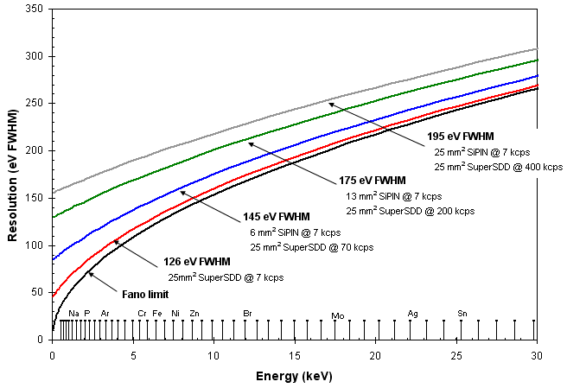
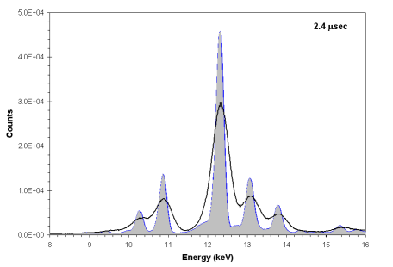
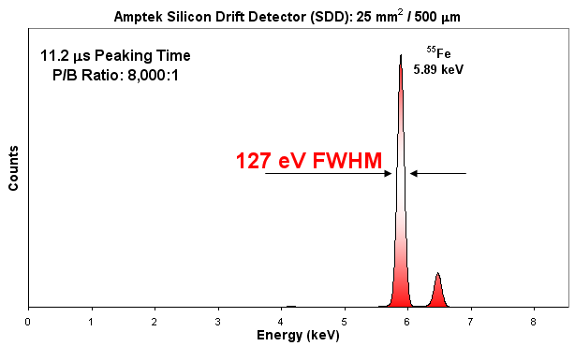
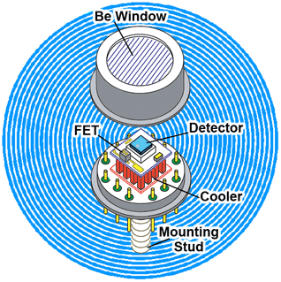
SDD Si drift detectors (Amptek, Ketek) http://www.amptek.com/drift.html
SDD
advantages are particularly important at low energies, high count rates, and for larger areas.
planar
Dynamic range ~20 000, so two such detectors, (instead of three for SphinX) to cover the dynamic range
Much lower noise, but same sensitivity to particles

Slide 11
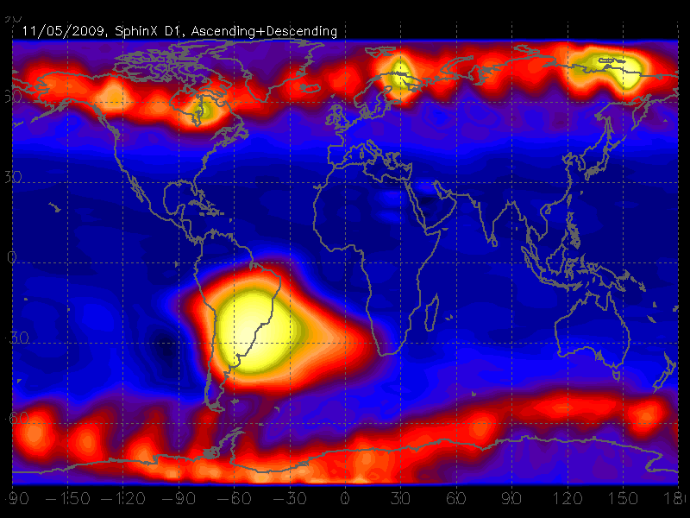
How SphinX 25 mm² PIN detector responds to particle environment SphinX heritage ~at 550km polar orbit
100 cts/s
< 1 ct/s
1000 cts/s

Slide 12
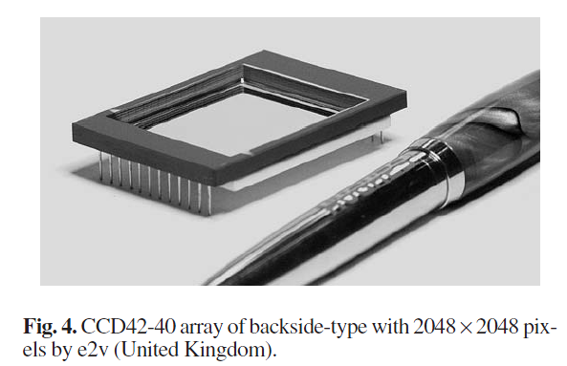
CCD- back illuminated http://www.e2v.com/
1024 x 1024 pixels, 13 micron size
Less than 0.1 mm thickness Si, so transparent to X-rays above few keV
Tracks due to particles seen
Already used, also by FIAN group for Mg XII 8.421 Å imaging
TESIS Mg XII image of non-active Sun

Slide 13
Desired orbits and payload availability
Orbits
LEO equatorial (+), ISS, see the Sun for 60 min each 100 min orbit, SAA, telemetry non-continuous, 400-700 km
LEO Polar semi Sun Synchronous (++) Coronas, up to 3 weeks out of shadow, SAA polar ovals, telemetry non-continuous, 400-700 km
Geosynchronous (geostationary) (++++), SDO, constant sunshine, continuous telemetry ~36000 km
L1 (SOHO) (+++)- far for fast telemetry
Interplanetary (Solar Orbiter, Interheliozond) (+++) telemetry problems, but 20x higher fluxes due to proximity
Availability
Russia, FIAN, IZMIRAN, national programs (monitoring, military, ISS-LEO, IHZ interplanetary 0.25-0.7 a.u.)- Kuzin, Kuznetsov
US, piggyback nanosatellites ~1-few liters volume, LEO, NASA, GSFC, Brian Dennis

Slide 14
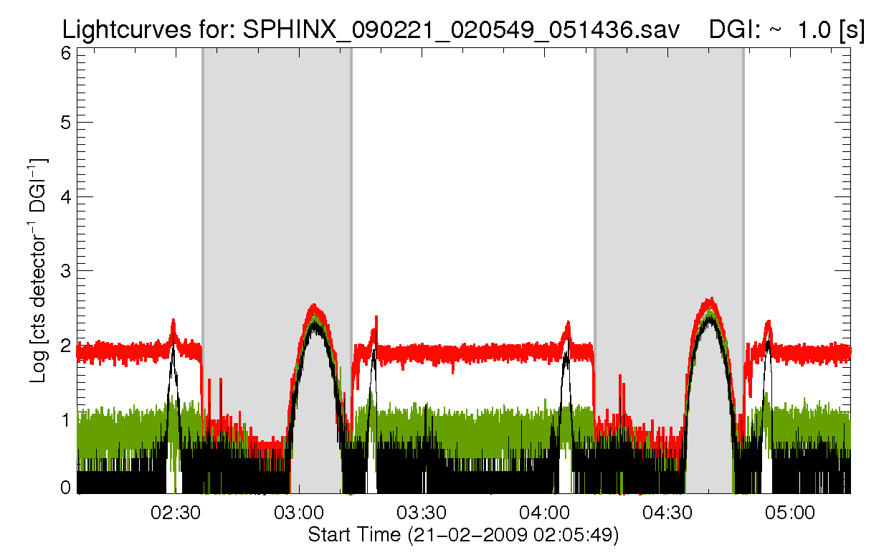
Russian Earth monitoring satellites: FIAN
Polar, Sun-synchronous, ~700km, but details are still not fixed
Much higher radiation particle background
HE electrons ~100÷1000 x Coronas
Protons 20÷100 x Coronas
2-3 kg class instrument
CCD detectors

Slide 15
Рентгеновский СПЕКТрофотометр РЕСПЕКТ ReSpect
ФИАН - ЦКИ ПАН
Agreement 2009
Launch ~2013
Spectral range 0.8-15 KeV
Registration of single photon
Registration activity from quiet corona to X-class flares
Good energetic resolution
Temporal resolution less than 1 second
Long life-time (8 years)
Absolute calibration during the lifetime
Operation in radiation belts, flare and after-flare fluxes of gamma-rays and energetical particles
FOW 6°

Slide 16
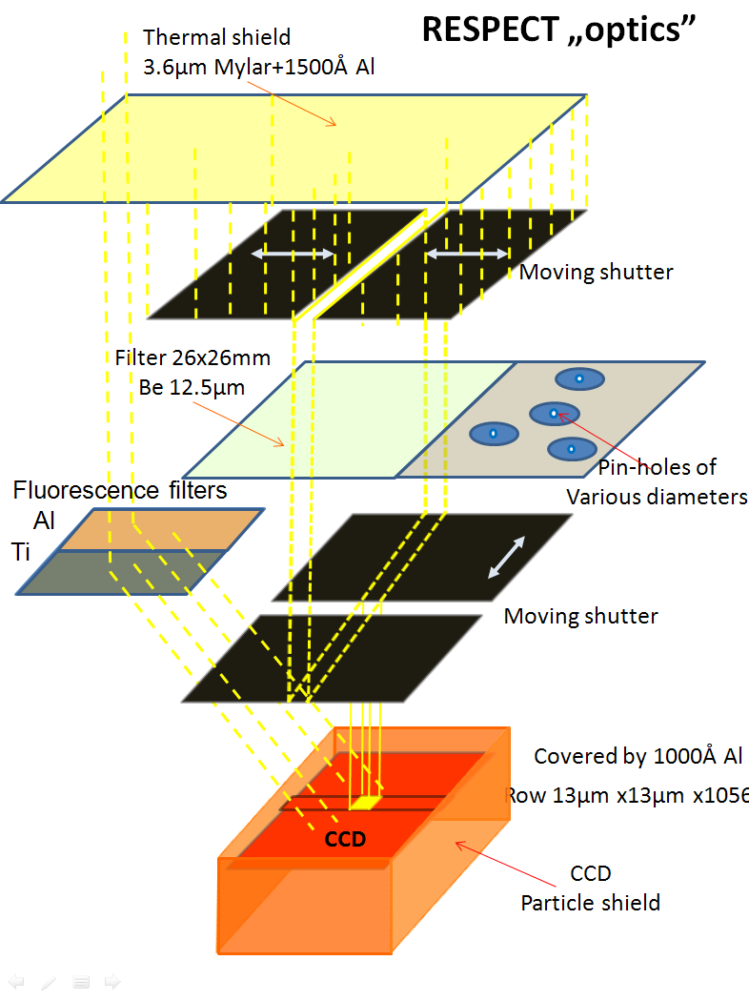
RESPECT measurements ideology
The front aperture is limited by system of two front-side moving diaphragms with flat sharp edges (1 µ rrms nonuniformity)
Slit width can be adjusted using respective sensors to within similar accuracy down to a fraction of the CCD pixel (13 x13 µ). The slit can be “moved” to any position within the input FOV (prevents memory effect)
On the same upper shaft, the ensemble of pin-hole system of various cross-sections is fixed, allowing to select desired size of the active pinhole, depending on the solar activity level. On the underneath of the second upper shaft, the Fe⁵⁵ radioactive source producing Mn characteristic lines at 5.9 keV is placed.

Slide 17
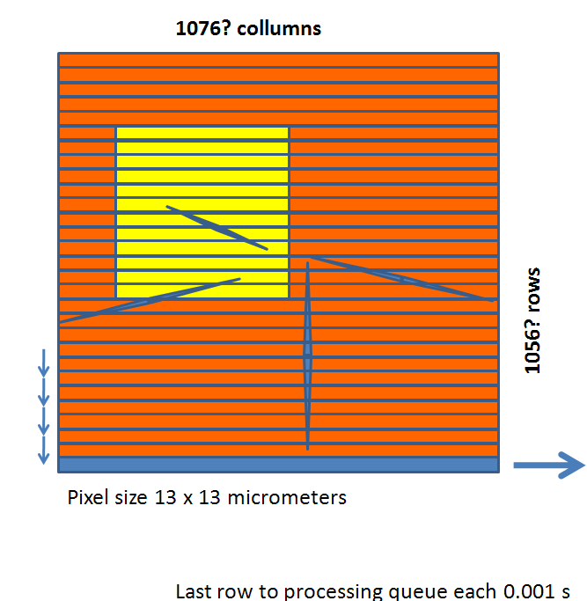
RESPECT ideology < 2 cts/pixel/exposure
Any solar photon absorbed within active CCD area produces electron-hole pairs in the Si, proportional to photon energy. 3.65 eV is required to produce one electron-hole pair. Therefore the signal from such an event, usually expressed in DN can be assed to determine photon energy if less than one photon is recorded over the “active “ life of the pixel in question (at most one second if the CCD row read-out time is 0.001s and number of rows is ~1000. This property is exploited in RESPECT design, where we make effords to have always the probability of less than 2 cts/pixel as integrated over exposure time of the pixel. Pixel exposure time to solar illumination is the time any pixel is find within the solar-illuminated area defined by slit positions, angular extend of the source (30 arc min for the non-active corona, 2arcmin for AR 20 acrsec for flare) and diffraction effects on the slits or pin-holes (depending on energy). The signal from a single soft X-ray photon is expected to be in the range between 200 and 2000 DN (0.75-7.5 keV). Larger signals may correspond to particles and therefore can be used to differentiate between photons and particles.
telemetry

Slide 18
Expected fluxes –source sizes & diffraction to be taken into account

Slide 19
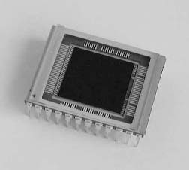

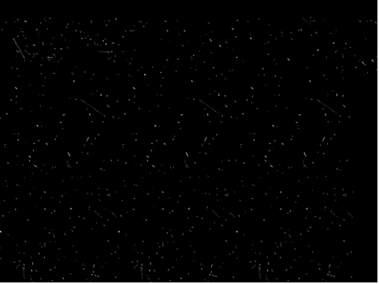

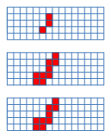
RESPECT particle rejection
Amplitude analysis > 2000 DN „reject”
Track identification (ZK)
Coodinate (attitude) conditions
Linear and/or chess-horse patterns removed
Ph+B
B
Ph

Slide 20
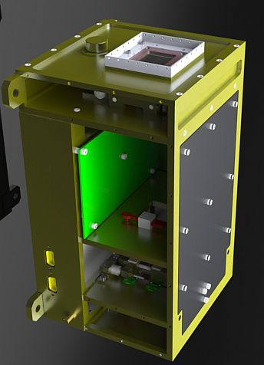
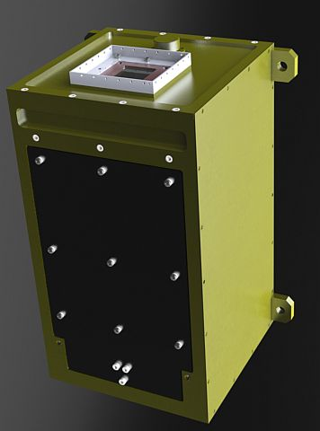
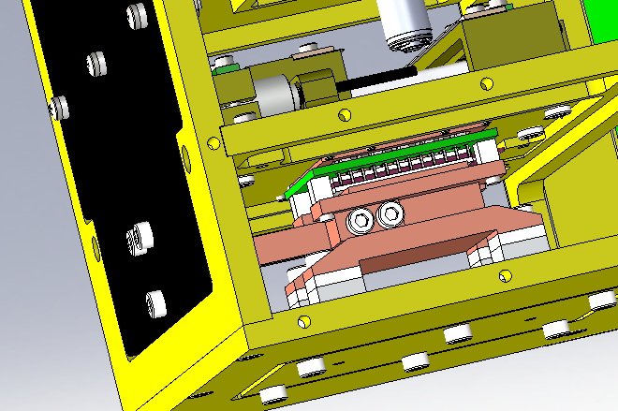
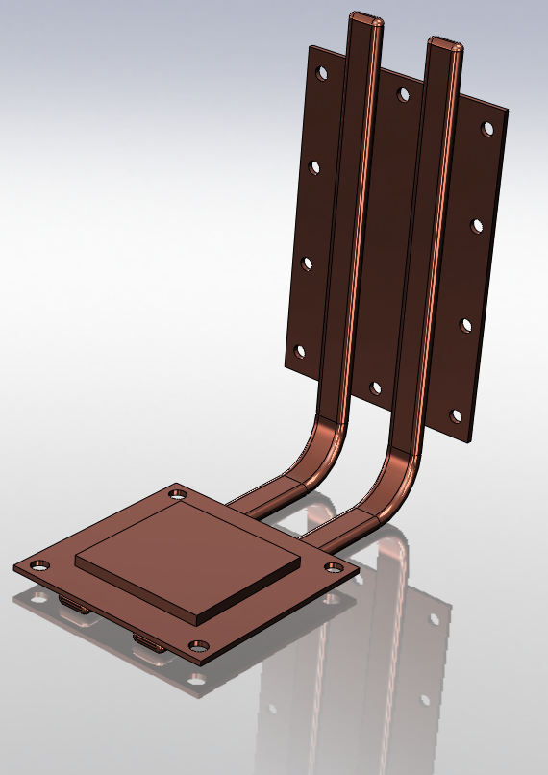
RESPECT- actual construction details (Jarek Bąkała)
Mass: < 3kg
passive and operate by two-phase heat transport (e.g., evaporation and condensation)

Slide 21
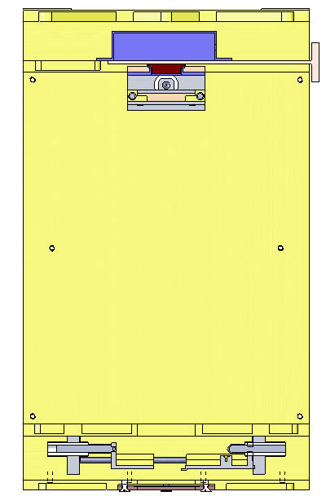
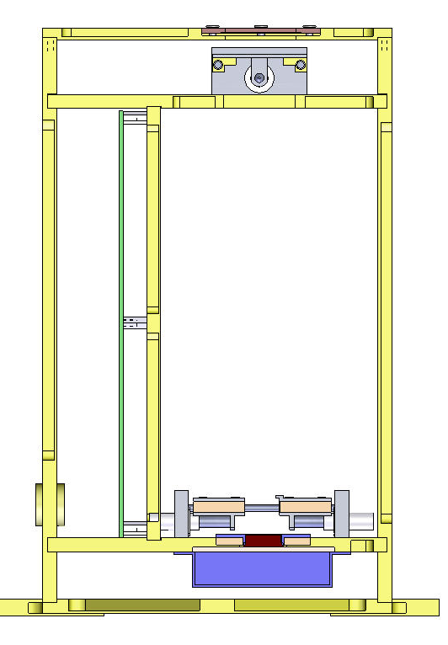
Fe⁵⁵
Moving shutter
25 cm
Moving shutter
CCD
Lead shield
CCD
Lead shield

Slide 22
RESPECT-present status
Details of mechanical construction nearly finished- to be agreed this Wednesday with FIAN- will receive CCD for tests
technology of straight edge construction available (1µ rms over 30 mm)
Alignment & precise position calibration procedures known
Ongoing are Vacuum & Thermal tests of piezzo and (stepper) motors (5)
Test equipment present including powerfull X-ray source (Amptek), precision vacuul drives & cooling systems present
Data reformatting & visualisation tasks are to be added as the data are going to the „public domain”

Slide 23
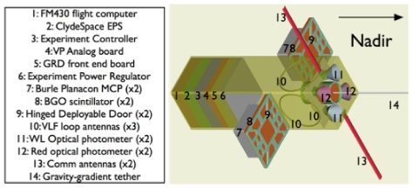
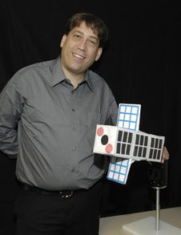
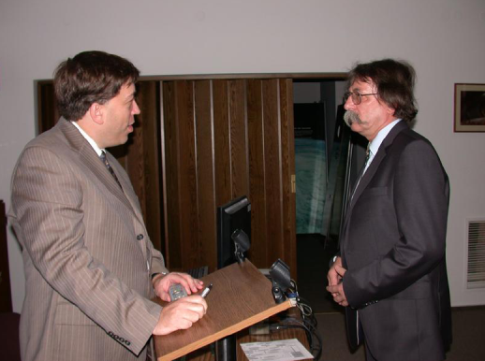
Nanosatellites CubeSat http://firefly.gsfc.nasa.gov/Spacecraft/satellite.html
30 cm
Doug Rowland, principal investigator for 'Firefly' stands next to the real size model of the nano satellite.

Slide 24
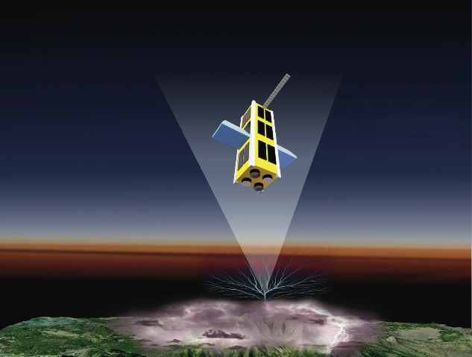
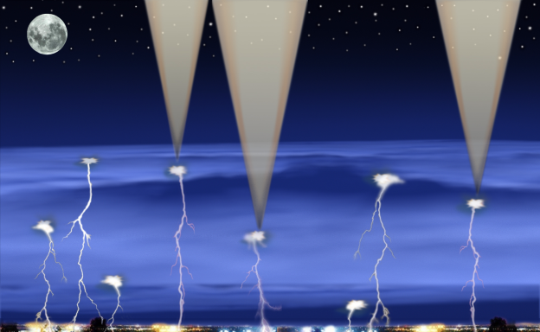
Cubesat (NSF): TerrestrialGamma-rayFlashes http://science.nasa.gov/science-news/science-at-nasa/2010/29jan_firefly/
NASA's Compton Gamma Ray Observatory (CGRO) first discovered TGFs in the 1990s. Designed to look outward at cosmic sources of gamma rays, CGRO also caught rare but tantalizing glimpses of gamma rays coming from Earth.
TGFs are likely produced by beams of very energetic electrons, which are accelerated in the intense electric fields generated by large thunderstorm systems.
Before CGRO, many scientists thought these very energetic types of radiation could be generated only near the Sun, or in black holes, large galaxies, or neutron stars.
FERMI
Antimatter:
http://www.nasa.gov/mission_pages/GLAST/news/fermi-thunderstorms.html

Slide 25

Aim: to extend and continue investigations of solar hot plasmas
Focus on soft X-ray range 0.8-15 keV
Bulk of thermal emission is formed
Substantial radiative cooling of the plasma takes place
Provide sufficient spectral & time resolution in a wide dynamic range
Photon stamping: Energy resolution (200 eV) & arrival time (down to 1 microsec)
Two detectors, two apertures: tiny-M+class flares large: non-active corona
Allow to study & monitor (of importance for space weather)
long term solar flux variability, average temperature & emission measure behavior, DEM studies, coronal energy balance
coronal plasma abundances
Provide measurements of orbital background particle fluctuations and auroral X-ray spectra (one detector in anti-solar orientation)
Measure soft X-ray signatures of Terrestrial Gamma-ray Flashes

Slide 26
Recommended satellite and orbit
Satellite:
Cube-sat or Firefly type
Orbit:
polar, sun synchronous, ├ Sun
one-axis constntly directed towards the solar disc centre within +- 1 degree, other to satellite Nadir
1 year+ lifetime, perigee above 300 km

Slide 27
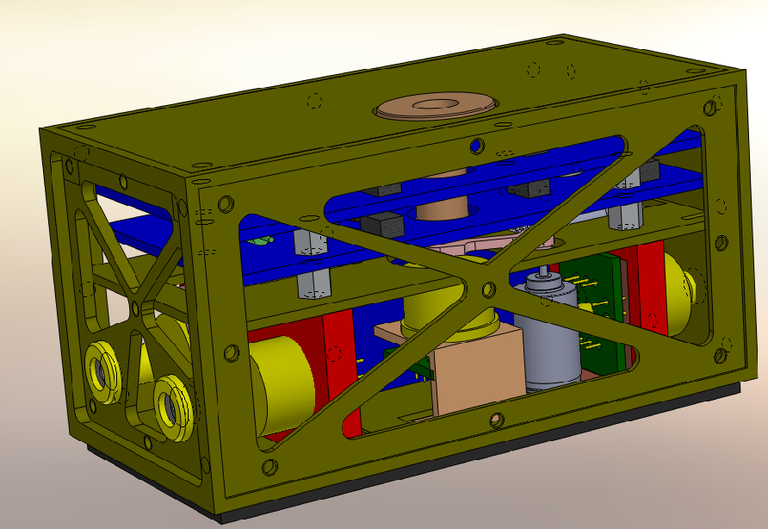
SphinX-NG possible configuration: detectors: 3 SDD+1CdT, Peltier cooled
Towards
The Sun
For
Coronal
spectra
Anti-solar for particles and auroral spectra
10 cm x 5 cm x 5 cm, 0.5 kg, 1-2 W
Towards the Earth for GRF detection (Nadir)

Slide 28
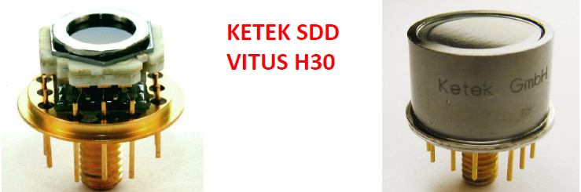

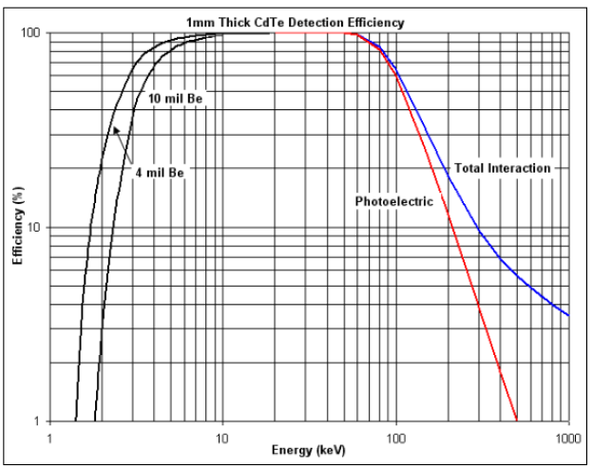

SphinX-NG detectors (Ketek)
Si SDD 3
CdT 1

Slide 29
Quantities to be measured
Event amplitudes 12 bits → conversion to energy (solar & auroral X-rays, particles, & their secondary effects)
Arrival time 1 µs → allow to build spectra at any longer time resolution as far as statistics allows
Housekeeping info
Temperatures, voltages, currents
FPGA technology for electronics
Compressed data are send to telemetry buffor

Slide 30
Expected fluxes to be seen (from SphinX heritage)
Non-active corona (AR absent, often in 2009)
1000 cts/s in large aperture detector, particle background < 0.001 cts/s/bin outside polar ovals and SAA
X-flare: 10^4 cts/s, through a tiny aperture (1 mm^2)
Polar ovals: between 100 and 10^4 cts/s/detector for low and high geomagnetic activity
SAA: ~1000 cts/s

Slide 31
SphinX-NG status
Direct collaboration between SRC and GSFC (first US visit in November, Jim Slavin & Doug Rowland). http://press.cbk.waw.pl/10/cbk10111701/index.html
Brian Dennis set up as NASA contact
Details of „return visit” to GSFC to be fixed today during the telecon with Brian-sign-up of agreement
US provides the launch opportunity within their nano-satellite programme
Poland- construction of the instrument (funding application through NCN, 1.5-2 mln zł this spring)

Slide 32
Thank you

Slide 33
SphinX-NG

Slide 34
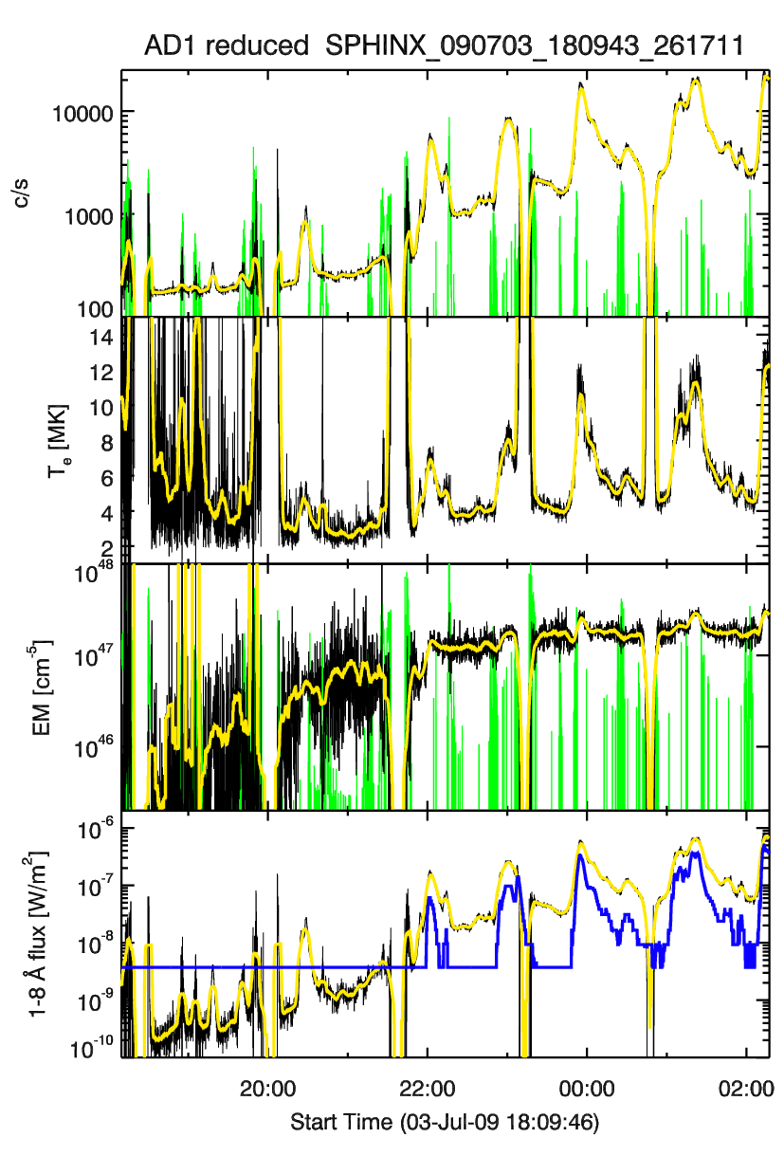
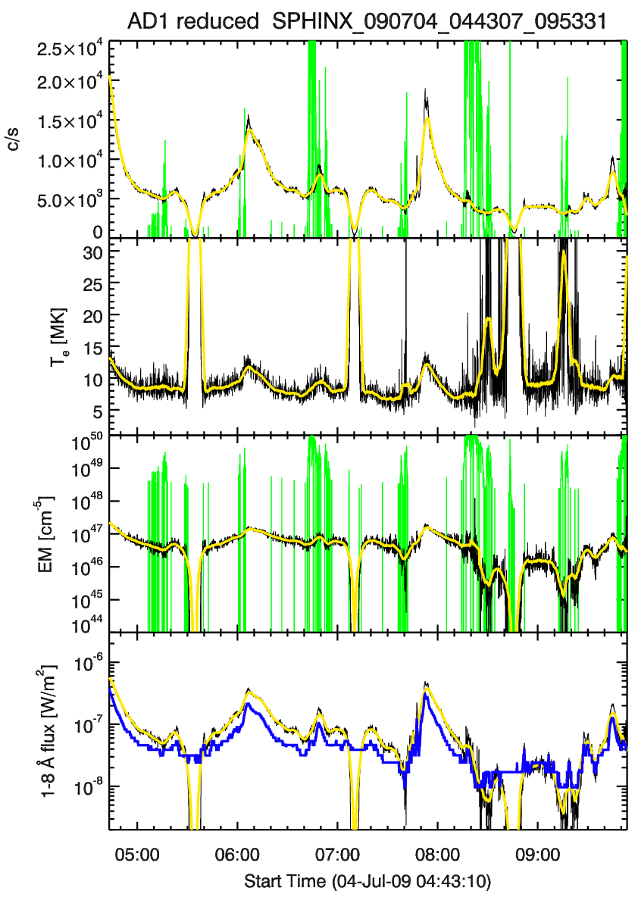
GOES vs SphinX

Slide 35

New X-ray classes
We are introducing new „classes” of X-ray solar variability, below GOES A1.0
A = 10⁻⁸ W/m² (present lowest)
S = 10⁻⁹ W/m²
Q = 10⁻¹⁰ W/m²
SphinX in its D1 channel is capable to observe events 100 x less intense than GOES
Most of variability since the launch is observed to happen below the GOES delectability threshold
XXXIV Zjazd PTA Kraków , Solar Session, 15 September 2009 Janusz Sylwester

Slide 36

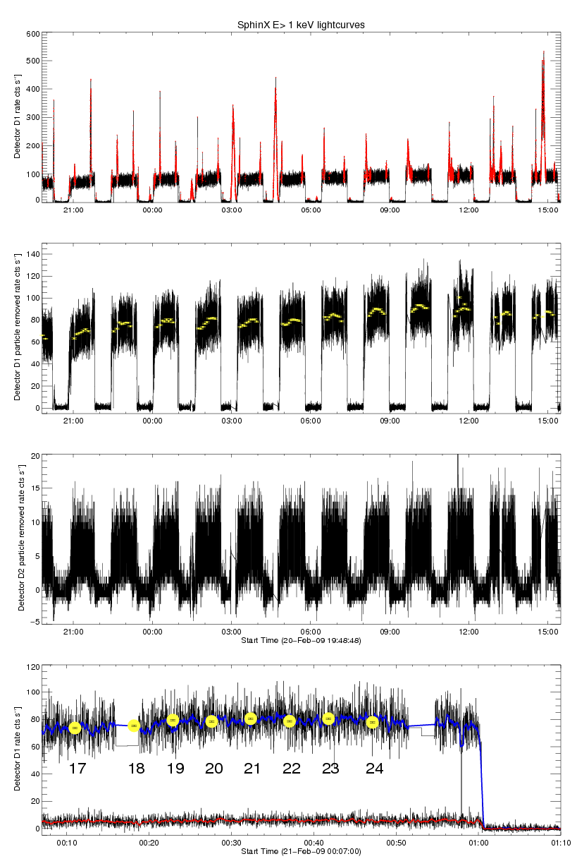
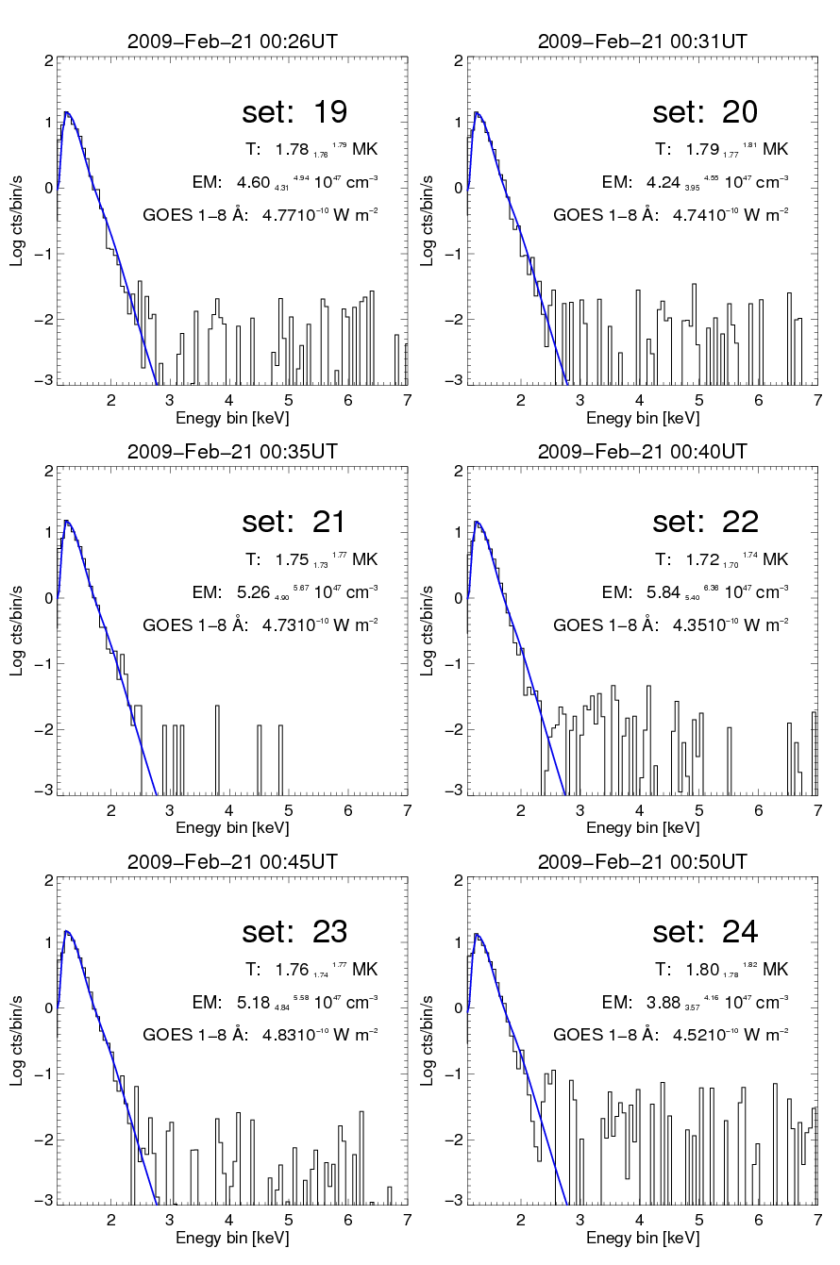
Determination of absolute levels of X-ray solar luminosity E > 1 keV
E₁
D1- DGI 1s
/E₂
D1
D2
XXXIV Zjazd PTA Kraków , Solar Session, 15 September 2009 Janusz Sylwester

Slide 37

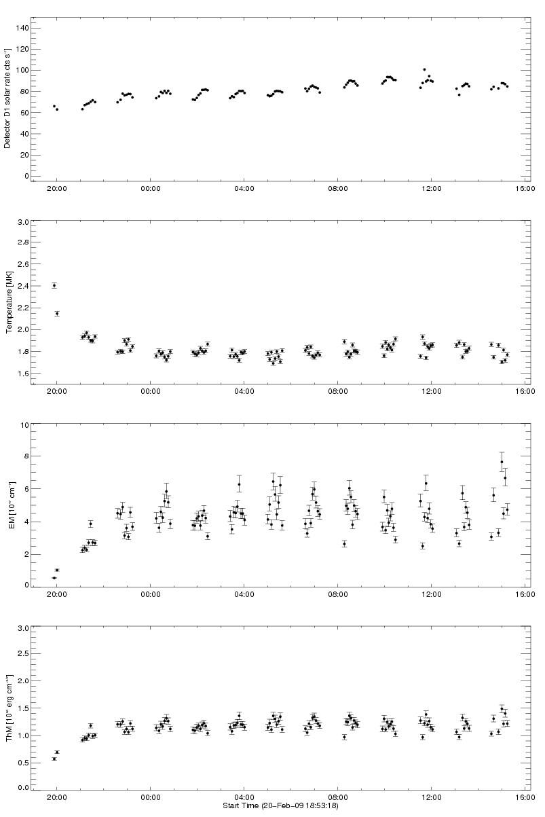
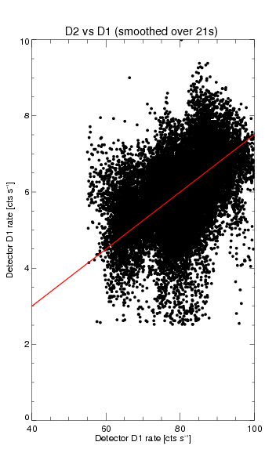
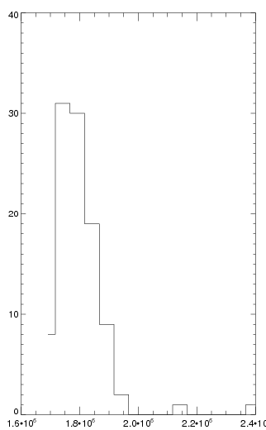
X-ray fluence at E > 1 keV
D1 rate
Histogram of T values
D2 rate
Instrument heating
Temperature
D1 rate
1.6 1.8 2.0 MK
Emission Measure
Example: for data set No. 50
Te 1.71 MK [ 1.69, 1.72 ]
EM 6.2 [ 5.7 , 6.7] 10⁴⁷ cm⁻³
Flux [1 - 15 keV] 1.4 10⁻⁸ W/m2
Flux _{GOES} [1 – 8 Å] 4.2 10⁻¹⁰ W/m2
Thermodynamic Measure
XXXIV Zjazd PTA Kraków , Solar Session, 15 September 2009 Janusz Sylwester

Slide 38
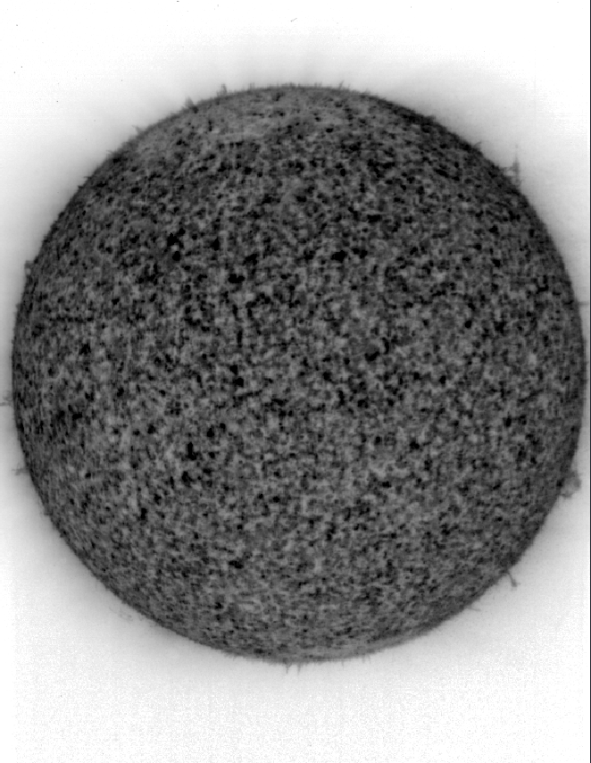
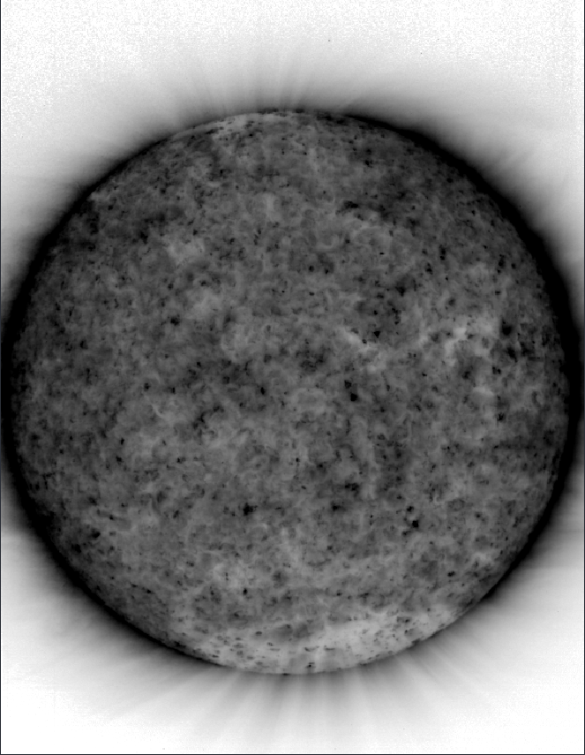
TESIS images (courtesy Sergey Bogaczev FIAN)
2009 02 20 18:28:42 304 Å
2009 02 20 18:27:42 171 Å
~80 000 K
~1 MK
XXXIV Zjazd PTA Kraków , Solar Session, 15 September 2009 Janusz Sylwester

Slide 39
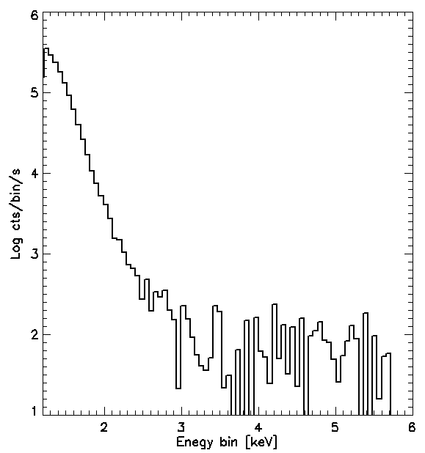
Longer exposure: ~18 hours
Counts below 3 keV ~ 1 mln
Counts above 3 keV ~ 3000
Ratio: 0.003
Any coronal heating model should „obey” this measurement
from now on
XXXIV Zjazd PTA Kraków , Solar Session, 15 September 2009 Janusz Sylwester

