Slide 1
Physical characteristics of selected X-ray events observed with SphinX spectrophotometer
eHeroes activity
B. Sylwester, J. Sylwester, M. Siarkowski
Space Research Centre, PAS, Wrocław, Poland
T. Mrozek
Astronomical Institute, Wrocław University, Poland Space Research Centre, PAS, Wrocław, Poland
K.J.H. Phillips
Mullard Space Science Laboratory, Dorking, UK

Slide 2
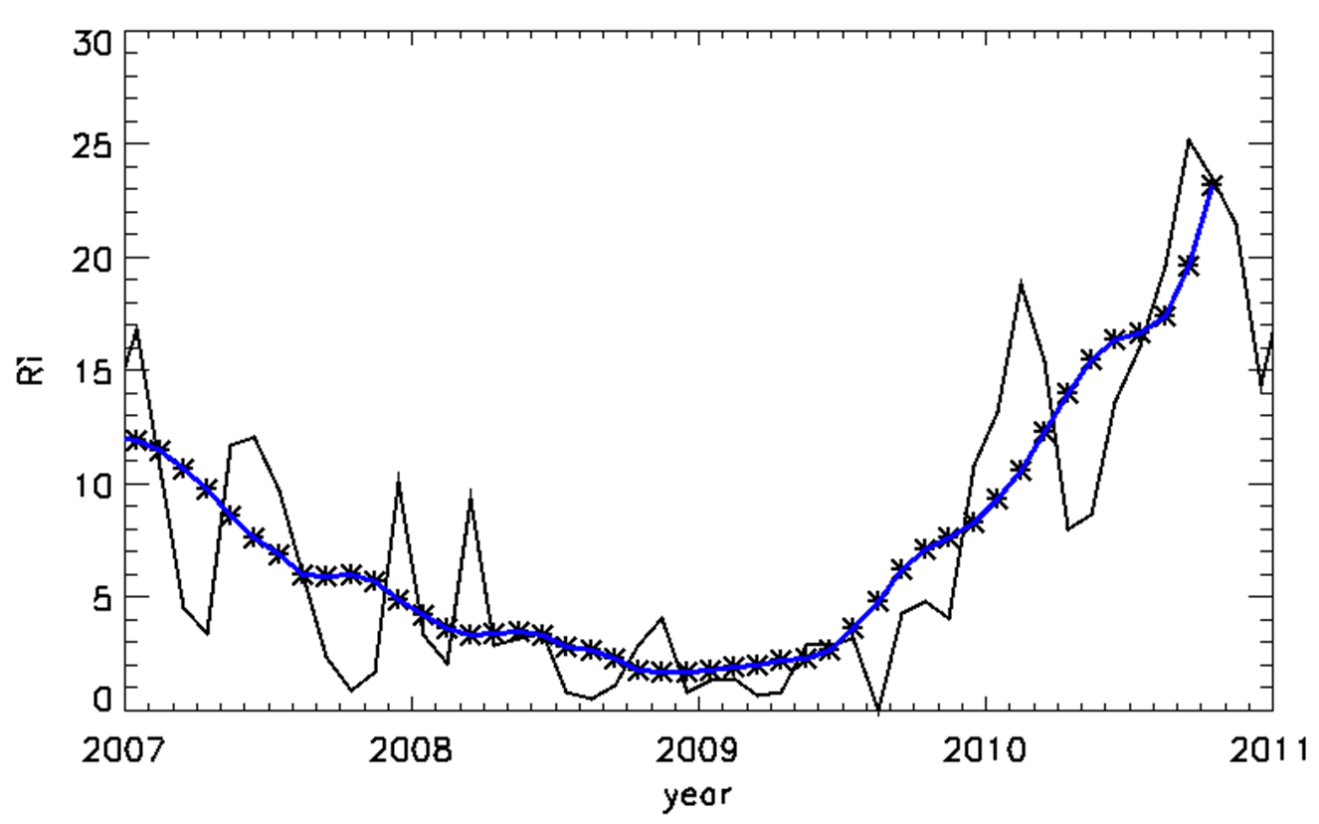
23/24 activity minimum & SphinX
monthly and monthly smoothed sunspot numbers
SphinX operated and collected solar X-ray spectra during the deep solar minimum in 2009 .

Slide 3
Solar Photometer in X-rays → SphinX
SphinX (Solar Photometer in X-rays) is the Polish full-disc spectrometer placed aboard Russian satellite CORONAS-Photon. The sensitivity (approximately 100 times greater than the GOES 1 - 8 Å energy channel) and energy resolution (FWHM = 464 eV) of SphinX enable to measure the spectra in 256 energy intervals covering spectral range between ~1.2 keV and 15 keV. The spectra were collected every 5 sec. The instrument was carefully calibrated before launch using characteristic X-ray lines (XACT → X-ray Astronomy Calibration and Testing facility, Palermo) and at Bessy II synchrotron source, Berlin. Thanks to this the reduced spectra are of high absolute accuracy.

Slide 4
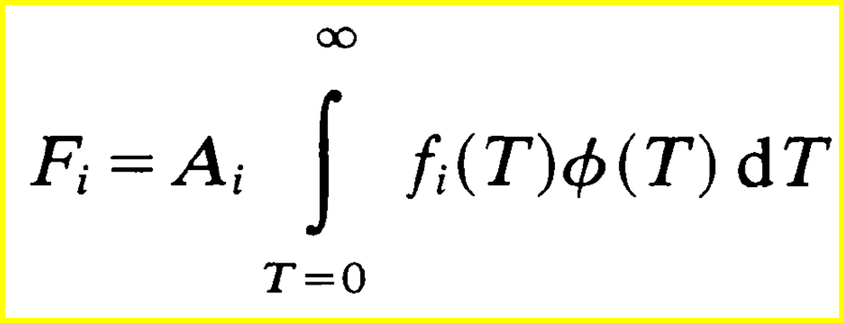
DEM inversion
For optically thin, multithermal plasma:
DEM characterizes the amount of plasma at various temperatures present in the source.
$$\frac{dV}{dT}$$
DEM ≡ Φ(T) ≡ N_{e}² is non-negative
F_{i} → measured fluxes obtained from SphinX spectra in i = 48 energy bins
f_{i}(T) → calculable theoretical emission functions for every spectral band used,
CHIANTI 7.0 atomic code has been used in this respect
A_{i} → assumed elemental abundance taken as constant over the source volume

Slide 5
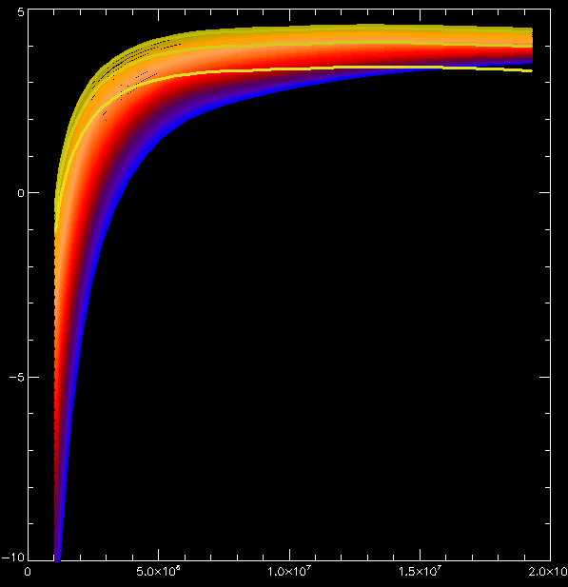
Emission functions - DEM inversion
From SphinX spectra we have selected 48 energy bins for which there were sufficient count rates covering the energy range from 1.26 keV to 4 keV. We determined the time-changing fluxes in these bins for flares selected. These fluxes constitute the input set for the differential emission measure (DEM) inversion F_{i} → Φ(T).
The theoretical fluxes have been calculated using the CHIANTI 7.0 code (http://www.chiantidatabase.org) with coronal plasma composition. In the spectral calculations, Bryans, Landi & Savin (ApJ, 691, 2009) ionization equilibrium has been adopted.
The iterative Withbroe-Sylwester (Sylwester et al., 1980, Sol. Phys. 40) DEM inversion method representing the maximum likelihood approach has been used with the pre-flare spectra subtracted in each case to get the DEM for the flare emission only. For each event, a sequence of DEMs has been calculated showing how the plasma temperature distribution evolves with time.

Slide 6
Data analysed
For this research we selected flares occurring in active region AR 11024 born on the disk on 3 July 2009. This single AR rotated off the disk on 14 July. More than 500 events i.e. flares or small brightenings have been identified on the soft X-ray lightcurve during that time. Here we present the results for 3 selected flares which differ in their GOES class, duration and the morphology. The common for them is the location within the same AR 11024.
The inversions have been carried out over the temperature range
1 MK - 20 MK.
10 000 iterations were performed for each inversion run in the accelerated scenario.
The inversion uncertainties were determined from 100 Monte Carlo exercises, where the input fluxes for time-frame of interest were randomly perturbed with corresponding measurement uncertainties.

Slide 7
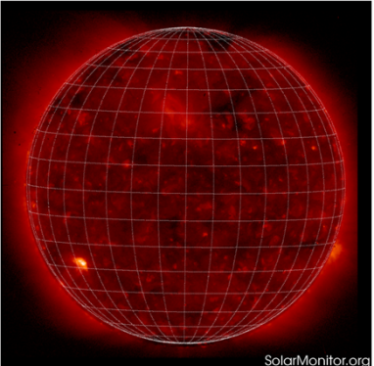
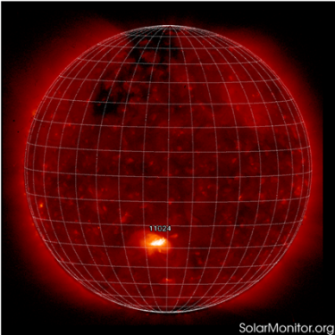
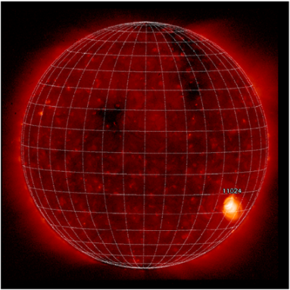
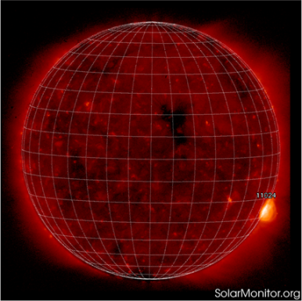
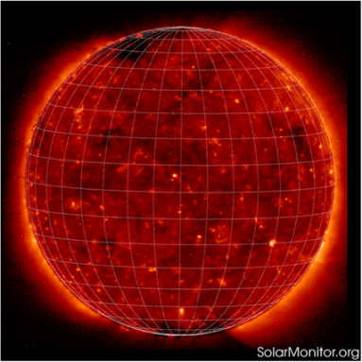
X-ray lightcurve of AR 11024 as seen by SphinX
XRT Hinode images

Slide 8
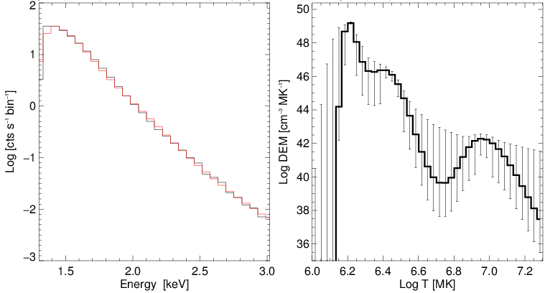
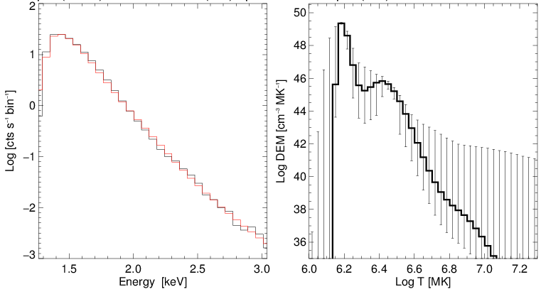
Pre and post AR
EM=2.7 10⁴⁸ cm⁻³
EM=2.9 10⁴⁸ cm⁻³
For times before the active region appeared and after it rotated off the limb, the DEMs show that the quiet corona has two temperature components with T=1.6 MK and T=2.6 MK. Just before the AR appeared, a small amount of hotter (10 MK) plasma is present which can probably be attributed to the decaying of AR 11023 preceded the AR 11024. This high-T emission is no longer seen after AR 11024 rotated off the limb.
An agreement between observed and DEM predicted fluxes is within 20 % for individual bins in this cases.

Slide 9
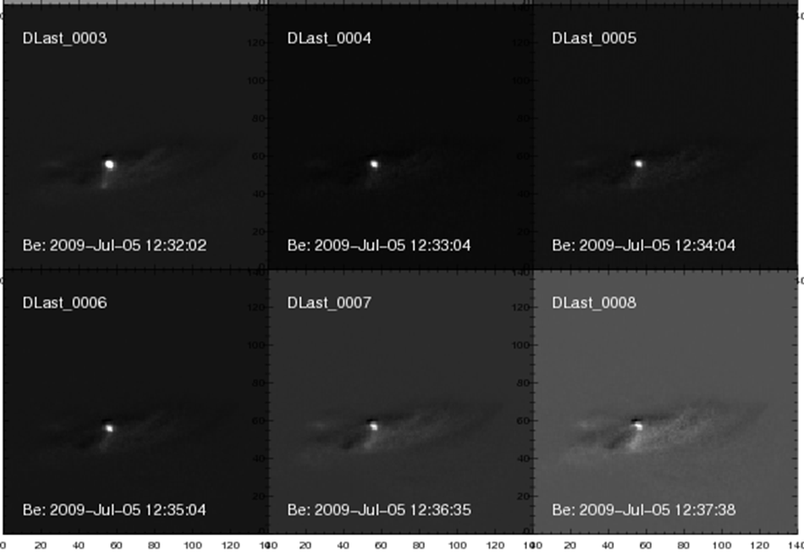
B3.0 SOL2009-07-05T12:30
Short lived flare
Δt = 11 min.
Point-like structure

Slide 10
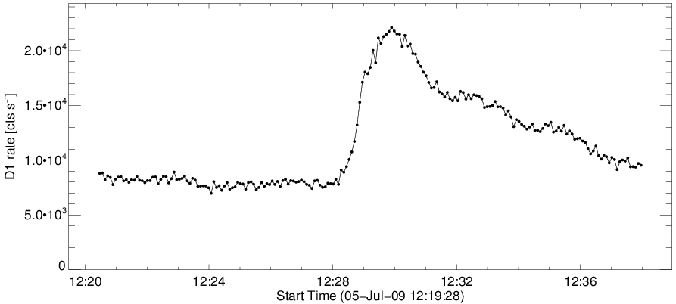
B3.0 SOL2009-07-05T12:30
Precursor
Bckg.
Total of 15 time intervals have been selected.

Slide 11
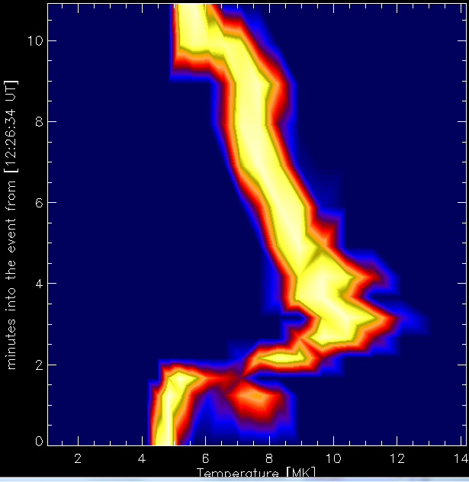
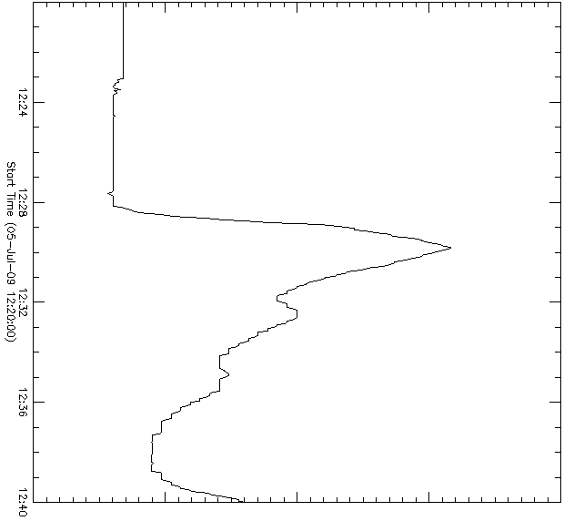
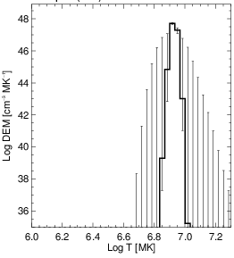
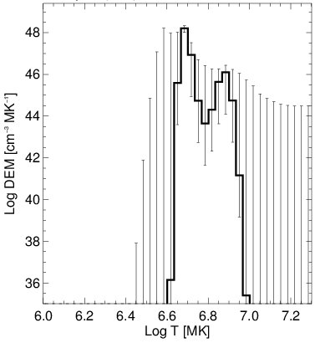
B3.0 SOL2009-07-05T12:30

Slide 12
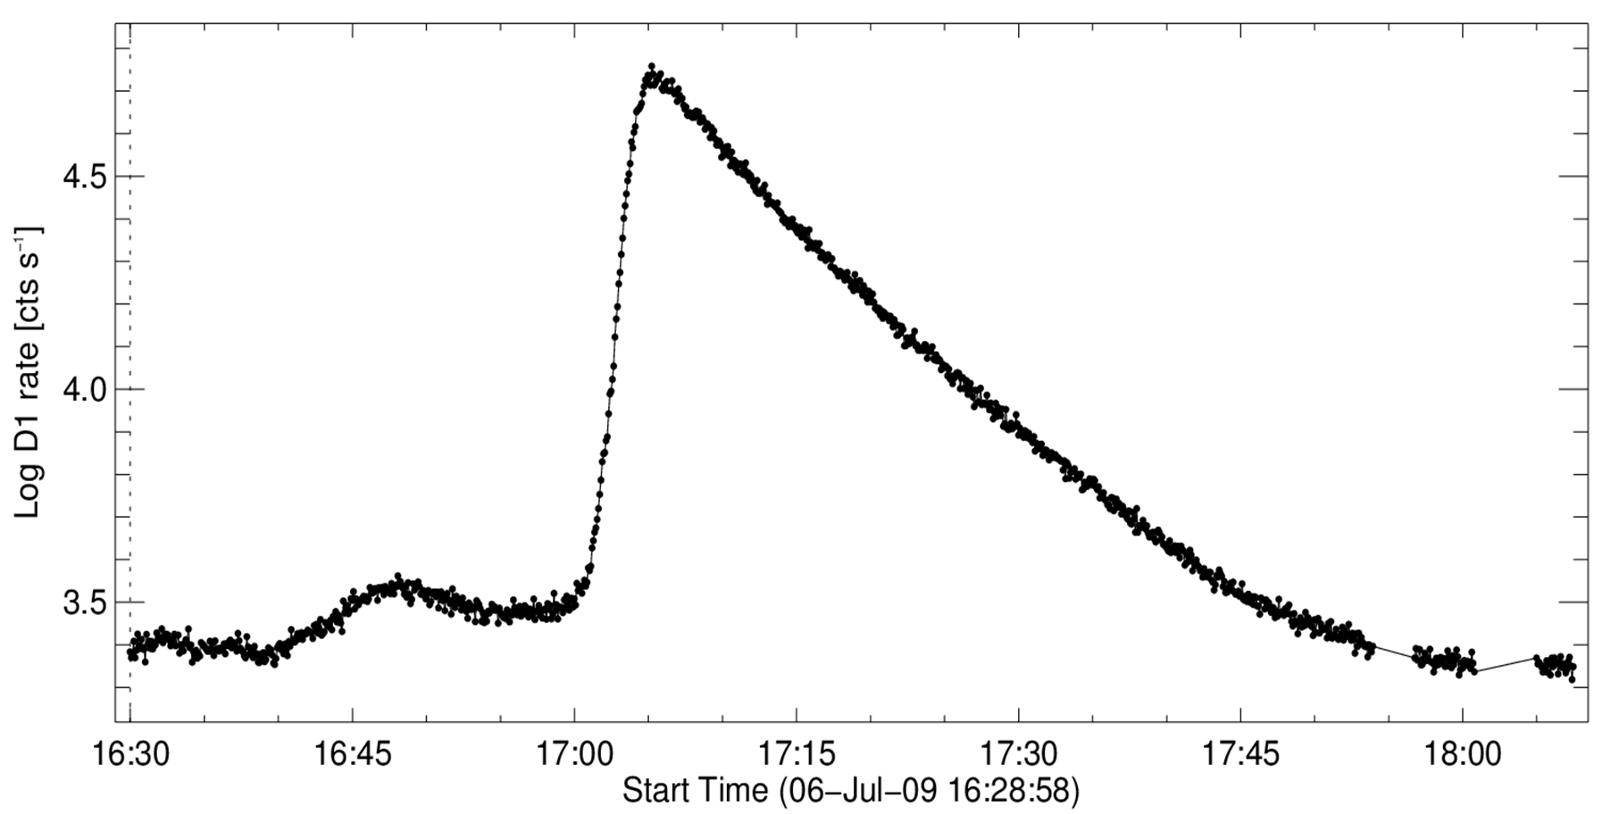
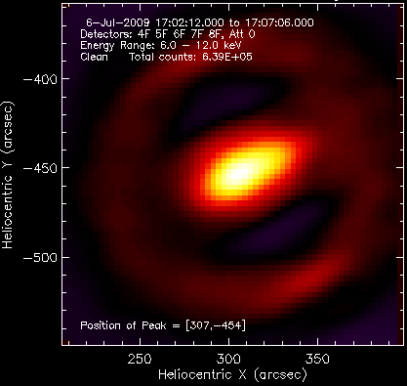
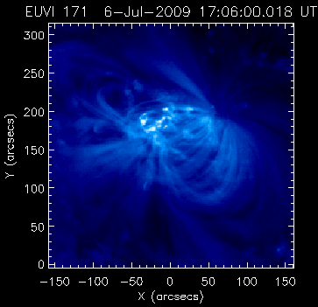
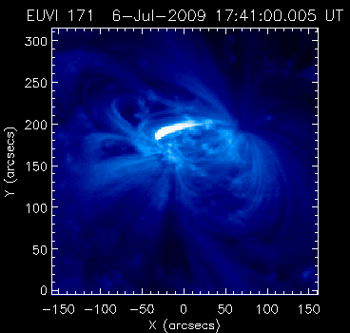
C1.0 SOL2009-07-06T17:05 flare
Every 5 min.
Every 5 min.
3 min.
Bckg.
Every 2 min.
1
STEREO A
33 time intervals
Δt =
85 min.

Slide 13
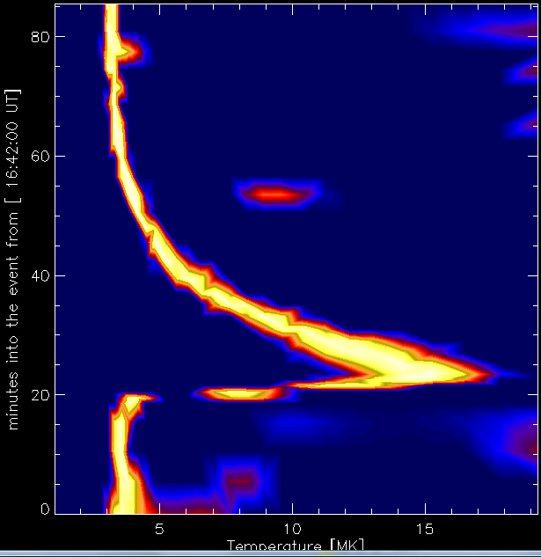
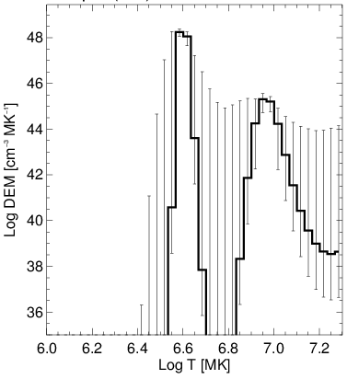
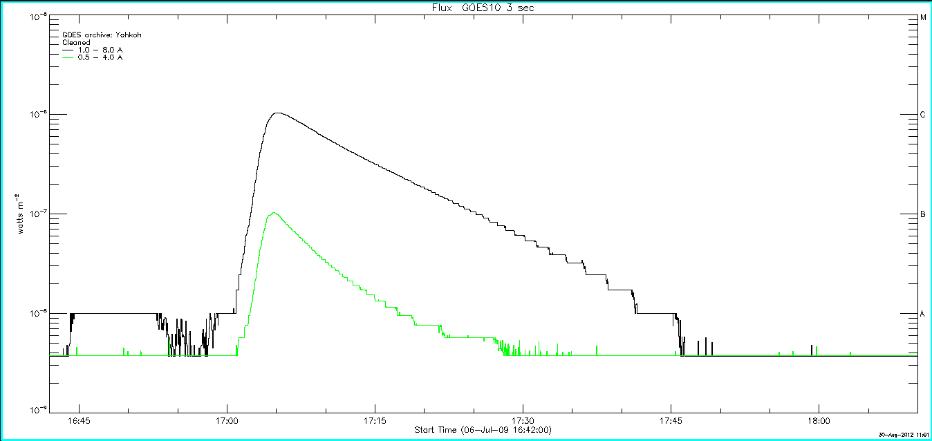
C1.0 flare DEM evolution

Slide 14
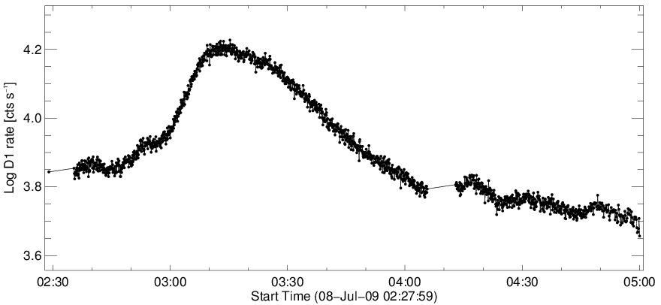
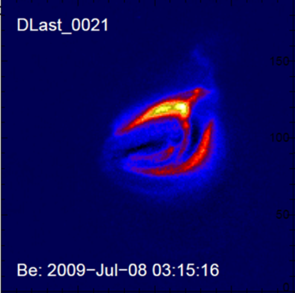
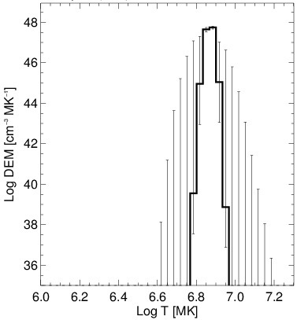
B1.8 SOL2009-07-08T03:12 flare
Every 10 min
Every 2 min
Every 5 min
Differential (relative to the last post-flare image) XRT image (Be medium filter corresponding to the maximum of the flare.
Δt = 140 min.
7.6 MK
5.4x10⁴⁷ cm⁻³
Total of 35 time intervals have been selected. DEM
(Differential
Emission
Measure)
distribution for maximum phase of the flare.

Slide 15
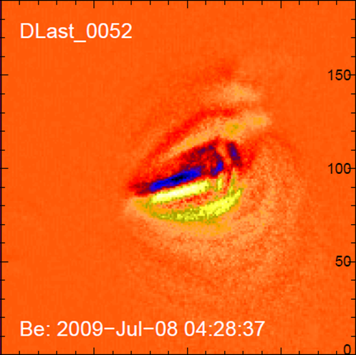
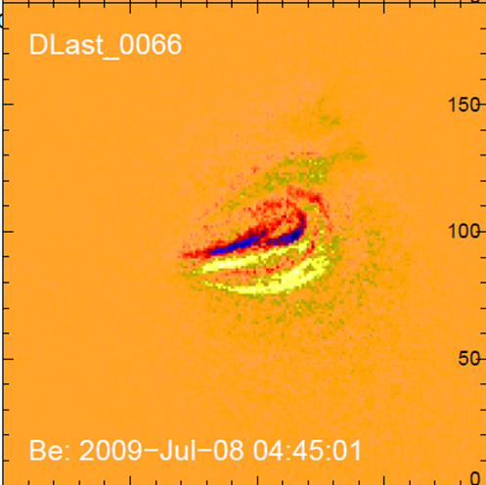
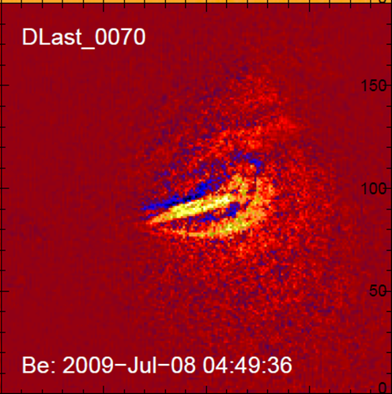
Late decay phase evolution (20 min.)

Slide 16
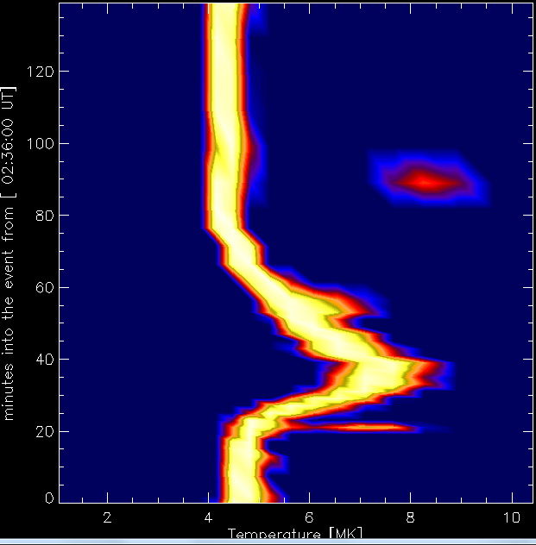
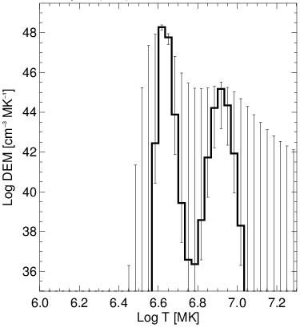
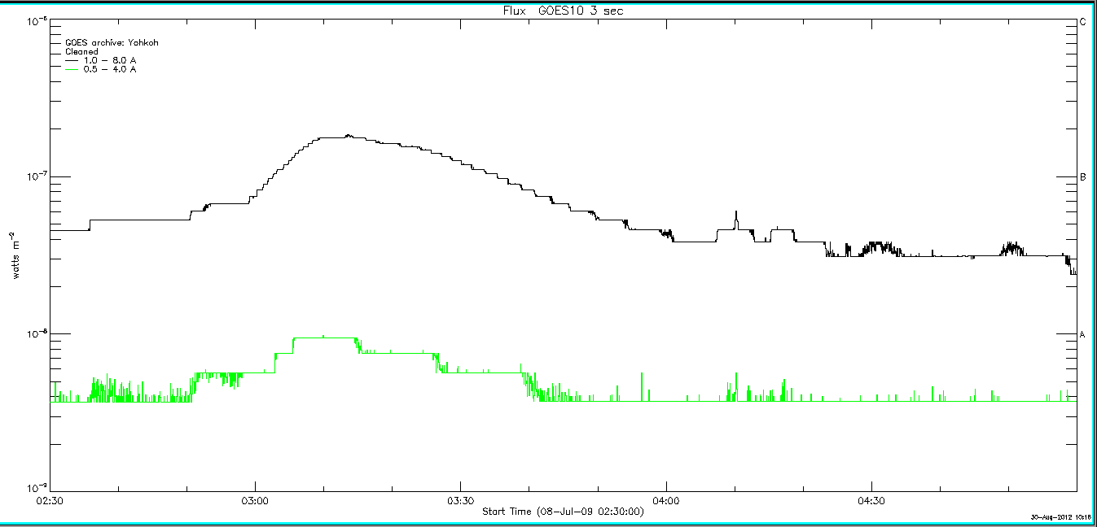
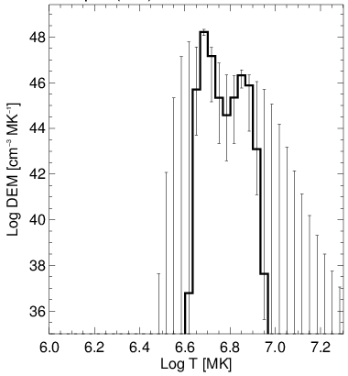
DEM evolution

Slide 17
Summary table
Date | [UT] | GOES class | T(max) [MK] | Duration [minutes] | Remarks
2009.07.05 | 12:30 | B3.0 | 12 | 11 | point like source
2009.07.06 | 17:05 | C1.0 | 17.5 | 85 | UV complicated
2009.07.08 | 03:12 | B1.8 | 8.5 | 140 | 2 loop like structure

Slide 18
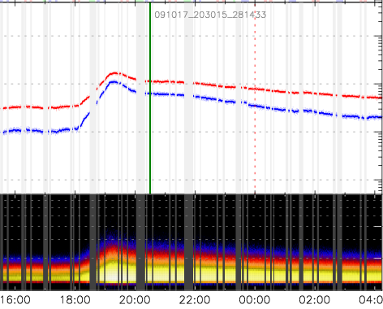
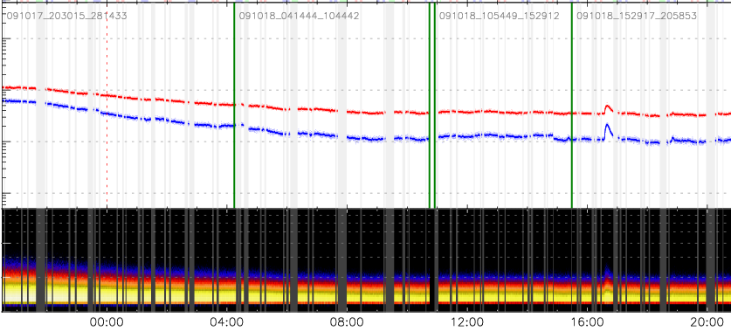
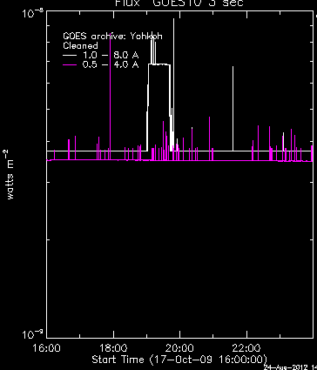
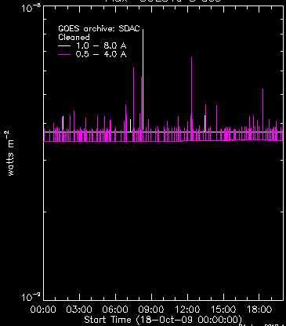
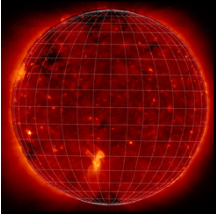
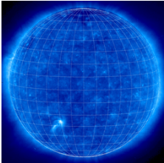
17/18 Oct. 2009; below A class; Δt=30 hours
AR 11027
XRT
EIT 171 Å

Slide 19
Take home message(s)
SphinX spectra enable us to find the temperature distribution of coronal plasma.
Flaring plasma consists of blobs of matter with well defined discrete temperatures.
Calculated DEM profiles will be further used to study the other thermodynamic parameters (N_{e}, E_{th}) within flaring volume with the support of available images. (Using EM from DEM distributions and Hinode XRT images we estimated the lover limit of density for compact B3.0 flare as N_{e}~ 3x10¹⁰ cm⁻³ and for the coolest, long lasting B1.8 flare N_{e}~ 5x10⁹ cm⁻³).

Slide 20
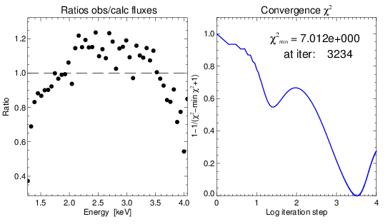
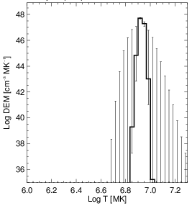
5.07.2009 flare – convergence & ratios

