Slide 1
RESIK spectral atlas for flares: data access and use
Janusz & Barbara Sylwester
Anna Kępa,
Mirek Kowaliński,
ZFS CBK

Slide 2
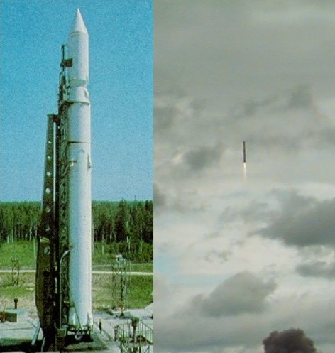
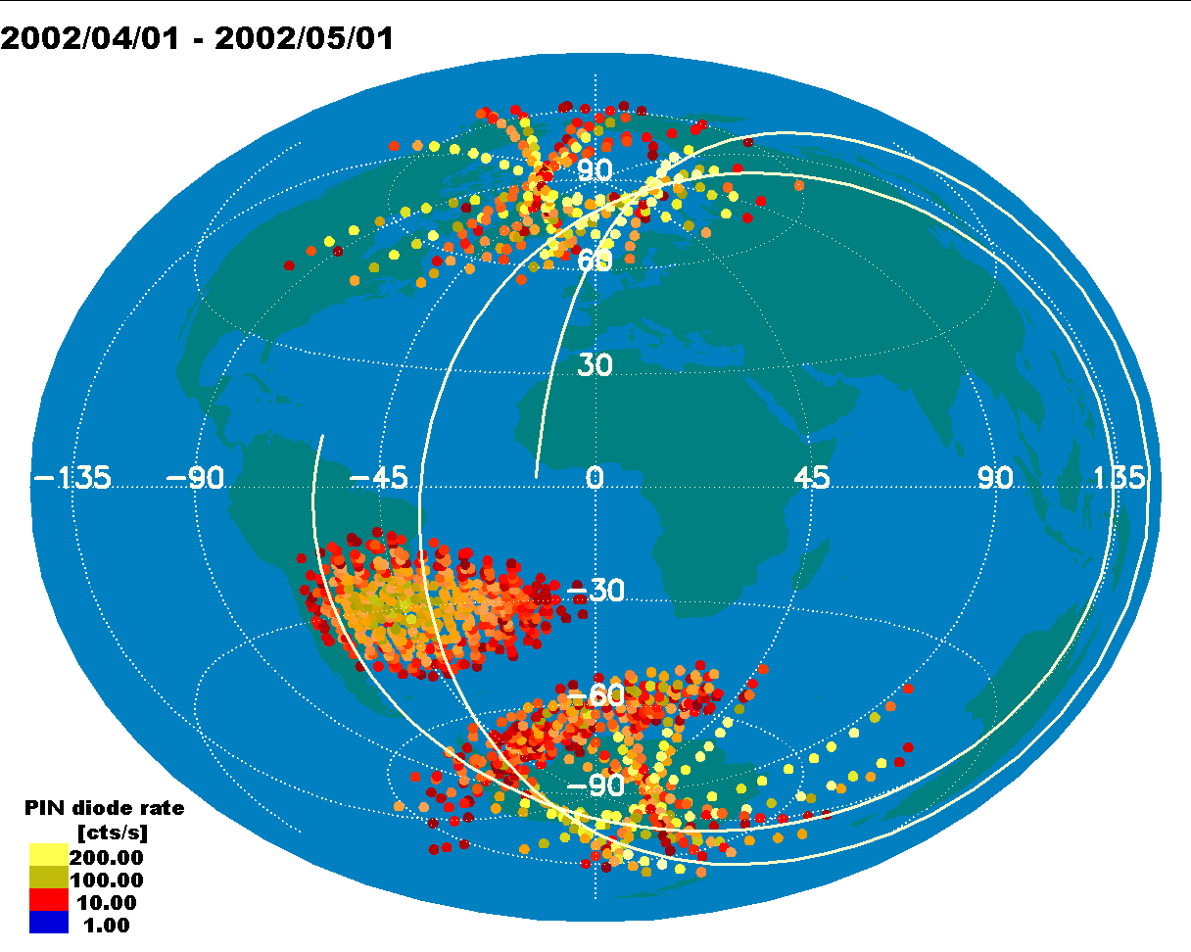
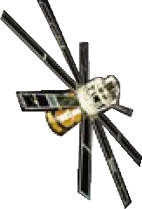
CORONAS-F launch, orbit & pointing
polar orbit, 95min,
~500 km
semi-Sun-synchronous
SS-14 Cyclone
x
10,
CORONAS-F
CORONAS-F launch from Plesetsk on 31 July 2001 morning
For description of the instruments, visit http://coronas.izmiran.rssi.ru/F/instruments .

Slide 3
Two Polish-led Bragg crystal spectrometers placed aboard, one rocking Diogeness, the other fixed bent crystal RESIK
Scheme of Coronas-F Payload
Diogeness
dispersion
planes
A
RESIK
dispersion
planes
1
B
2
3
4
II

Slide 4
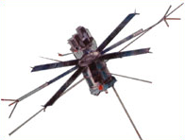
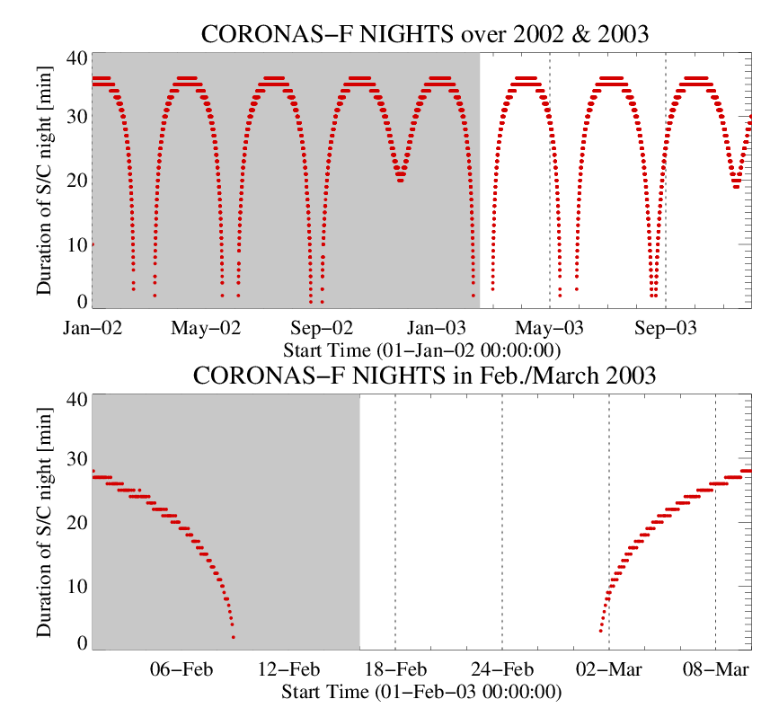
S/C nights
Position of the satellite is being calculated every DGI (1-10s).
There are
~20 mln Lon. Lat, Height values assigned to each measurement
as well as H○ and various angles from orbital IDL programme using two-line orbital elements
(Z. Kordylewski)
H○

Slide 5
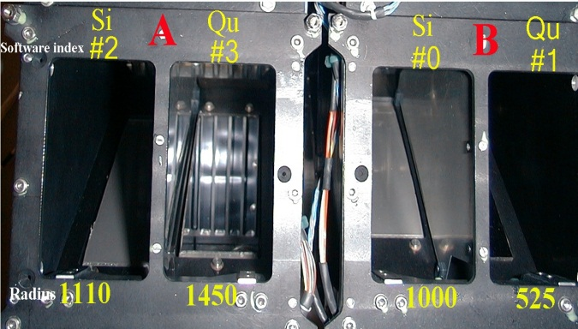
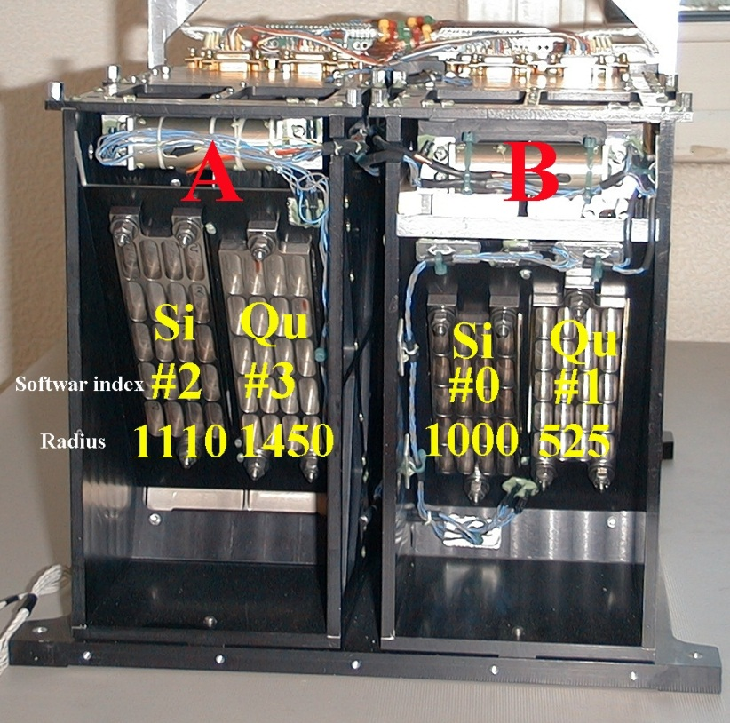
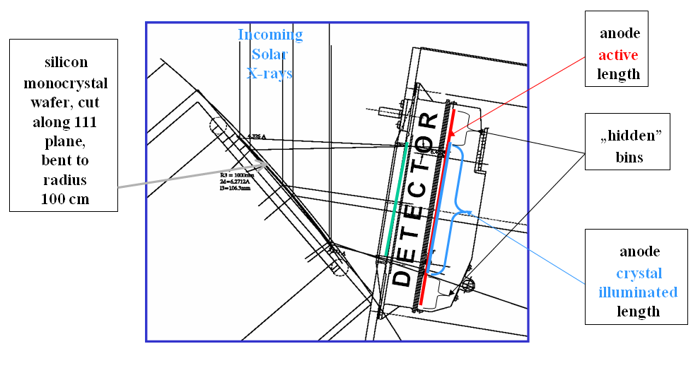
Crystal-detector geometry
Direct illumination
nλ = 2d sin(θ)
Θ₁
EUV filetr aperture
λ₁
Position sensitive
proportional
detector
Θ₂
R
λ₂
Bent
Crystal
~30 cm, 20 kg

Slide 6
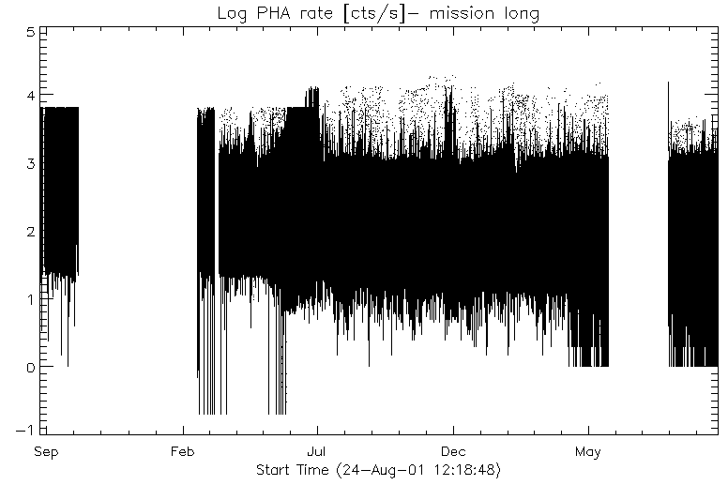
Phases of RESIK operations
ADS under control separately for each channel
End of spectra records
HV
On
Always
Full range of ADS
0-255
Bad
spectra
Good Ar spectra
Optimum settings
Fluo exercise
2001 2002 2002 2002 2003
19 mln samples (DGI), 1.8 mln spectra 25 GB, only some (5000) reduced…

Slide 7
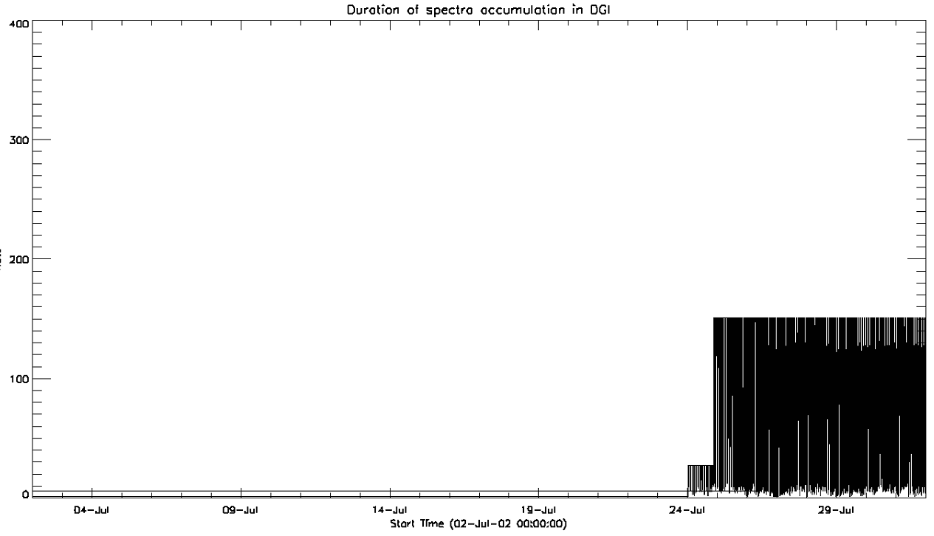
Implementation of dynamic spectra collection exposures
On 24 July 2002 new software has been uploaded that regulated
the exposure depending on the rate in the detector.
That caused that spectra accumulation time adjusted between 5 min and 2 s
10 s spectra accumulation time
2002

Slide 8
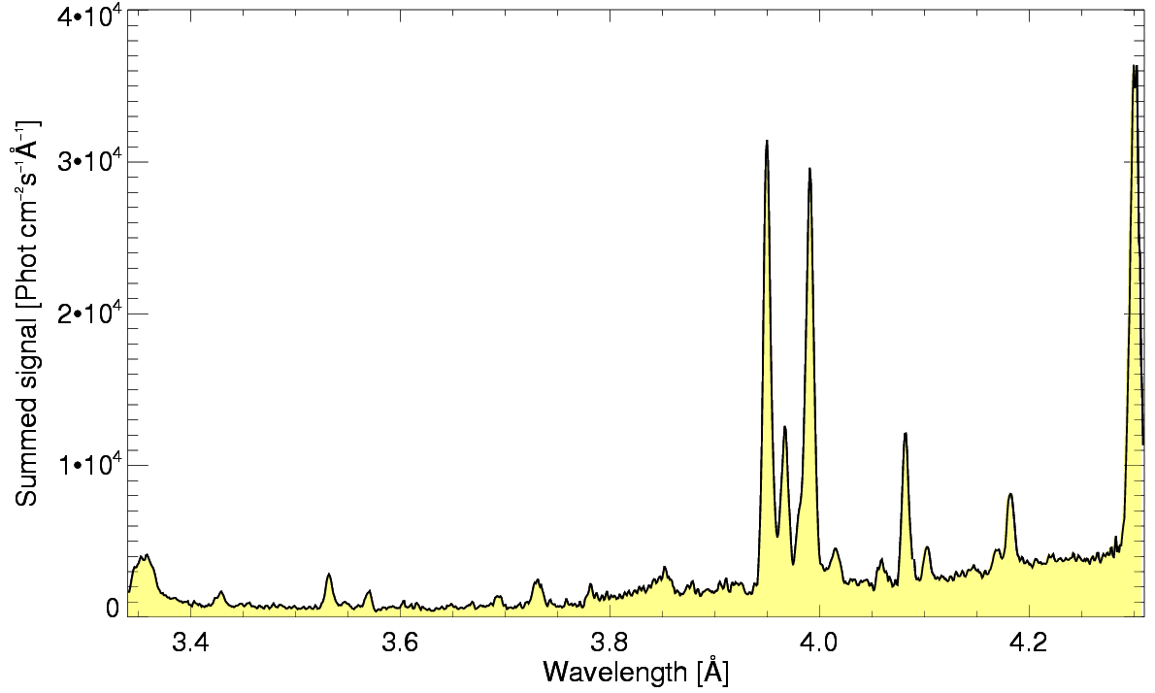
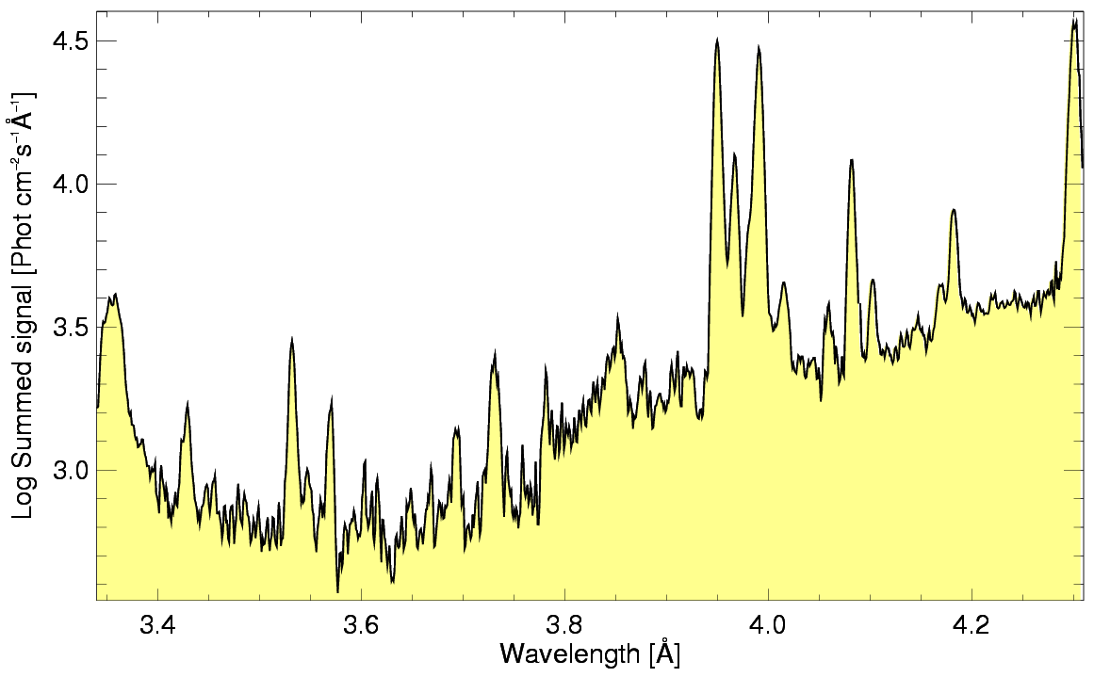
Channel 1 and 2 averaged RESIK spectra
Ar XVII
w,x,y,z
S XV
3p
S XVI
6p
S XV
4p
Ar XVII
3p
Ar XVIII
2p
S XIV
sat
K XVIII
w,x,y,z
?
S XIV
sat
?
?
Ar XVI
sat
S XVI
5p
S XVI
4p
Channel 2
Channel 1

Slide 9
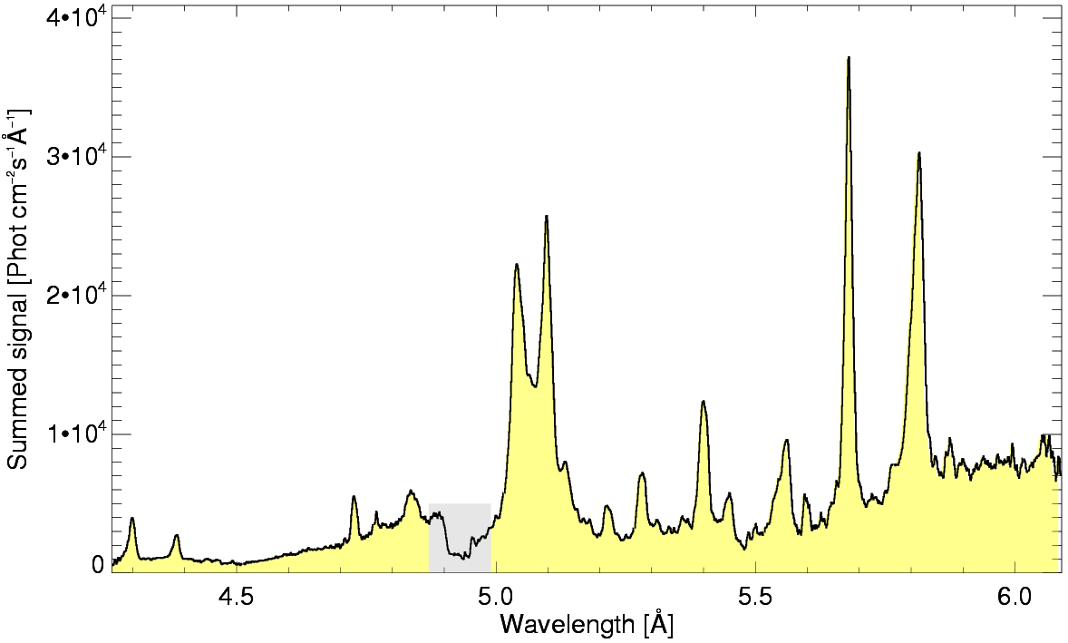
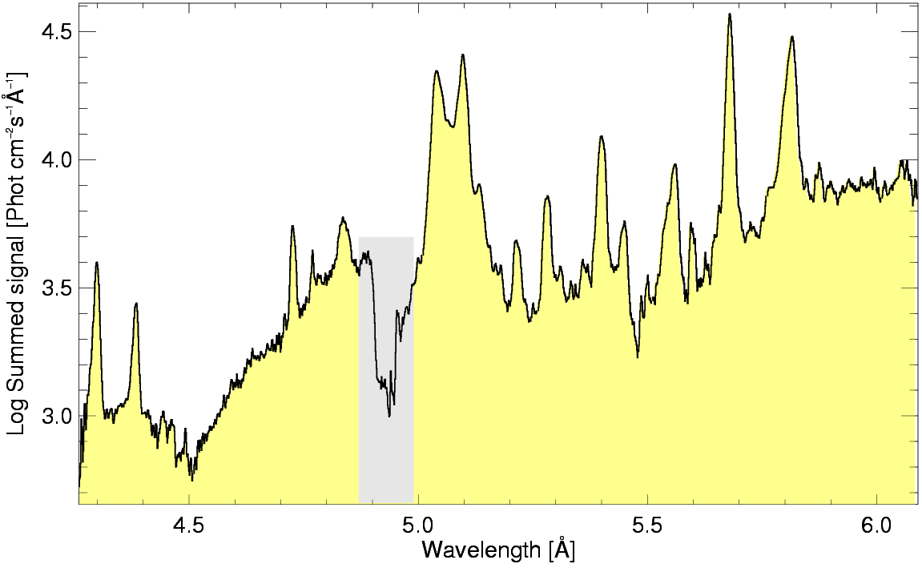
Channel 3 and 4 averaged RESIK spectra
Si XIII 3p
S XV
3p
S XV
w,x,y,z
Si XIII
5p
Si XII sat w3
S XVI
2p
Cl XVI
w,x,y,z
Si XIV
3p
Si XIII
4p
Si XII
sat w4
?
Al XIII
3p
S XIV
sat
Si XIV
8p
Si XIV 6p
Si XIII
sat w5
Si XIV 5p
Al XIII 4p
Al XIII 5p
Channel 3
Channel 4

Slide 10
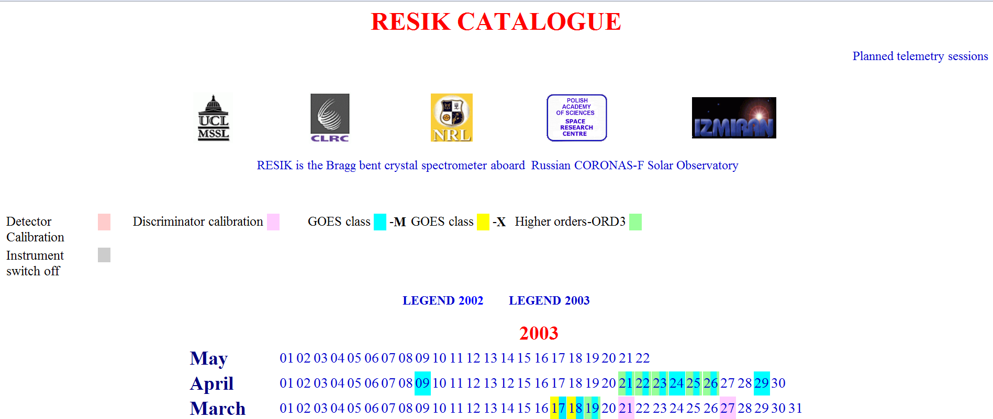
RESIK catalogue Aug 2001- May 2003
http://www.cbk.pan.wroc.pl/experiments/resik/resik_catalogue.htm
Provide access to catalogue pages

Slide 11
RESIK spectra reduction progress
Effects considered
All factors discussed in the instrument paper
Removed fluorescence from the crystal support (semi-empirically)
Saturation (electronic dead-time) effects correction performed
Wavelengths converted to centre of the disk source location
36 flares reduced ~5000+ spectra
16 new flares added from last year
Cases identified with time dependent offset for limb events (source transversal motion)
Further steps – mission long approach
http://www.cbk.pan.wroc.pl/body/publikacje/2005/rip.html

Slide 12
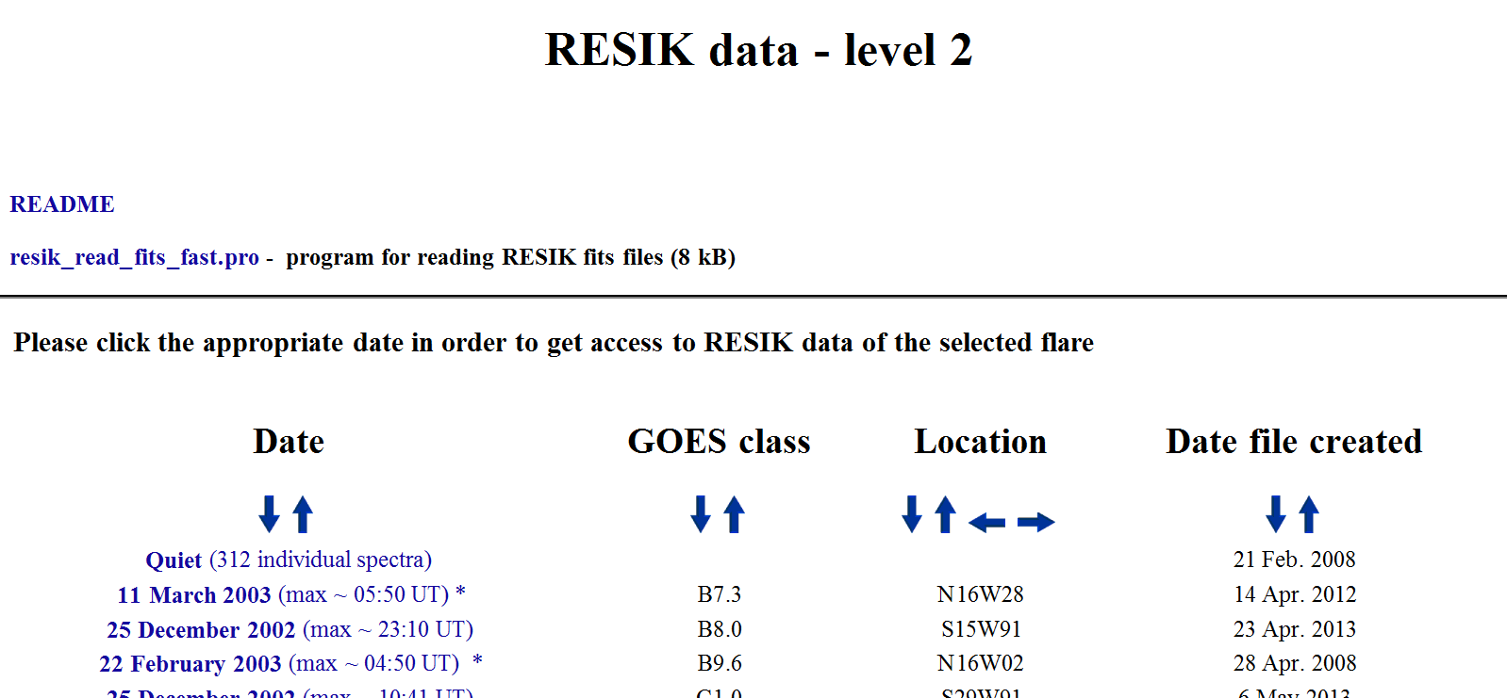
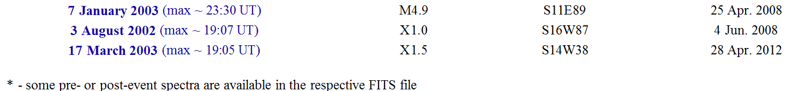
Accessing Level_2 catalogue fits files (Szymon & Anna) http://www.cbk.pan.wroc.pl/experiments/resik/RESIK_Level2/index.html

Slide 13
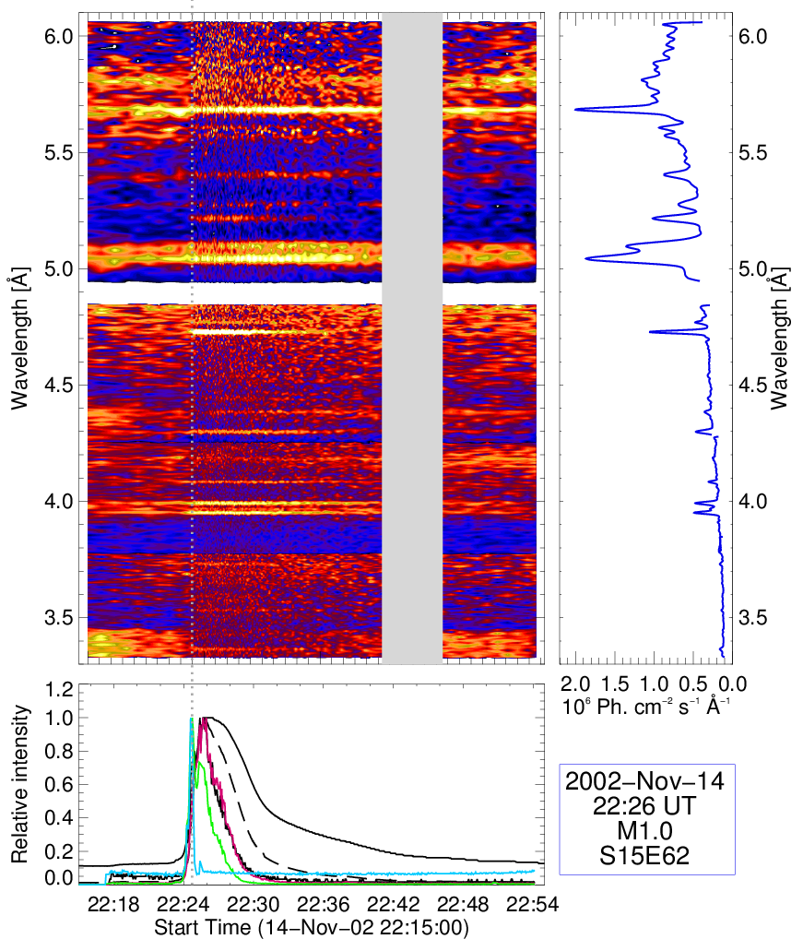
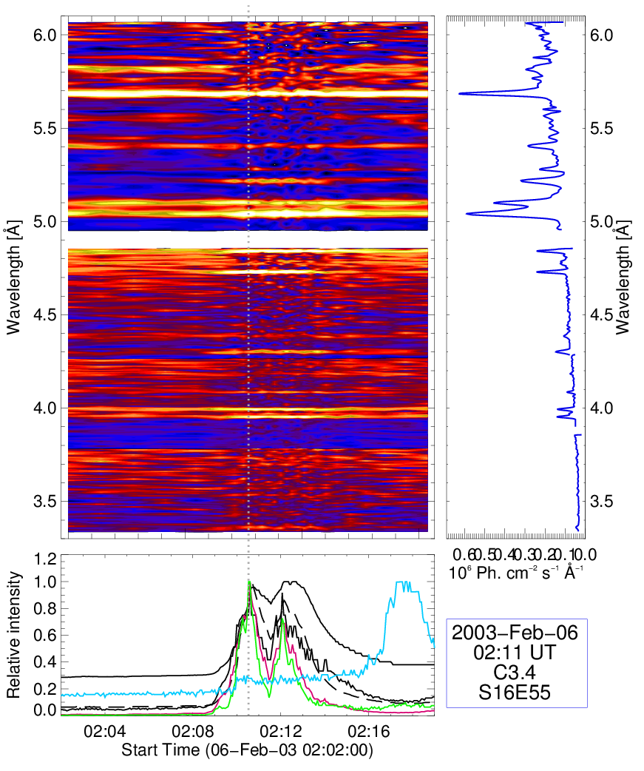
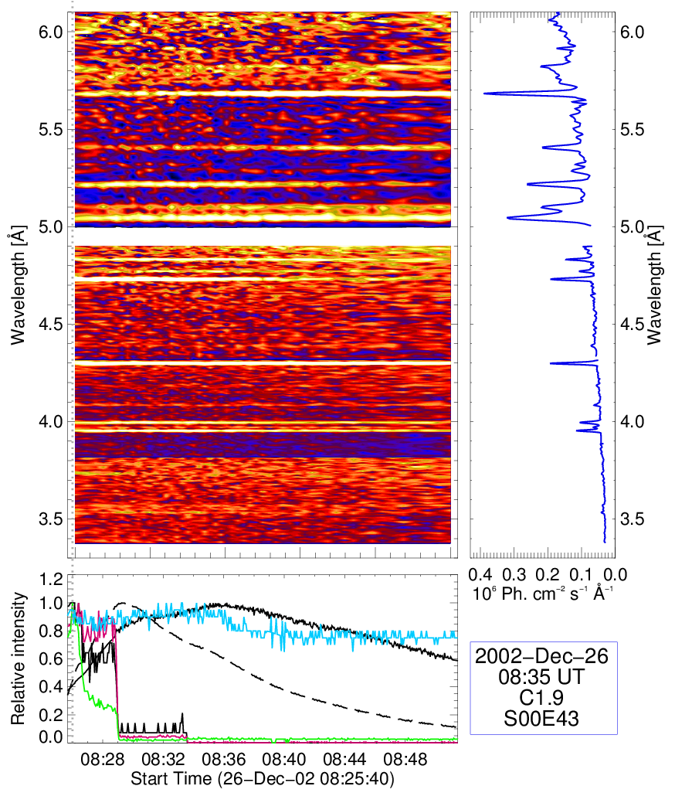
Two examples of events from Level_2 catalogue page

Slide 14
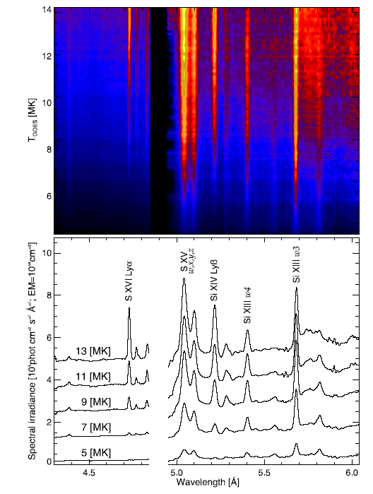
RESIK solar flare spectra: Si XIII + satellites
Temperature stack plots
RESIK solar flare spectra stacked in ascending order of temperature (from GOES).
Done:
Abundance estimates:
K, Ar, Cl, S and Si
Orange arrows mark n=3 and n=4 satellites to Si XIII w3 and w4 lines.

Slide 15
Direction of future analyses
Investigations of solar plasma
Further kappa-distribution diagnostics (Ar lines & their satellites)
Kappa effects on elemental abundance determinations
DEM- dependent S & Si abundance studies (now in progress)
Calibration of PHA sygnal with energy (rate dependence of gain)-2s lightcurves at several energies from 0.5 – 10 keV
Further reduction of selected flares to Level_2 (AK, BS, JS)
Systematic automatic reduction of every recorded S/C day spectrum (~2 mln.)
Investigation of magnetosperic & aeronomic effects PIN & PHA 1-2 s time resolution
Crossings of polar van Allen belts geomagnetic storms and disturbances
SAA variability
Night portion emission
Analysis of hidden-bin emissions
Studies of X-ray auroral illumination & spectra
Studies of Height profiles of X-ray absporption

Slide 16
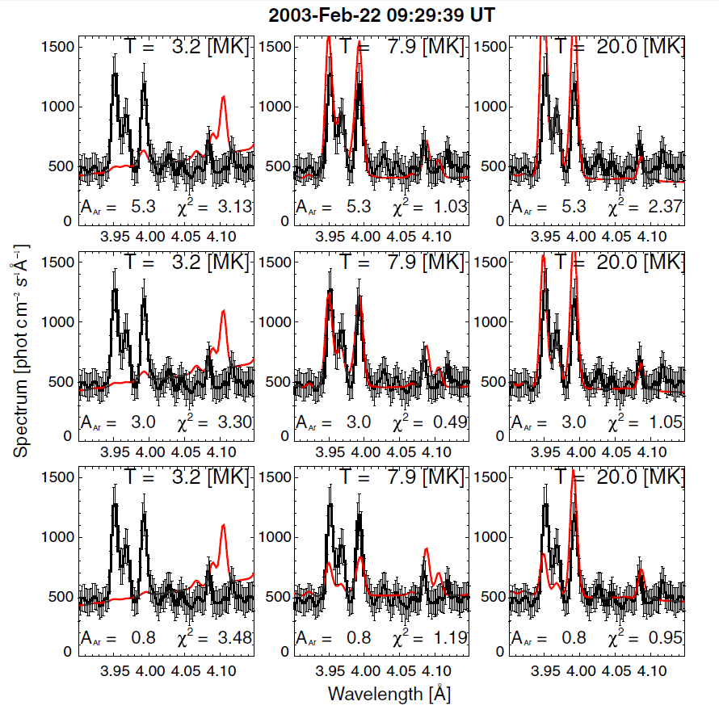
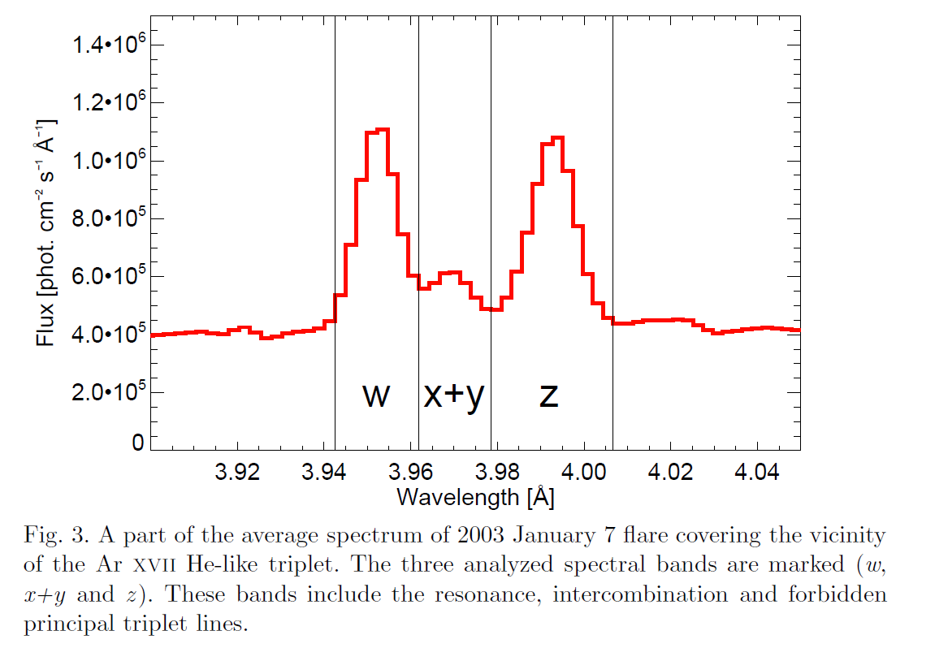
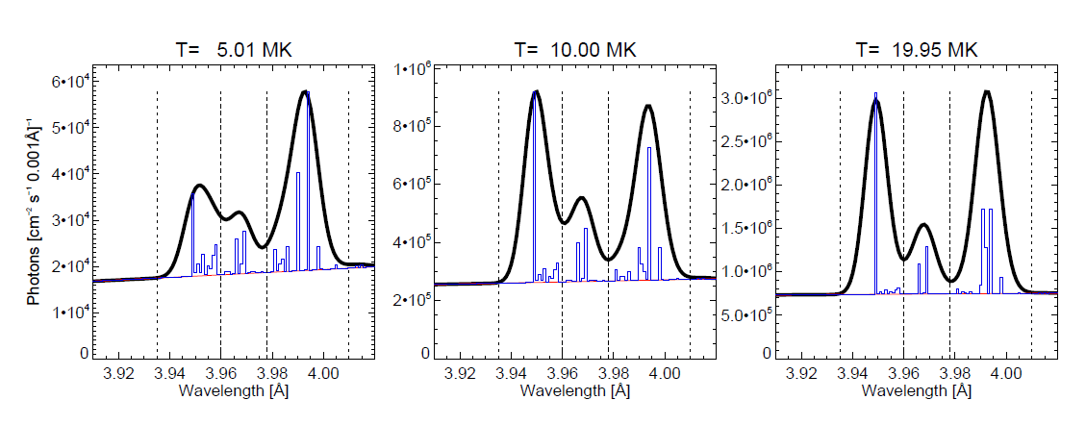
Fitting Ar triplet spectra κ-effects they are free from fluorescence

Slide 17
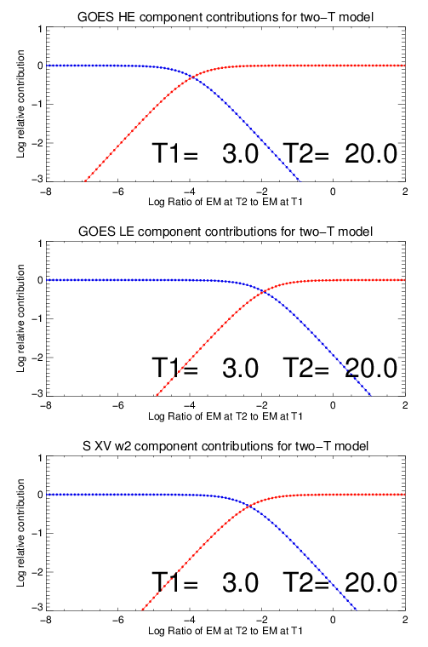
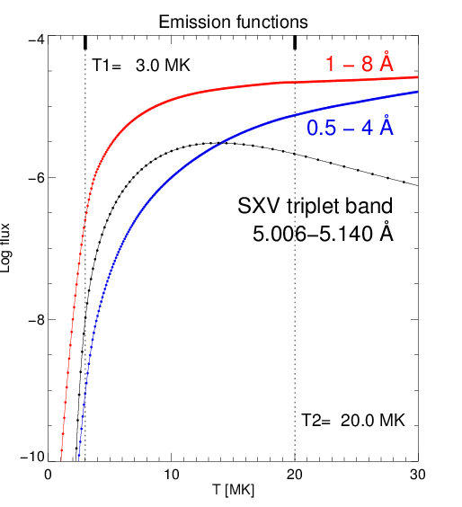
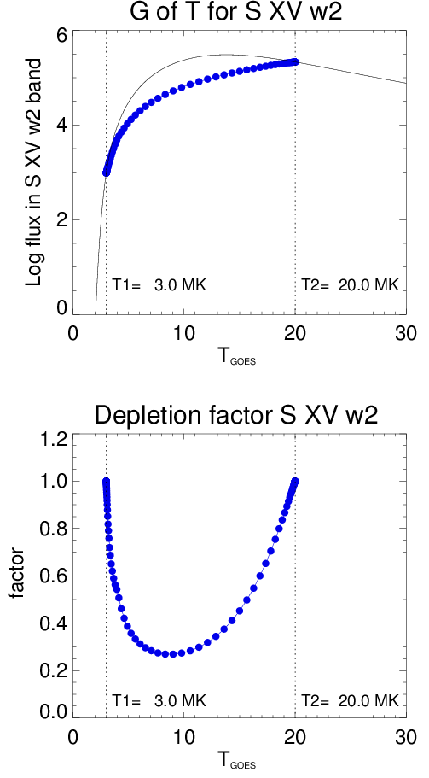
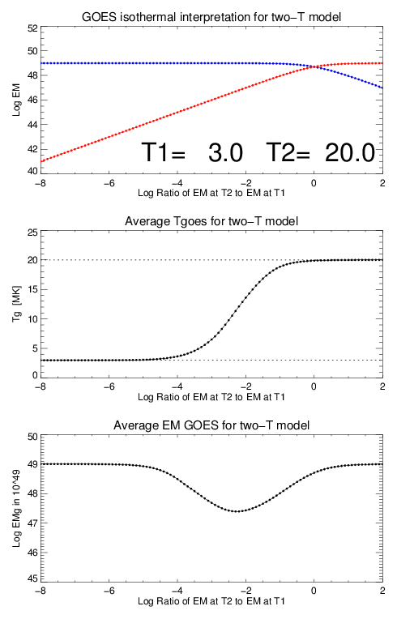
DEM-abundance: S
T1
T2

Slide 18
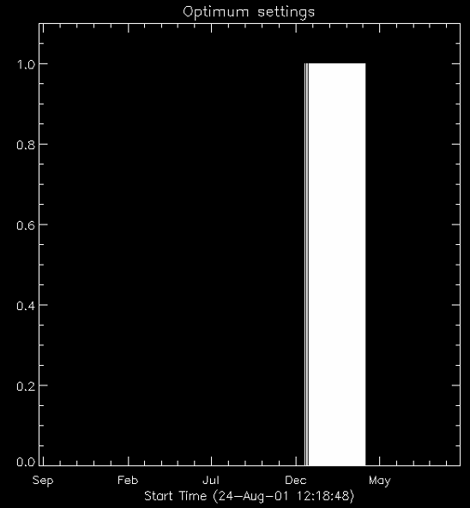
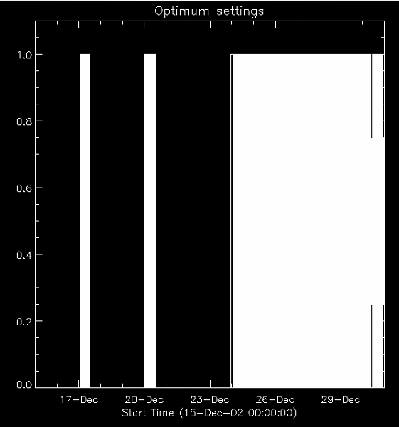
„Discovered” optimum settings

Slide 19
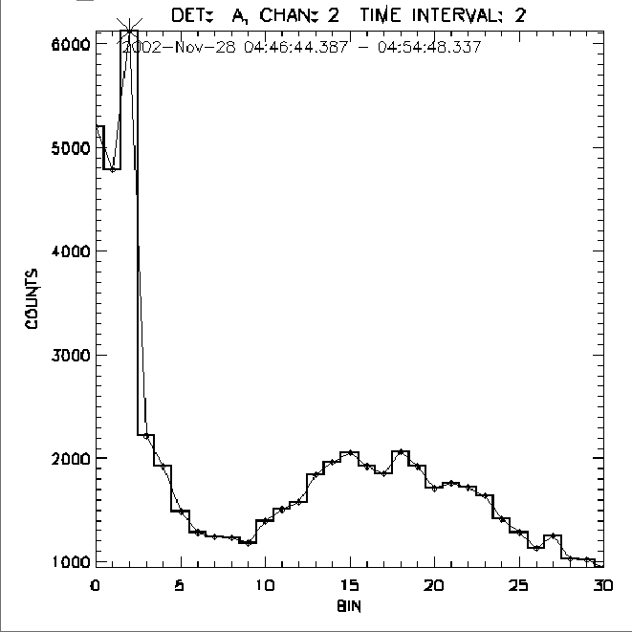
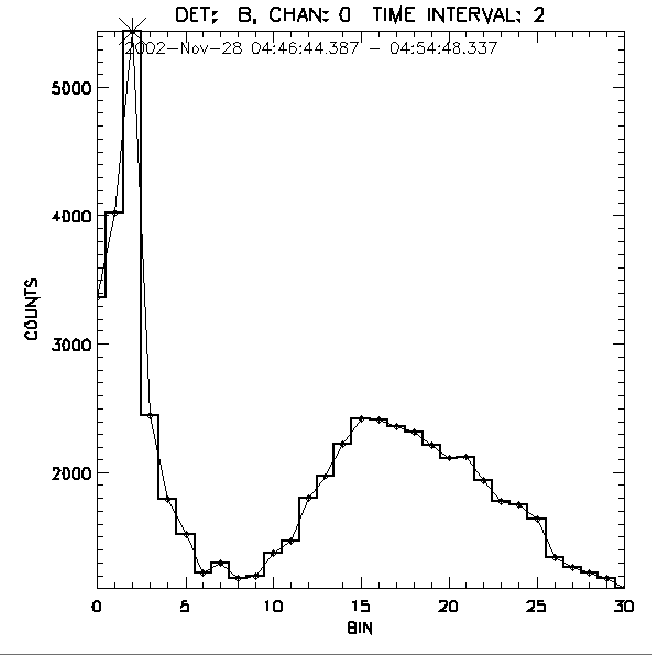
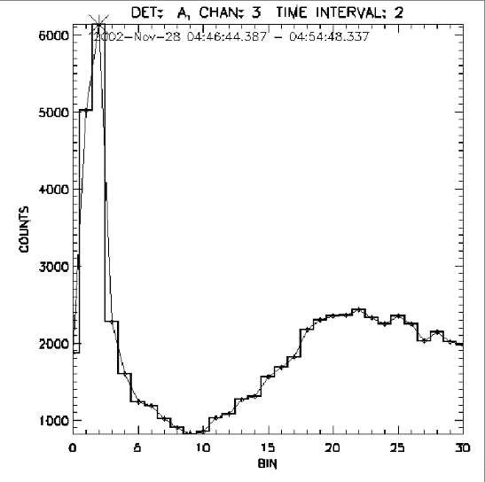
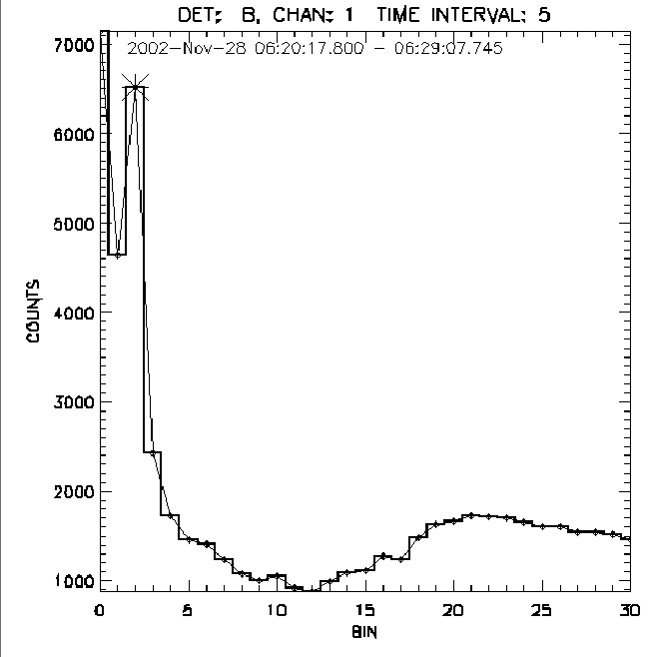
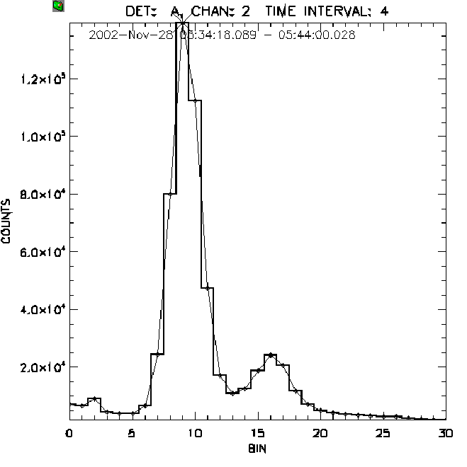
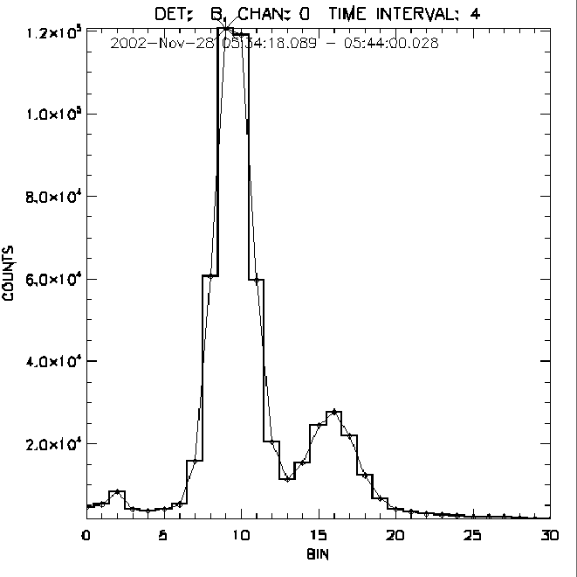
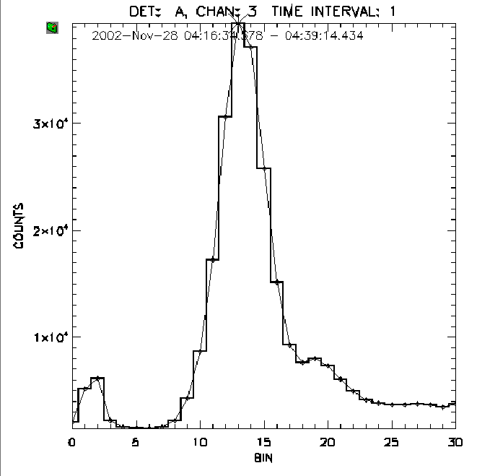
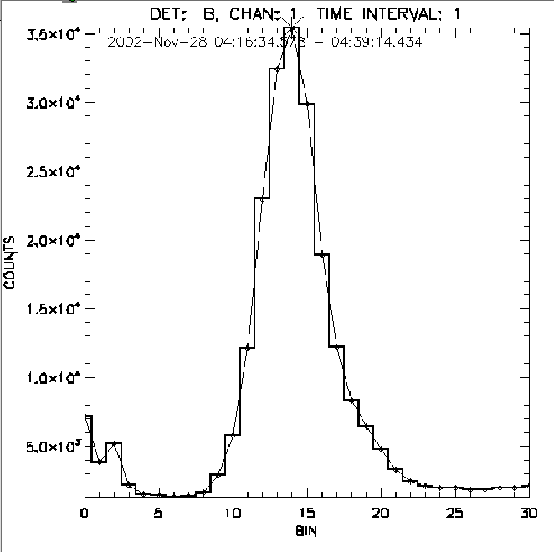
PHA spectra (~20 mln available each 2s)
night
night
night
night
day
day
day
day
#1 #2 #3 #4
Si fluorescence @ 1.75 keV

Slide 20
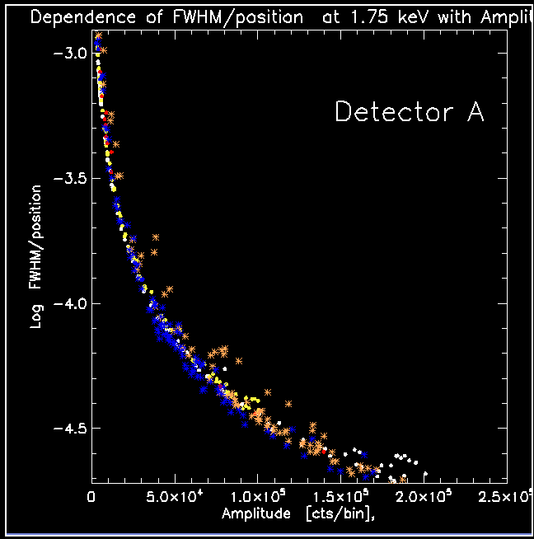
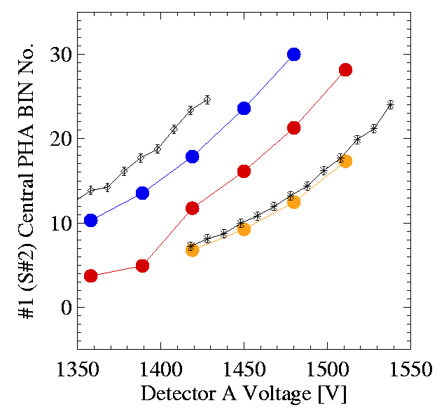
Overlaying in-flight & lab. PHA bin energy calibration
Det. A
5.9 kev
Diamonds corresponds
To Ge (1.254 A = 9.89 keV)
Stars
Mo Lya (5.407 A = 2.29 kev)
Lab V scale is offst
+15V from real
Gain of the PHA amplifier was adjusted in order to have Fe55 line somewhere in the centre of the PHA binscale.
The lab calibration was made with exactly the same
Conditions as in flight.
8.98 kev
2.29 kev
1.75 kev
3.47 kev
Corrected

Slide 21
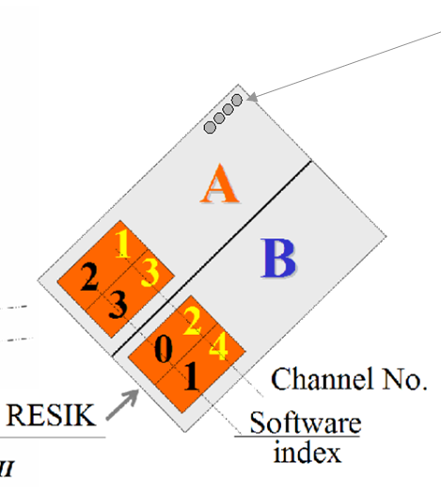
Records of PIN detectors
Four PIN detectors mounted behind the 100μ Al foil. No X-rays, but particle –sensitive
Idea of Witold Trzebinski

Slide 22
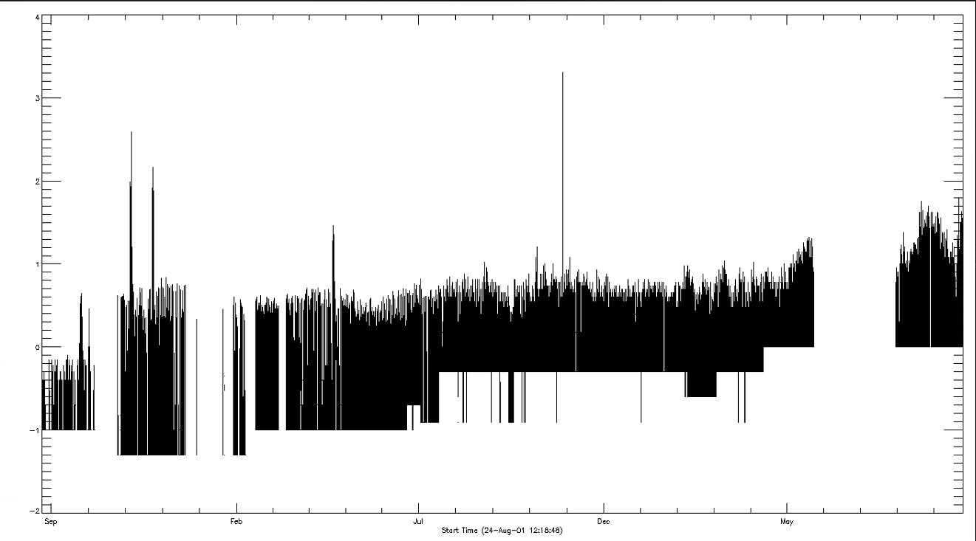
RESIK particle environment through PIN averaged rates
a, b c d e f g h
Several periods of enhanced geomagnetic activity

Slide 23
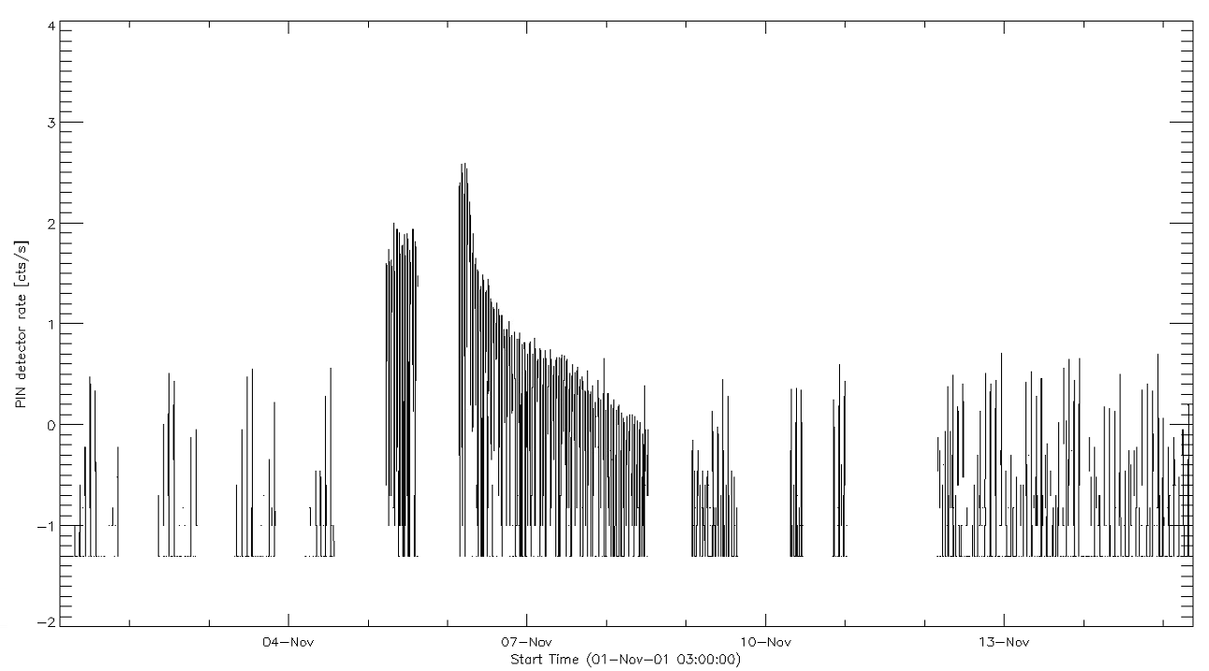
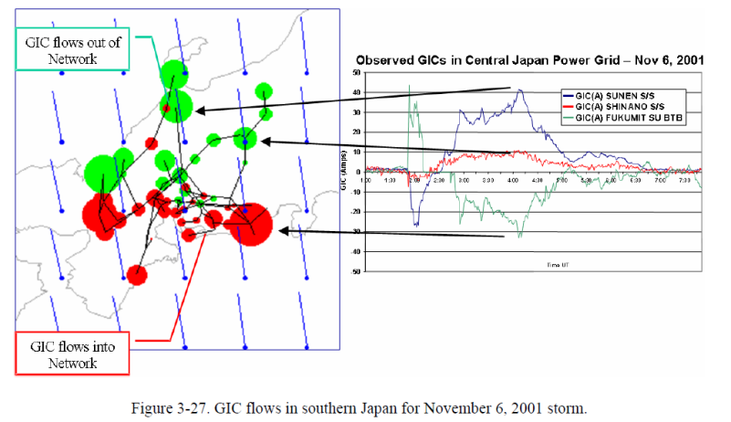
Period „c”
Polar oval crossings
SAA SAA

Slide 24
Conclusions
A lot of new work to be done
Collaboration with Elena and Marian’s groups highly desired
Results are important for planning ChemiX
There is some funds available to support one person FTE (full time eqivalent) job: „as soon as possible”- pass the info to interested (PhD) students. In addition visitors from abroard can be supported for month-long visits.

Slide 25
Examples of spectra: hot & cool

Slide 26
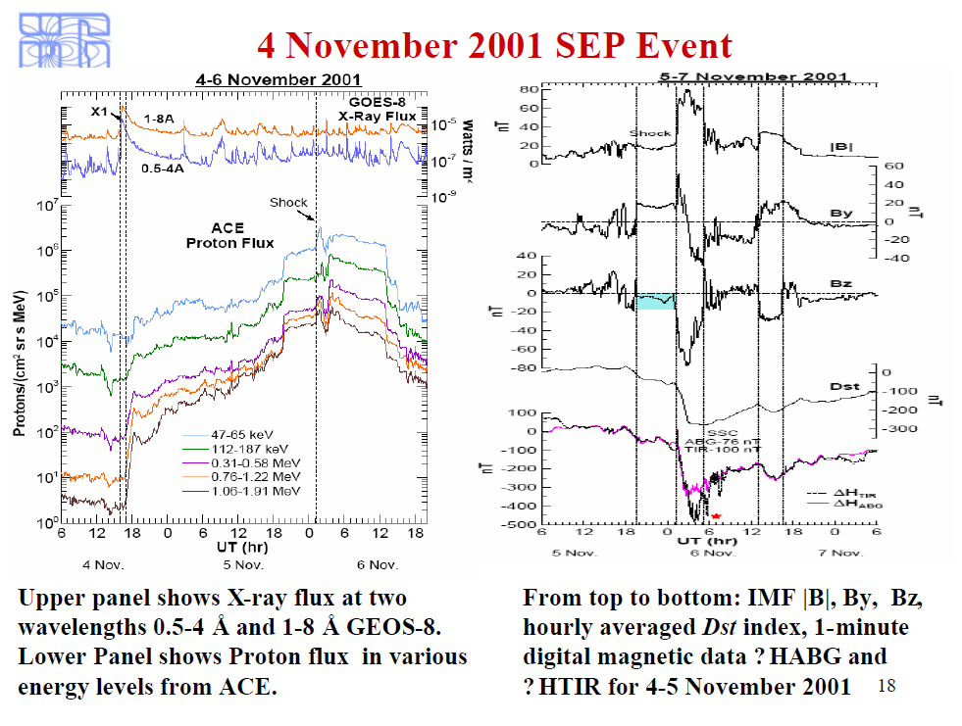
Related SEP event

Slide 27
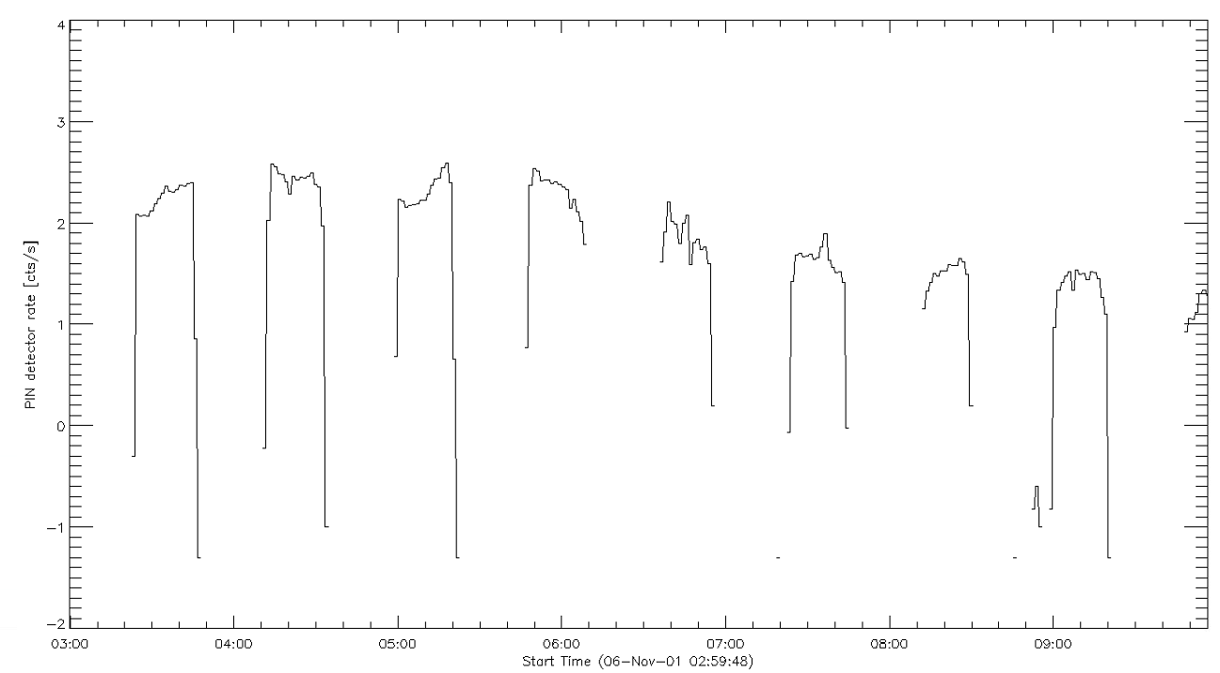
Period „c”

Slide 28
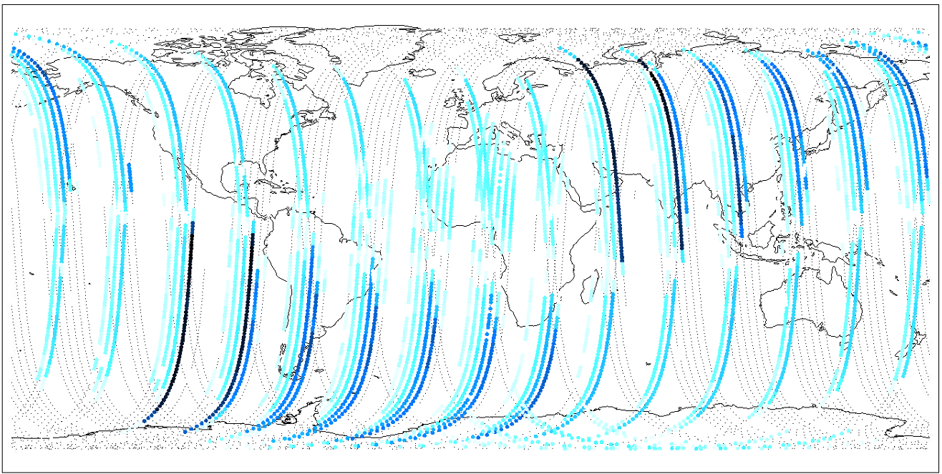
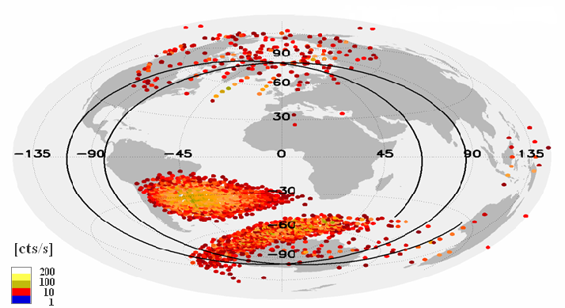
From where the high rates come

Slide 29
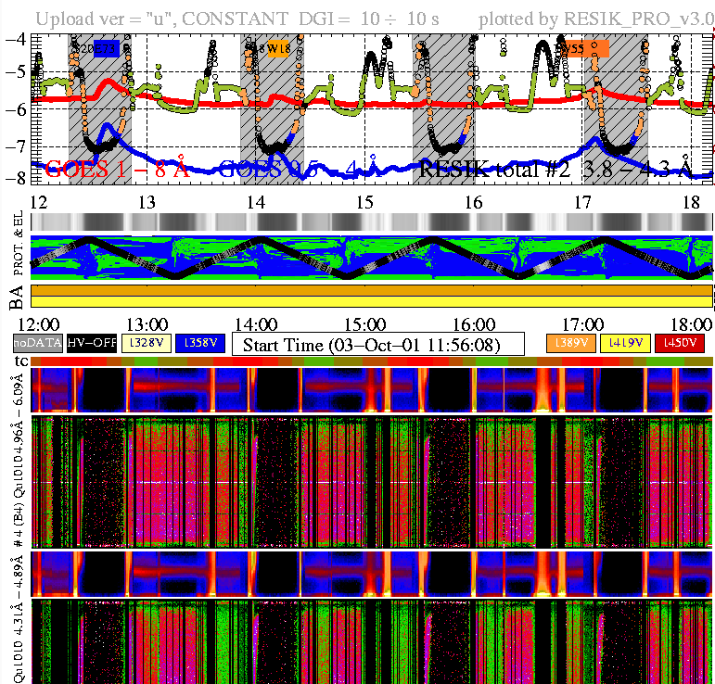
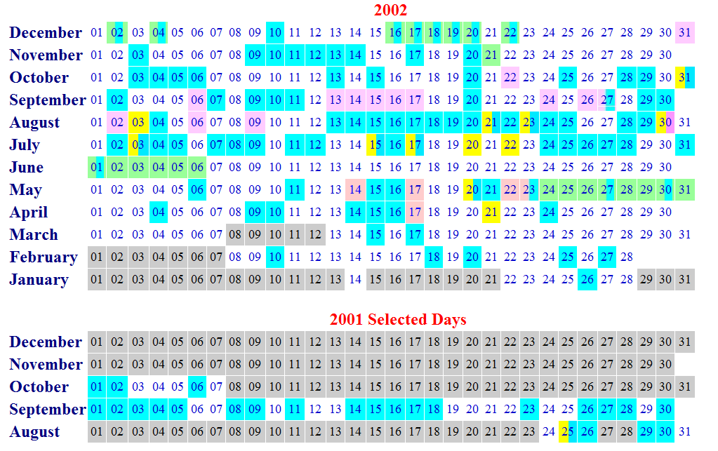
Period when HV was constantly on

Slide 30


Map from PHA0 for February 2002 Mirek Kowaliński

Slide 31



Removing orbital background
measured
Taken during
Night close
To Equator
Difference
Normalized
Through
Hidden bins
flux

Slide 32

Orbital background removal how it is done?
Taken as average of many night portions of the records over entire bin band
0 – 255 in four detectors
Out of auroral ovals
Out of SAA
Distinctive “hidden bin” peaks, where the 45 spectral bins are compressed to 10 bins
(higher level)
Assymetry due to instrument construction: particles “easier” penetrate the lower-wavelenght portion of the detector.
By the heigth of the indicated peak, the entire background profile is removed from the “real” spectrum.
Caution: No auroral correction yet available

Slide 33
Rate dependence of gain

Slide 34
Enhance particle emission from PHA courtesy Mirek Kowaliński

Slide 35
Future analyses 2
Investigations of ambient X-ray emission
S/C night-PHA and spectra
Systematic reduction of every recorded spectrum (~1mln)
Auroral emission & spectra collection
Investigation of magnetosperic effects PIN & PHA
Crossings of polar van Allen belts geomagnetic storms and disturbances
SAA variability
Night portion emission

Slide 36



Examples of offset variability
Source initially above the limb
Flare starts on the disc

Slide 37



Slide 38


Slide 39
Instrument settings plot HV

Slide 40
Instrument settings plot ADS

