Slide 1



RESIK measurements of particle background radiation & non-solar emission
eHeroes 2nd General Meeting
10 - 12 March, 2014 Davos, Switzerland
J. Sylwester, W. Trzebiński, M. Kowalinski, J. Bakala, Z. Kordylewski, J. Barylak, S. Gburek
Space Research Centre, PAS, Wrocław, Poland
I. Myagkova
Skobel’tsyn Institute of Nuclear Energy, Moscow State University, Russia

Slide 2
outline
SRC
PAS
Construction & placement of RESIK detectors
Signals useful to study particle environment
Calibration of RESIK particle signal against particle spectrometer MKL
Conclusions and further work-
Possible collaborations

Slide 3
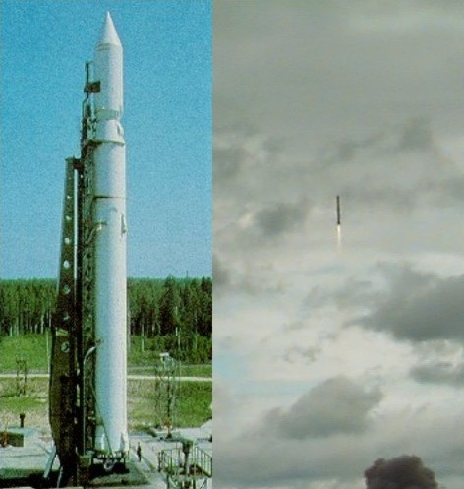
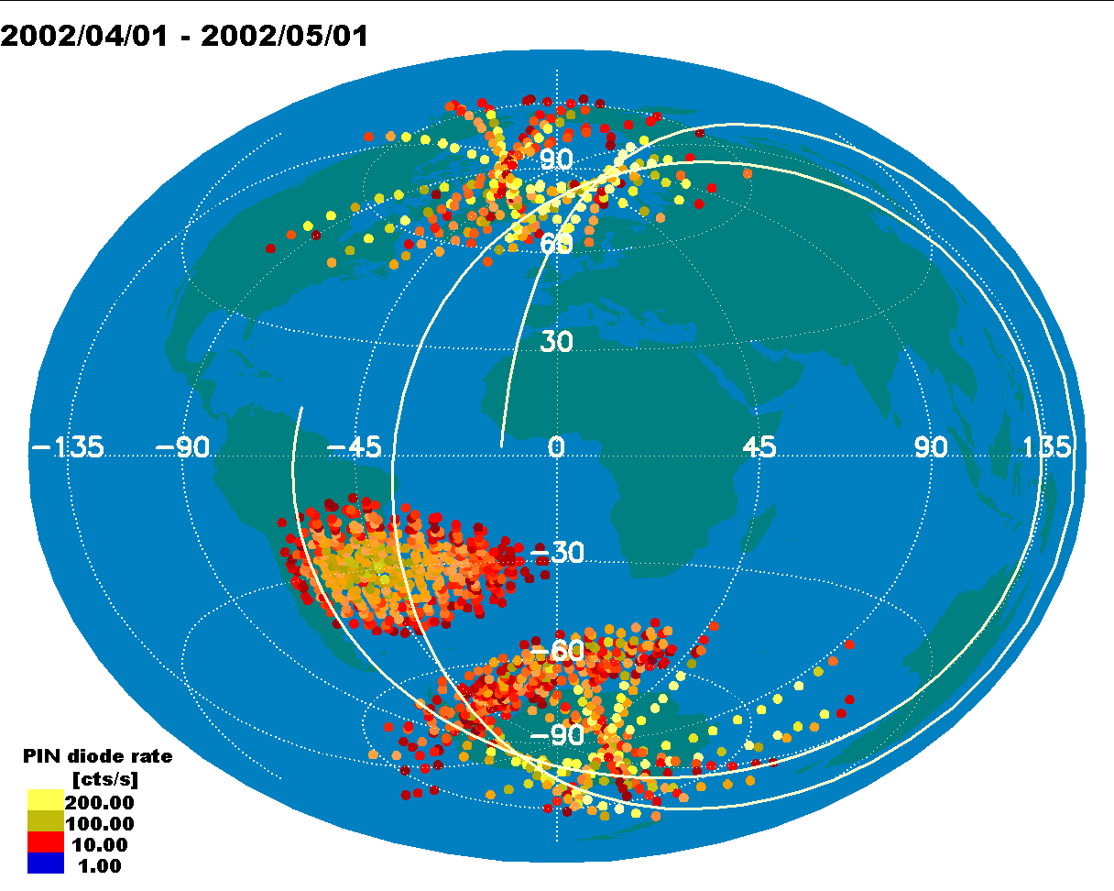
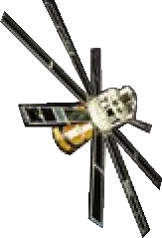
CORONAS-F operation
SRC
PAS
31 July 2001-Dec. 2006
polar orbit, 95min,
~500 km
semi-Sun-synchronous
SS-14 Cyclone
x
10,
CORONAS-F
eHeroes 2nd General Meeting 10 - 12 March, 2014 Davos, Switzerland J. Sylwester

Slide 4
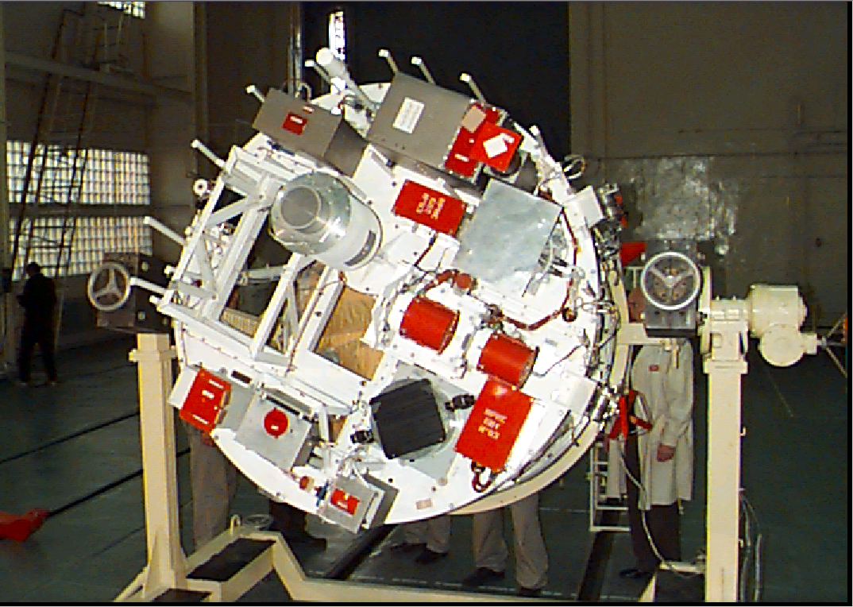
RESIK on CORONAS-F
SRC
PAS
eHeroes 2nd General Meeting 10 - 12 March, 2014 Davos, Switzerland J. Sylwester

Slide 5
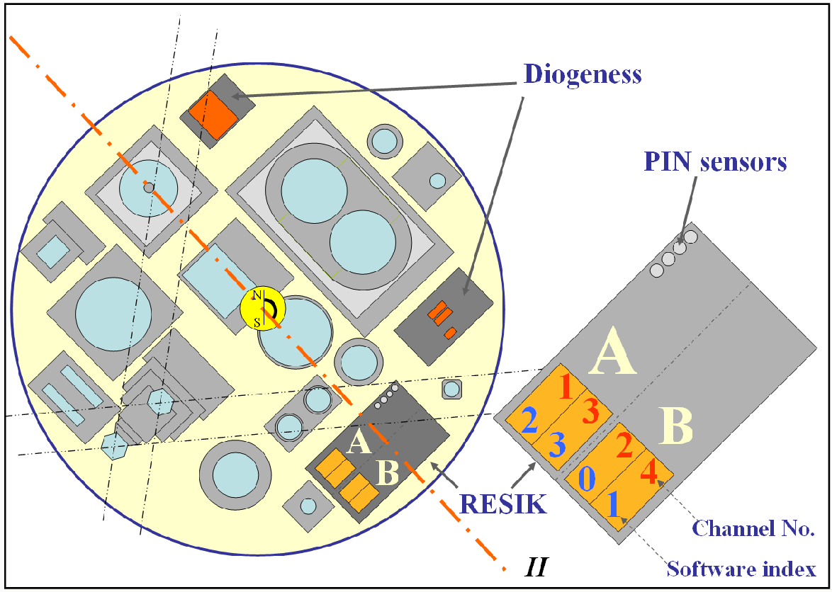
CORONAS-F payload view from the Sun
SRC
PAS

Slide 6
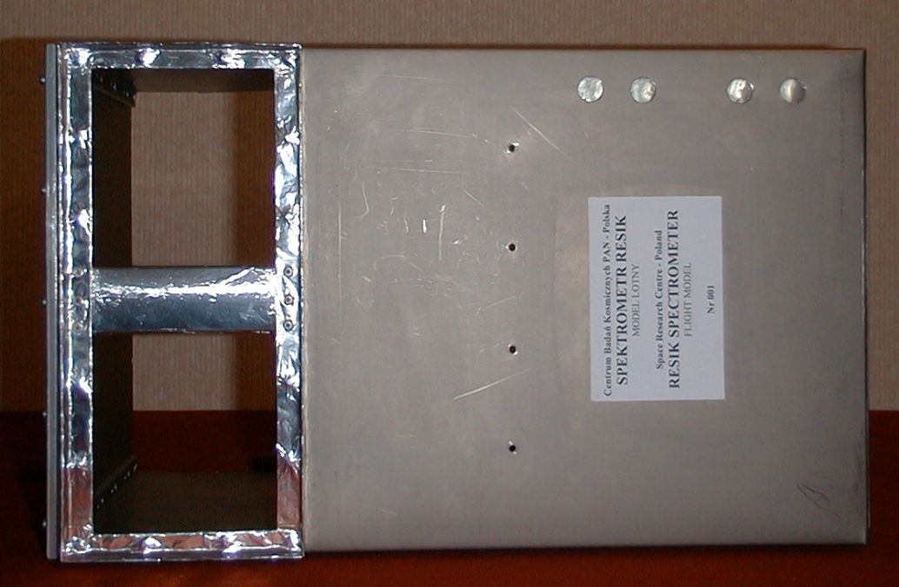
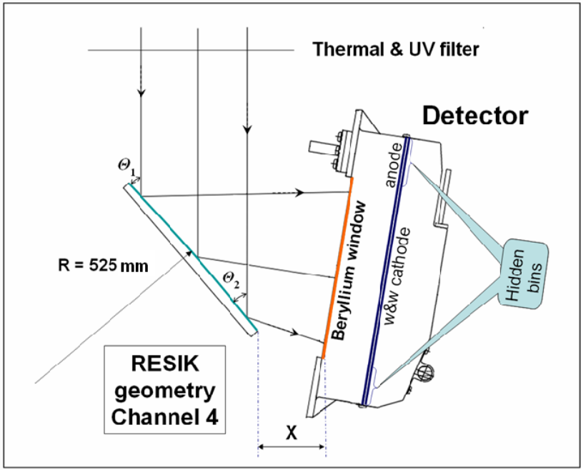
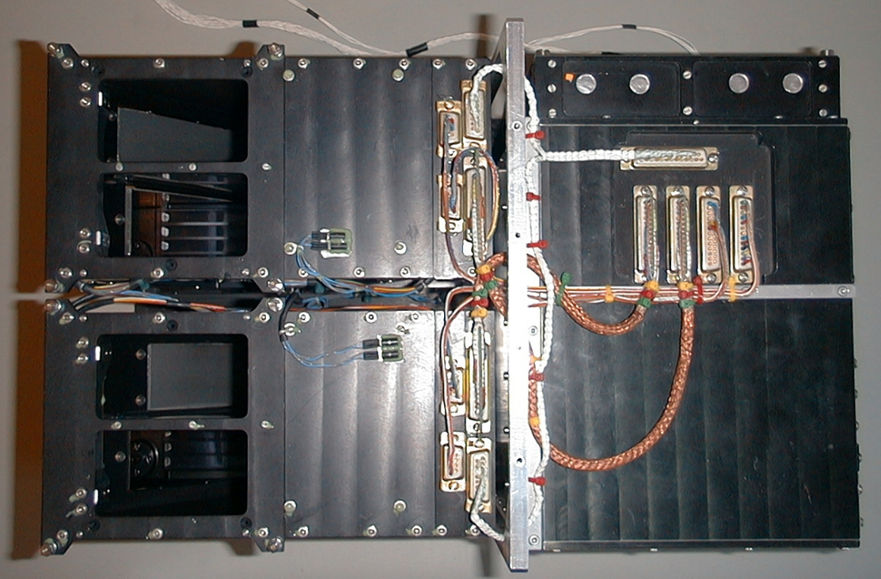
This was a great idea to put
4 PIN detectors inside RESIK the detectors were of the type NTE3033
Infrared Photodiode 7 x 8 mm behind 2 x 80 micron Al foils diameter 14 mm. This part was covered by MLI
RESIK detectors
The main spectroscopy 4 detectors contained parts of anodes (hidden bins HB) upper (better screened and lower). Every signal recorded on anode has been pulse –height analysed into 32 bin spectrum. Its energy range depends on HV applied
SRC
PAS
Titanium cover with
MLI removed
Upper HD
UHB
Lower HD
LHB

Slide 7
RESIK signals with particle signatures
SRC
PAS
PIN detectors
  4 independent „identical” detectors (4 x20 mln data)
RESIK PHA
  2 independent detectors with regulable HV
  4 independent PHA 32 bin data (4 x32 x 20mln/4 since commuted)
Satellite conditions
  Sat day/night, longest night 25 min →0 for long days
  SAA, polar ovals transition, geomagnetic storms
RESIK spectral hidden bins
  UHB,LHB x 2 mln spectral measurements
Total of 40 mln points, up to 40 at the same time
eHeroes 2nd General Meeting 10 - 12 March, 2014 Davos, Switzerland J. Sylwester

Slide 8
RESIK important periods of operation
SRC
PAS
Early „learning” operations between
2001-Aug-24 12:19:48 & 2001-Oct-07 00:59:34
  Const HV ON
  Const DGI=10s
Const DGI=20 s 2001-Oct. & 2002 Feb.
ADS Tweaking 2002-Feb. & 2002 Jul.
  Constant DGI = 10s
DGI =8 or 2s 2002-Jul. & 2003 Apr.
DGI =1 s 2003-Apr & 2003 Sep.
eHeroes 2nd General Meeting 10 - 12 March, 2014 Davos, Switzerland J. Sylwester

Slide 9
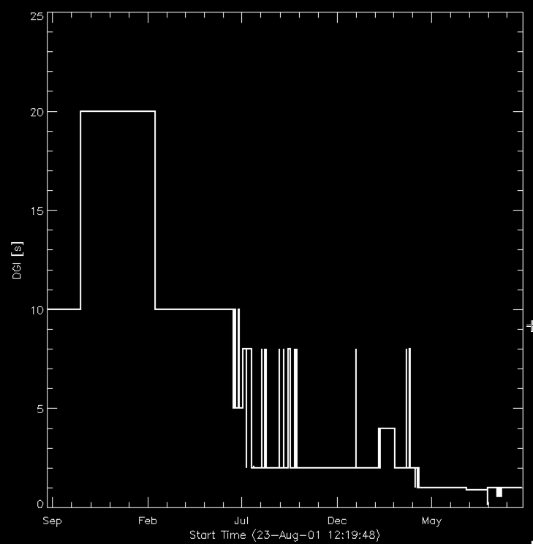
RESIK DGI- sampling time plot
SRC
PAS
Sampling of conditions along the orbit are ~DGI
8km for 1s
160 km for 20s
plot_ut,date_time_all,dgi_all,xst=1,dmin=1440,yst=1,yra=[0,25],ytitle='DGI [s]', charsize=1.5, charthick=1.5, psym=10, thick=2
eHeroes 2nd General Meeting 10 - 12 March, 2014 Davos, Switzerland J. Sylwester

Slide 10
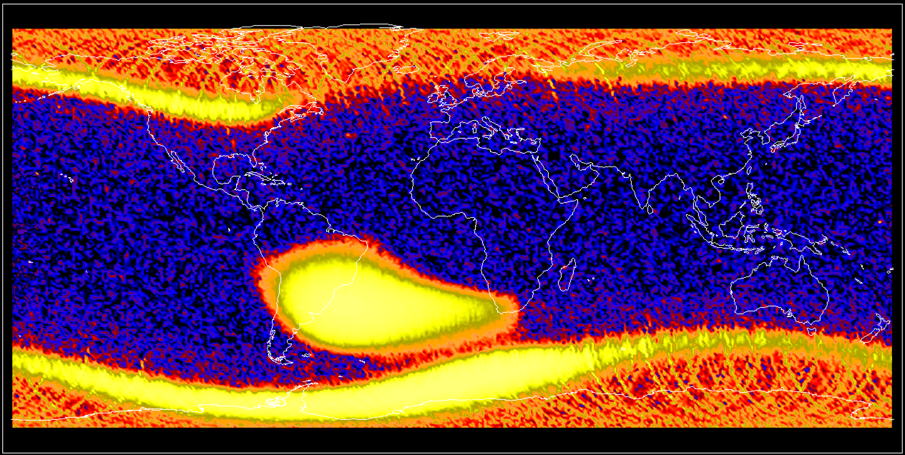
PIN sum: 3e7 events mission long 1 x1 deg
SRC
PAS
oval
SAA
oval
eHeroes 2nd General Meeting 10 - 12 March, 2014 Davos, Switzerland J. Sylwester

Slide 11
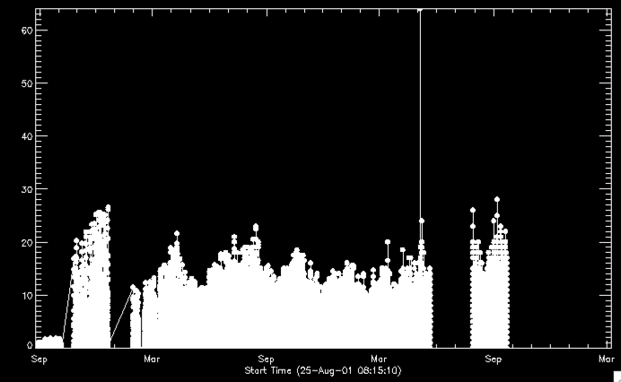
Rates in SAA
SRC
PAS
Strange change of SSA in November 2001
eHeroes 3rd General Meeting 10 - 12 March, 2014 Davos, Switzerland J. Sylwester

Slide 12
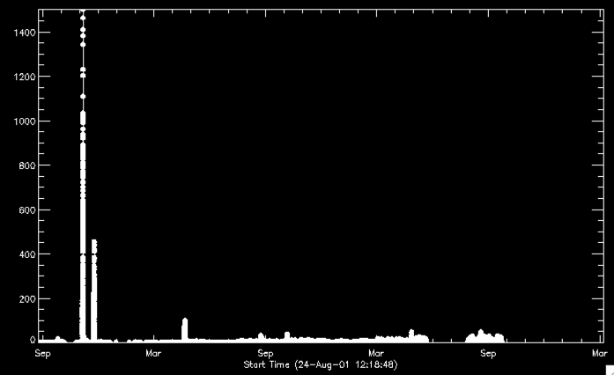
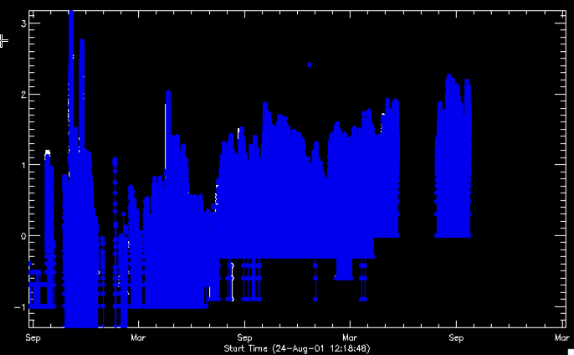
Polar regions the most variable
SRC
PAS
North oval region
North & South (blue) log scaling
eHeroes 3rd General Meeting 10 - 12 March, 2014 Davos, Switzerland J. Sylwester

Slide 13
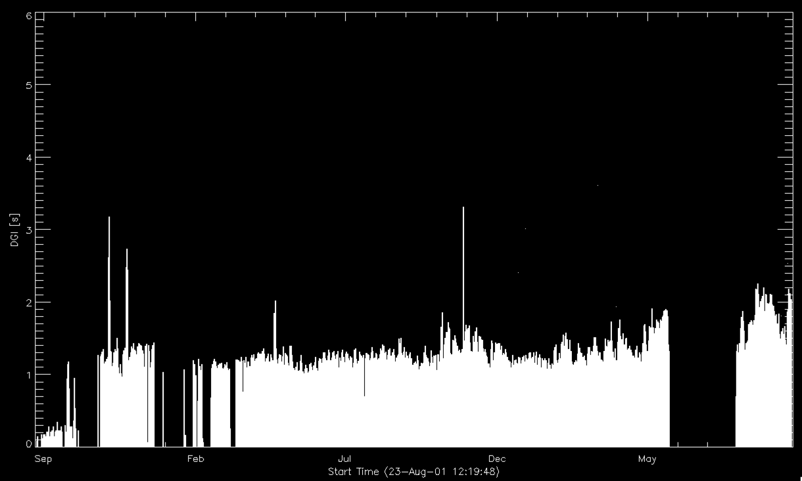
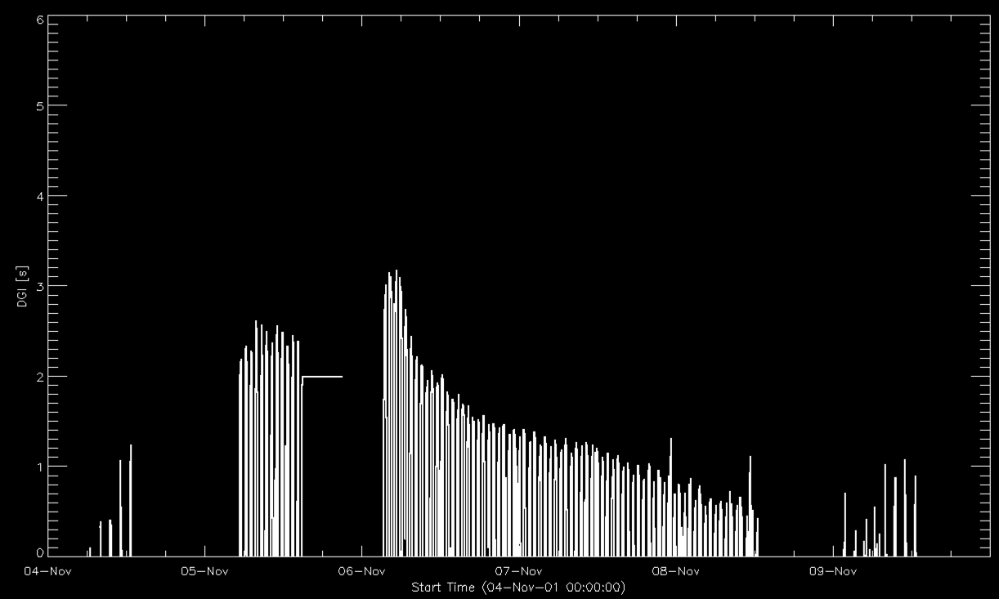
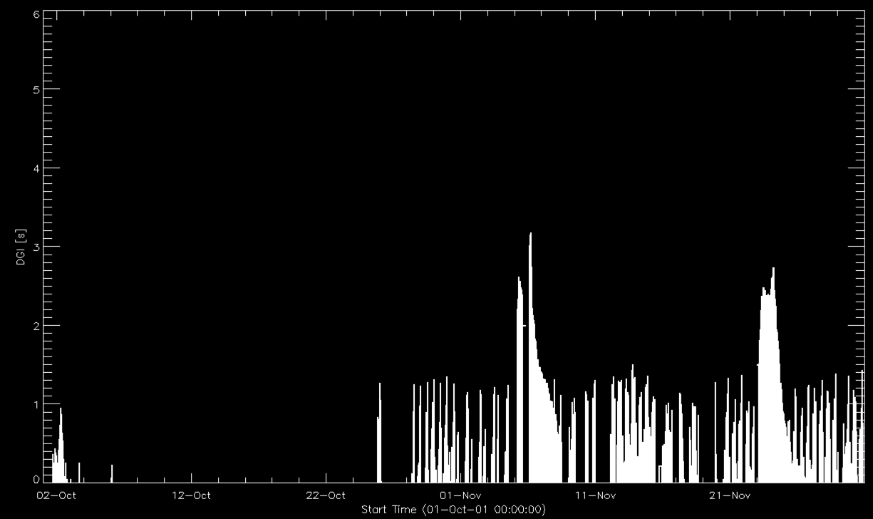
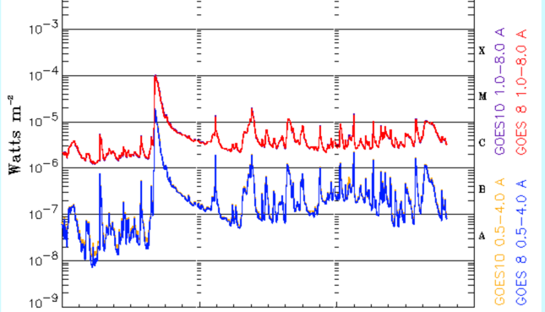
What is seen during a medium size storm?
SRC
PAS
plot_ut,date_time_all,alog10(total(pin_rate,1)),xst=1,dmin=1440,yst=1,yra=[0,6],ytitle='DGI [s]', charsize=1.5, charthick=1.5, psym=10, thick=2
eHeroes 3rd General Meeting 10 - 12 March, 2014 Davos, Switzerland J. Sylwester

Slide 14
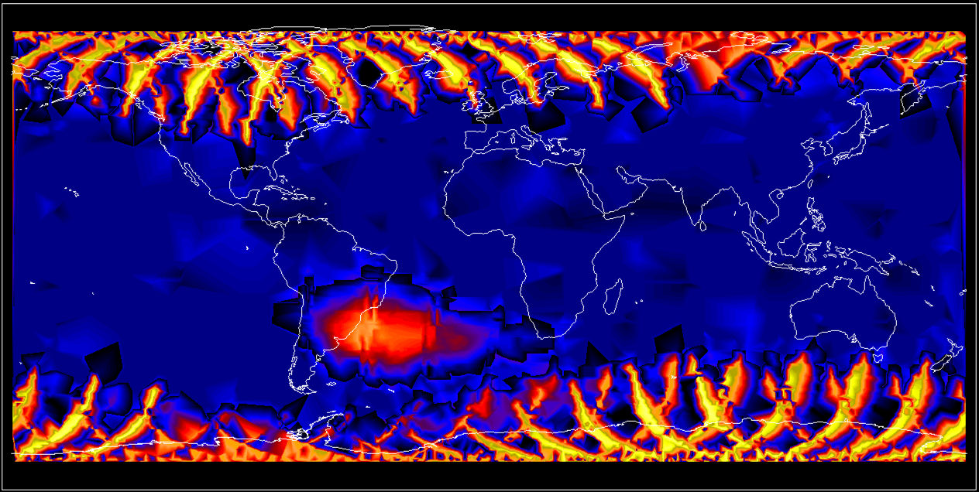
RESIK within CORONAS-F
SRC
PAS
eHeroes 2nd General Meeting 10 - 12 March, 2014 Davos, Switzerland J. Sylwester

Slide 15
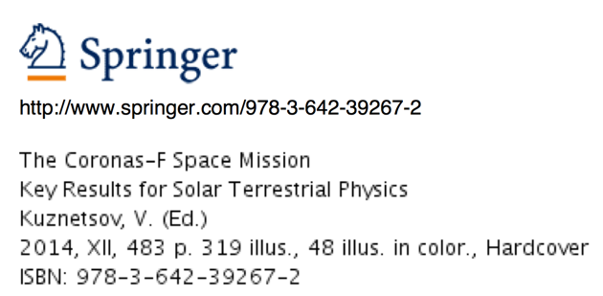
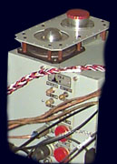
RESIK and MKL on CORONAS-F http://smdc.sinp.msu.ru/index.py?nav=coronasf
SRC
PAS
Electron fluxes:
  e.3-.6 - 0.3-0.6MeV; 1/cm2*sr*s
  e.6-1.5 - 0.6-1.5MeV; 1/cm2*sr*s
  e1.5-3 - 1.5-3.0MeV; 1/cm2*sr*s
  e3-6 - 3 - 6MeV; 1/cm2*sr*s
  e6-12 - 6 -12MeV; 1/cm2*sr*s
Proton fluxes:
  p1-5 - 1 - 5MeV; 1/cm2*sr*
  p14-26 - 14 - 26MeV; 1/cm2*sr*s
  p23-26 - 23 - 26MeV; 1/cm2*sr*s
  p26-50 - 26 - 50MeV; 1/cm2*sr*s
  p50-90 - 50 - 90MeV; 1/cm2*sr*s
Mixed channels:
  0.5p>9 - electrons E>0.5MeV, protons E>9MeV; 1/cm2*sr*s e>1p>9 -
  electrons E 1MeV, protons E>9MeV; 1/cm2*sr*s e1.6p23 –
  electrons E 1.6MeV, protons E>23MeV; 1/cm2*sr*s e1.6p90 –
  electrons E 1.6MeV, protons E>90MeV; 1/cm2*sr*s
  Alpha (He ions)a23-33 - alpha 23-33MeV; 1/cm2*sr*s
http://www.springer.com/astronomy/extraterrestrial+physics%2C+space+sciences/book/978-3-642-39267-2
eHeroes 2nd General Meeting 10 - 12 March, 2014 Davos, Switzerland J. Sylwester

Slide 16
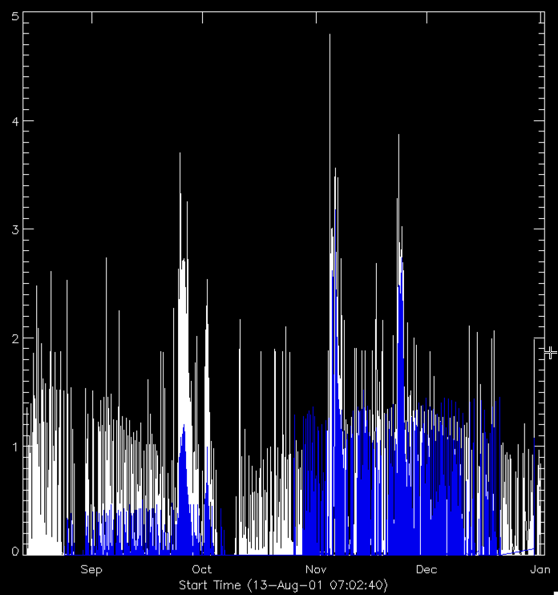
MKL protons
26-50 kev & PIN
SRC
PAS

Slide 17
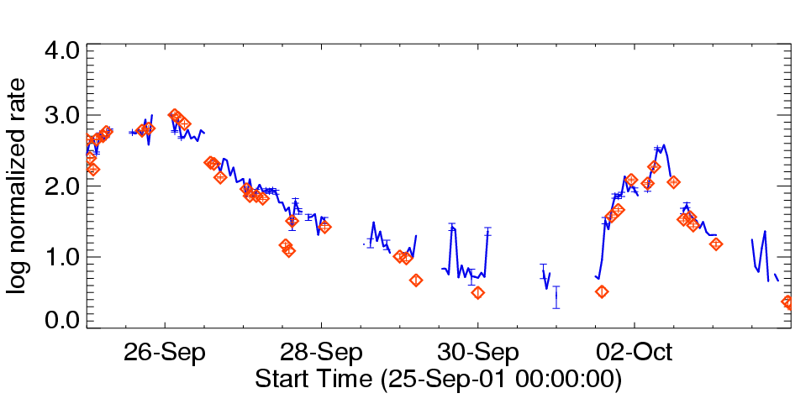
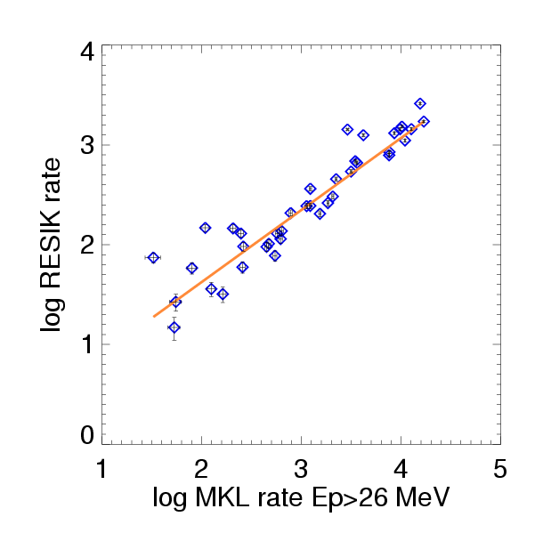
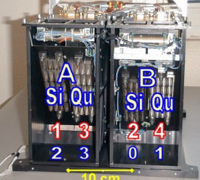
corellation of PIN signal with MKL detector’s
SRC
PAS
„early rather weak geomagnetic storms”
eHeroes 2nd General Meeting 10 - 12 March, 2014 Davos, Switzerland J. Sylwester

Slide 18
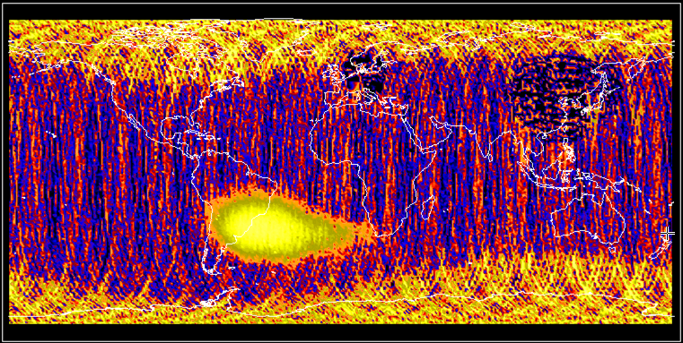
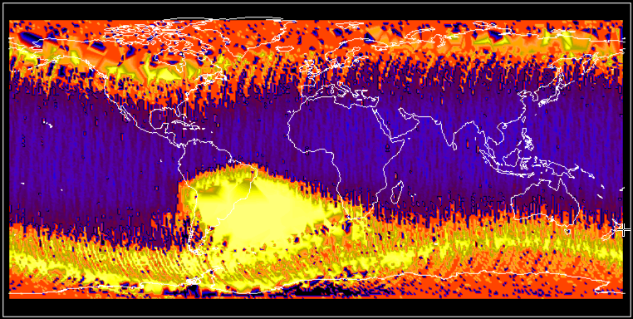
MKL protons 23-26 keV
SRC
PAS

Slide 19
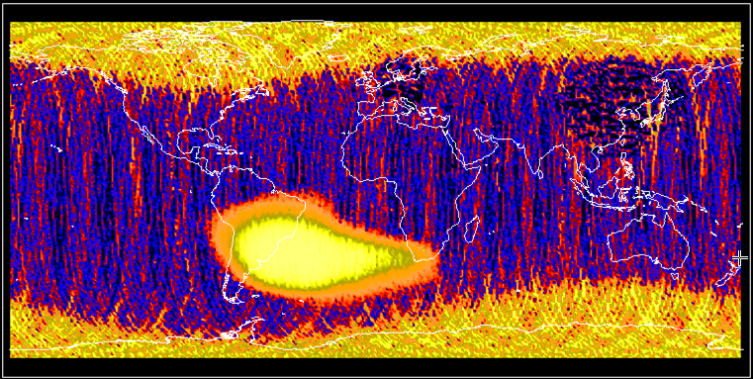
MKL protons 26-50 keV
SRC
PAS
zz=display_on_map(alog10(p26_50>0 +2.),-lon,lat,size_deg,time_j,hvu_all[*,0:n_elements(lat)-1],rates, dgi_all[0:n_elements(lat)-1],region=[[-50,-15],[-30,-10]])

Slide 20

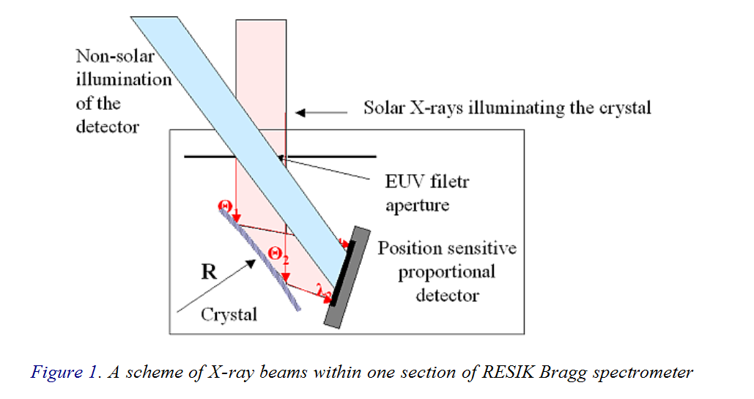
Now back to RESIK gas detectors (Ar + Xe)
SRC
PAS
PHA
signal
eHeroes 2nd General Meeting 10 - 12 March, 2014 Davos, Switzerland J. Sylwester

Slide 21
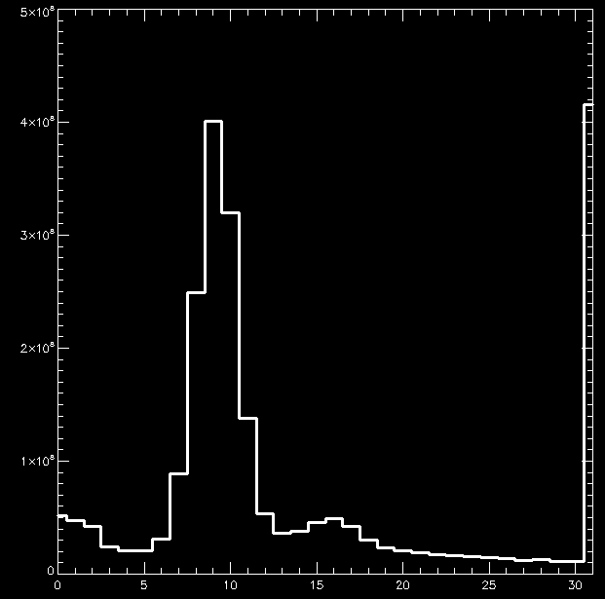
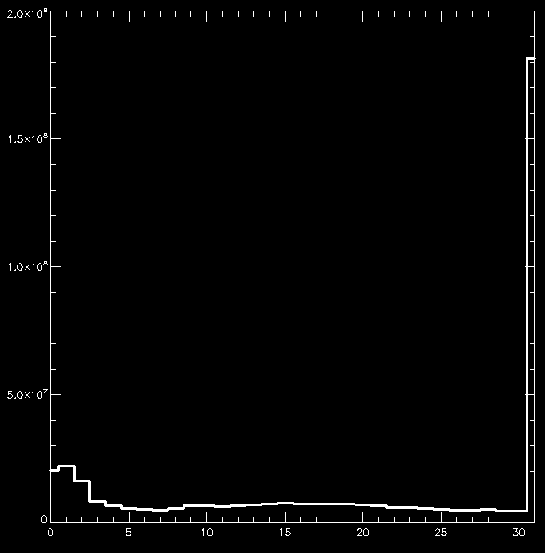
RESIK PHA Spectra
Example PHA channel #2 HV:1450 V
SRC
PAS
S/C DAY
S/C NIGHT
Terrestrial Oxygen 0.5 keV
Solar 1st order 3.5 kev
?
Si Fluo 1.75 keV
eHeroes 2nd General Meeting 10 - 12 March, 2014 Davos, Switzerland J. Sylwester

Slide 22
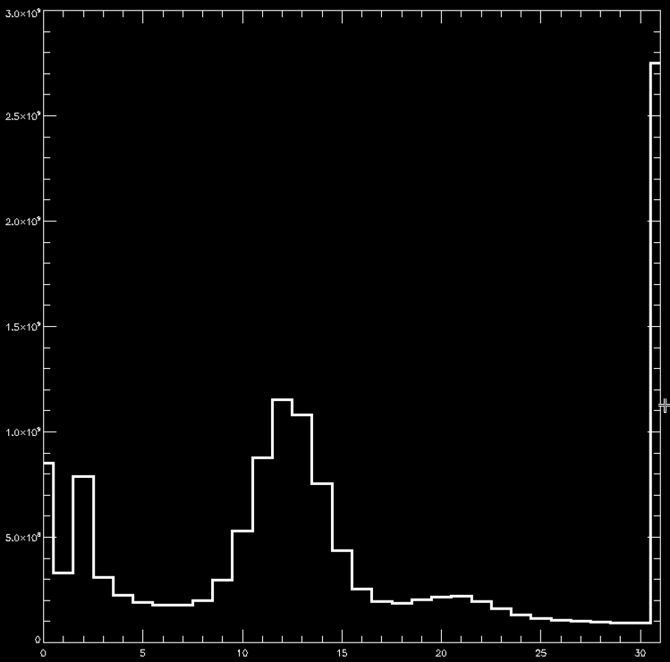
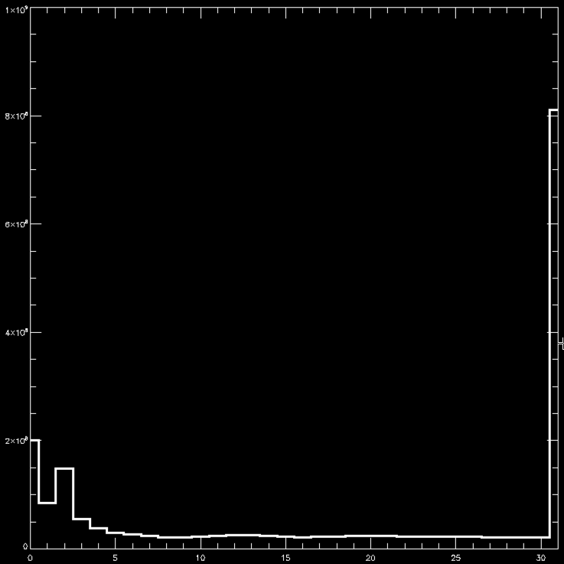
RESIK PHA Spectra
Example PHA channel #2 HV:1480 V
SRC
PAS
S/C DAY
S/C NIGHT
Si Fluo 1.75 keV
Terrestrial Oxygen 0.5 keV
Terrestrial Oxygen 0.5 keV
Solar 1st order 3.5 kev
?
eHeroes 2nd General Meeting 10 - 12 March, 2014 Davos, Switzerland J. Sylwester

Slide 23

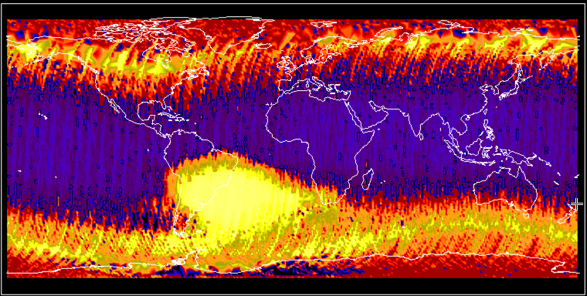
Terrestrial
0.5 keV emission S/C nights
SRC
PAS
zz=display_on_map(pha2_all[2,wh],int_lon_all[wh],int_lat_all[wh],size_deg,date_time_all[wh],hvu_all[*,wh],date_time_all[wh], dgi_all[wh],region=[[-50,-15],[-30,-10]])
eHeroes 2nd General Meeting 10 - 12 March, 2014 Davos, Switzerland J. Sylwester

Slide 24
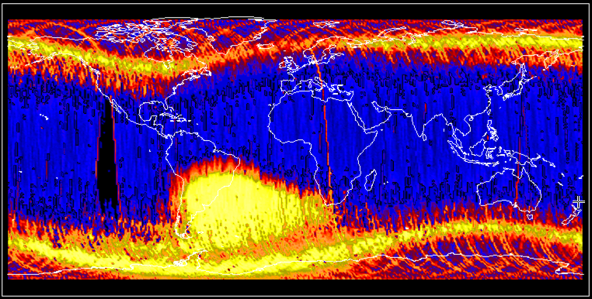
Terrestrial
0.5 keV emission S/C days
SRC
PAS
eHeroes 2nd General Meeting 10 - 12 March, 2014 Davos, Switzerland J. Sylwester

Slide 25
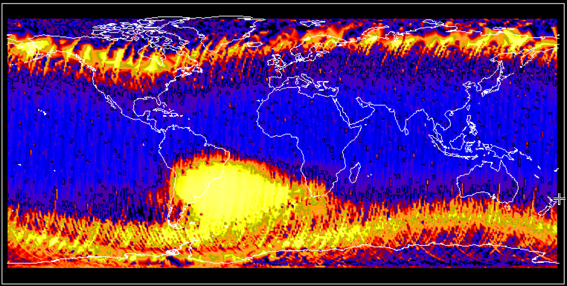
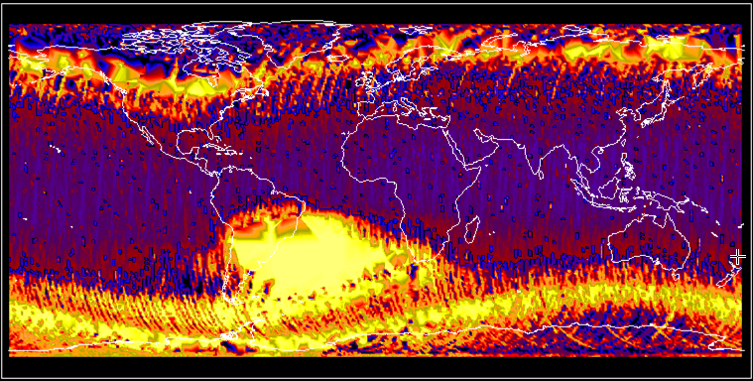
Terrestrial
1.5 -7 keV emission S/C nights
SRC
PAS
zz=display_on_map(total(pha2_all[7:25,wh],1),int_lon_all[wh],int_lat_all[wh],size_deg,date_time_all[wh],hvu_all[*,wh],date_time_all[wh], dgi_all[wh],region=[[-50,-15],[-30,-10]])
eHeroes 2nd General Meeting 10 - 12 March, 2014 Davos, Switzerland J. Sylwester

Slide 26
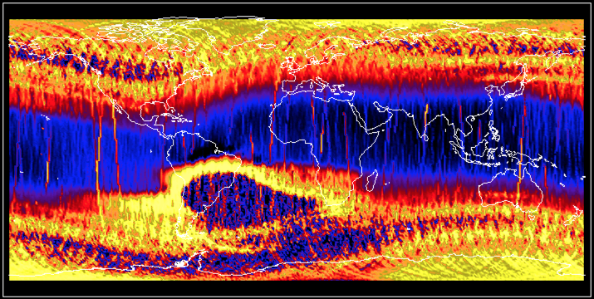
31st bin 1 x 1 deg resolution
SRC
PAS

Slide 27
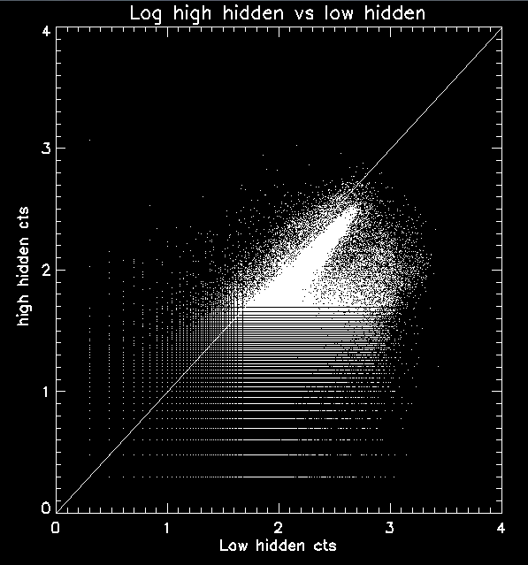
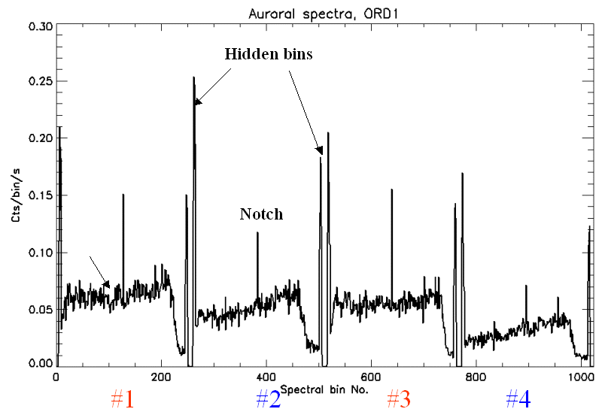
Hidden bins correlations
SRC
PAS
eHeroes 2nd General Meeting 10 - 12 March, 2014 Davos, Switzerland J. Sylwester

Slide 28
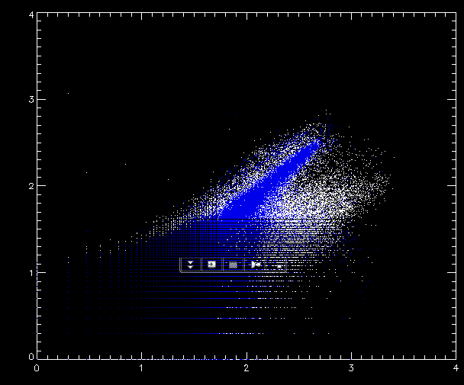
Hidenn bins day vs night chan 0
SRC
PAS
plot,alog10(wi0_pl[wh_sp_day]),alog10(wi0_ph[wh_sp_day]),psym=3
IDL> oplot,alog10(wi0_pl[wh_sp_night]),alog10(wi0_ph[wh_sp_night]),psym=3,color=45
eHeroes 2nd General Meeting 10 - 12 March, 2014 Davos, Switzerland J. Sylwester

Slide 29
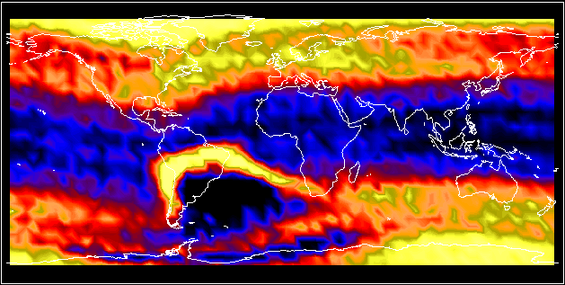
High hidden chan 0
SRC
PAS

Slide 30
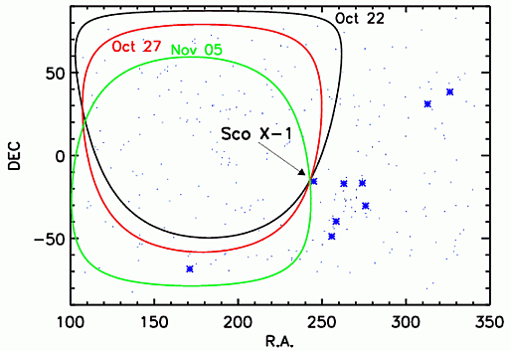
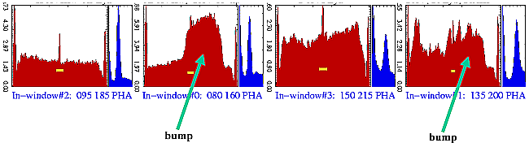
Non-solar contributions
SRC
PAS
eHeroes 2nd General Meeting 10 - 12 March, 2014 Davos, Switzerland J. Sylwester

Slide 31
Ongoing & Possible collaborations
SRC
PAS
Skobeltsyn Institute MGU, Moscow
  Understanding & Calibrations of various RESIK Signals- for quiet and stormy conditions
Plasma physics group, SRC Warsaw
  Understanding signals due to severe storms
Lebedev Physical Institute, Moscow
  Relation between the PIN signals and CCD tracks signal
ROB & SPENVIS groups, Belgium
  Quiet & stormy condition response of PROBA-2
eHeroes 3rd General Meeting 10 - 12 March, 2014 Davos, Switzerland J. Sylwester

Slide 32
Thank you eHeroes
Team
SRC
PAS

Slide 33
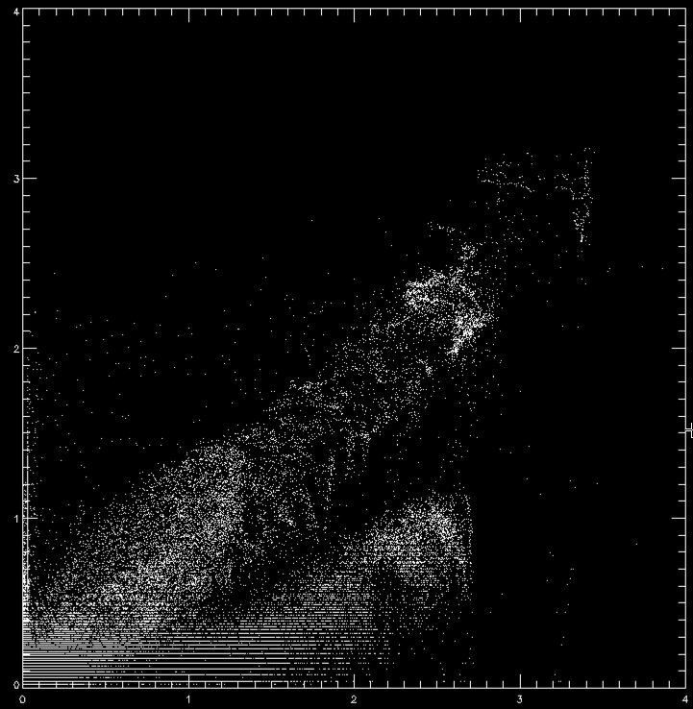
RESIK and MKL on CORONAS-F
MKL data on: http://smdc.sinp.msu.ru/index.py?nav=coronasf
SRC
PAS
eHeroes 2nd General Meeting 10 - 12 March, 2014 Davos, Switzerland J. Sylwester

Slide 34
RESIK within CORONAS-F
eHeroes 3rd General Meeting 10 - 12 March, 2014 Davos, Switzerland J. Sylwester

Slide 35
RESIK within CORONAS-F
eHeroes 3rd General Meeting 10 - 12 March, 2014 Davos, Switzerland J. Sylwester

Slide 36
RESIK within CORONAS-F
eHeroes 3rd General Meeting 10 - 12 March, 2014 Davos, Switzerland J. Sylwester

