Slide 1
Determination of elemental abundances from X-ray spectra in the multitemperature approach
B. Sylwester, J. Sylwester, A. Kępa
Space Research Centre, PAS, Wrocław, Poland
K.J.H. Phillips
Natural History Museum, London, UK
V.D. Kuznetsov
IZMIRAN, Moscow, Russia

Slide 2
ABSTRACT
We present results of elemental abundance determinations for flaring plasma using the X-ray spectra obtained with Polish-led spectrometer RESIK placed aboard the Russian CORONAS-F satellite. RESIK was an uncollimated bent crystal spectrometer taking instant measurements of spectra in four channels covering the soft X-ray range between 3.3 Å and 6.1 Å. The overall shape of measured spectrum depends considerably on the plasma elemental composition and the plasma distribution with temperature conveniently described by so called differential emission measure (DEM). High sensitivity of RESIK makes recorded spectra uniquely suitable for investigations of the temperature structure of the source DEM as well as the plasma elemental composition. In this respect we present a new method allowing for determination of abundances and subsequent DEM distributions consistent with the observed spectral line and continuum intensities.

Slide 3
RESIK
RESIK was designed to observe solar coronal plasmas in four energy bands. The nominal wavelength coverage of RESIK is 3.3 Ǻ – 6.1 Ǻ. It contains many spectral lines of H- and He-like ions of various FIP elements from K (FIP=4.34 eV) through Si (8.15 eV) and S (FIP=10.36 eV) to
Ar (FIP=15.75 eV).
This makes RESIK spectra suitable to solar composition investigations and the thermodynamic parameters determinations.

Slide 4
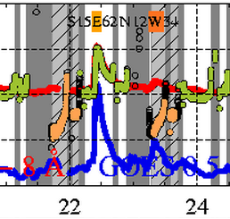
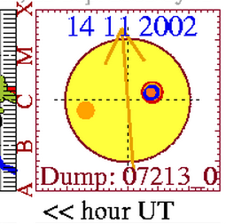
M1.0 flare: SOL2002-11-14T22:26
www.cbk.pan.wroc.pl/experiments/resik/2002
Well obseved, total of 127 individual spectra summed into 19 time intervals for detailed analysis.
Average RESIK spectrum integrated over 26.5 min

Slide 5
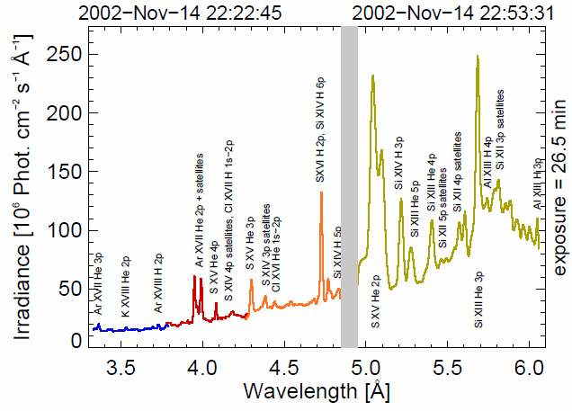
Average RESIK spectrum for M1.0 flare
On the recorded spectra many spectral lines formed in H- and He-like ions of various FIP elements from K (FIP=4.34 eV) through Si (8.15 eV) and S (FIP=10.36 eV) to Ar (FIP=15.75 eV) and the real continuum below the lines are seen.
The line and continuum emissions are assumed to be formed in most cases in thermal optically thin coronal plasma of temperature between 3 MK and 30 MK.

Slide 6
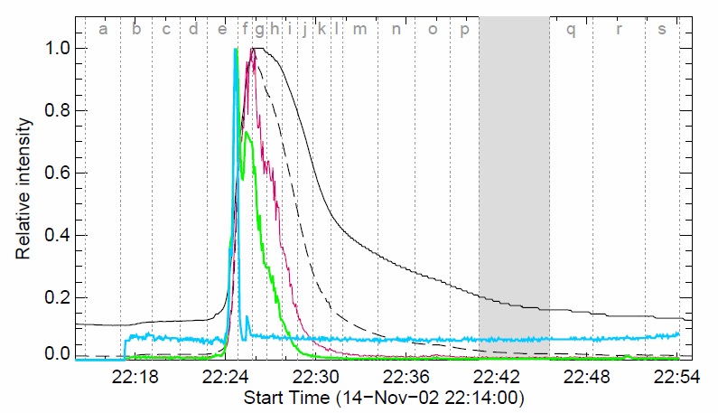
Normalised lightcurves
GOES
0.5 – 4 Å
1 – 8 Å
RHESSI
6 – 12 keV
12 – 25 keV
25 – 50 keV
19 time intervals selected (a-s)
Sample spectra for: rise (e), maximum (g) and decay (n) phases

Slide 7
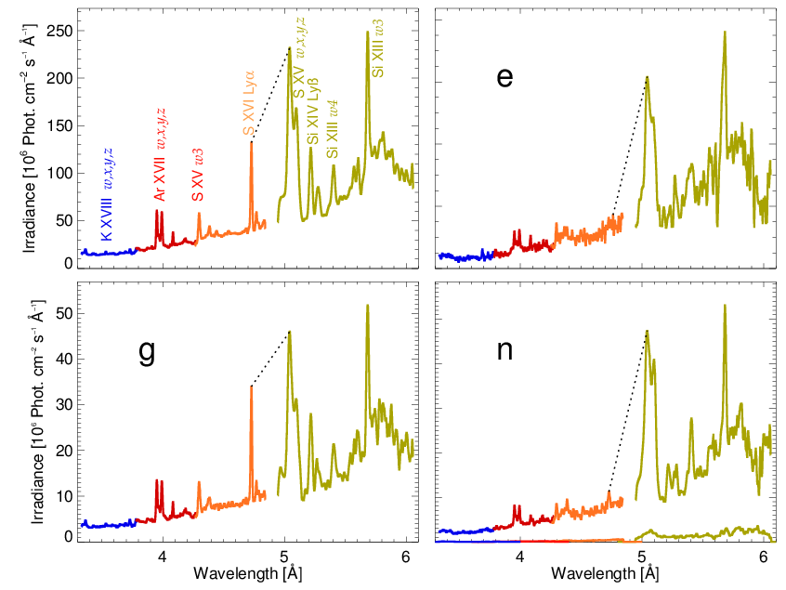
Spectral differences SOL2002-11-14T22:26
Average spectrum
Rise phase
Maximum phase
Decay phase

Slide 8
X-ray fluxes for optically thin, multithermal plasma
DEM → always positive, characterizes proportions of plasma at particular temperature intervals dT
F_{i} → fluxes obtained from RESIK spectra in i=15 passbands (observations)
f_{i}(T) → theoretical emission functions for each spectral band,
calculated from CHIANTI 7.0 for unit elemental abundance A_{i}
A_{i} → elemental abundance taken as constant

Slide 9
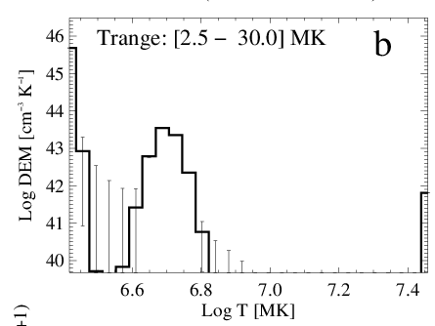
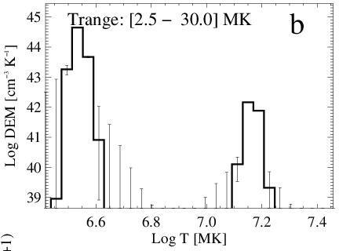
DEM dependence on the abundance
Photospheric
Coronal
From the absolute RESIK spectra we have selected 15 narrow bands containing the most intense lines and continuum. They constituted the input set for the differential emission measure (DEM) calculations. The Withbroe-Sylwester iterative algorithm corresponding to the maximum likelihood procedure (Solar Phys., 67, 1980) has been used.
The theoretical fluxes have been calculated based on the CHIANTI 7.0 code with adopted photospheric and coronal plasma composition respectively. Bryans ionization equilibrium has been adopted (ApJ, 691, 2009). As the observed fluxes we have used the total fluxes integrated over the flare duration in 15 selected spectral bands.
For DEM determinations the10 000 iterations have been performed and the errors have been obtained from 100 Monte Carlo realizations of DEM calculations.
Completly different distribution of emitting plasma for different abundances

Slide 10
AbuOpt method
for i=1,2…15
The AbuOpt algorythm starts by finding an abundance set that is consistent with the observed spectra: Observed fluxes are integrated in 15 spectral bands. We solve the set of above equations changing the unknown abundance A_{i} for the element giving the line i ( values from 0 to 16 times „coronal” one → 21 different values). The other element abundances were kept at their coronal values. For each assumed abundance A_{i} we ran the Withbroe-Sylwester (W-S) iterative algorythm and after 1000 iterations the resulting DEM and value of normalized χ² was obtained describing the difference between the measured and fitted fluxes.
For each run after 1000 iterations we have: A_{i}, φ_{i}, and the best fit χ²

Slide 11
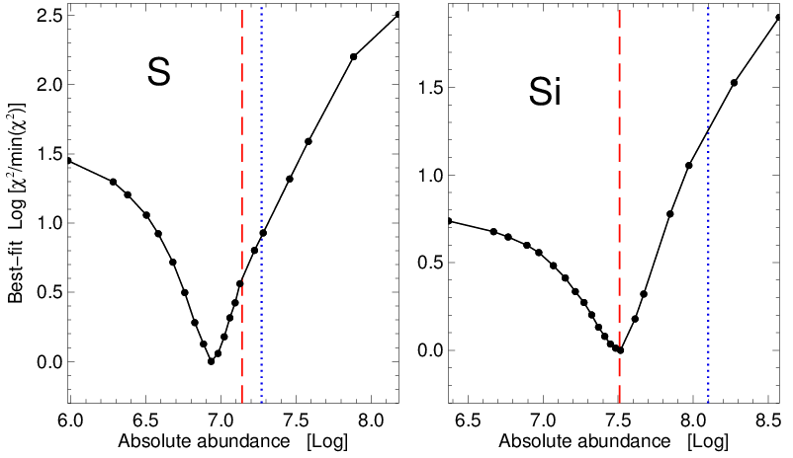
AbuOpt results (S, Si) for whole flare spectrum
We interpret the results of such exercise in the way that the abundance corresponding to the minimum χ² is the optimum one for which the agreement between the observed set of spectral fluxes and the theory is the best. Dashed red line denotes the photospheric and dotted blue the coronal abundance.

Slide 12
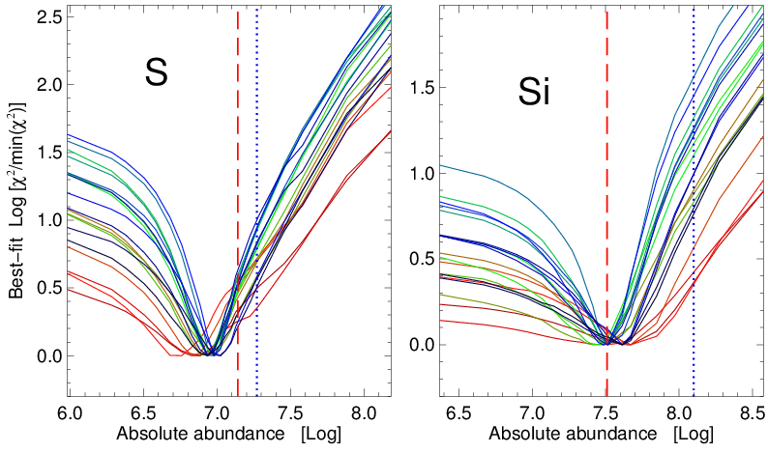
AbuOpt results for individual time intervals
Different colours correspond to individual time intervals analysed (19). Minima at similar position but changing a little → time variations of abundance during the flare evolution. Dashed red line denotes the photospheric and dotted blue the coronal abundance.

Slide 13
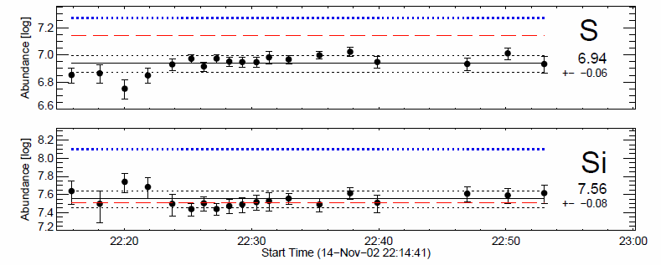
AbuOpt results
Adopting these new, optimised abundances we can calculate the DEM distributions for individual time intervals using the W-S iterative procedure. Calculations have been carried out within the temperature range 2 - 30 MK. We have performed 10 000 iterations.

Slide 14
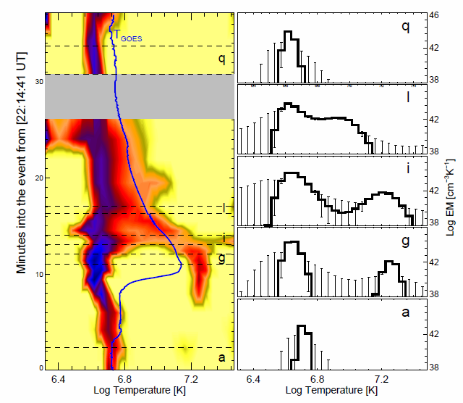
Variations of DEM distributions
Right: Emission measure distributions for the intervals indicated in the left plot, derived from the W–S routine. Vertical error bars indicate uncertainties. A cooler (temperature 3 - 6 MK) component is present over all the time interval, and hotter component (~16 - 21 MK) at the main phase of the GOES light curve with the EM ~100 times smaller.
Left: Contour plot of the differential emission measure during SOL2002-11-14T22:26 flare, darker colors indicating greater EM. Horizontal dotted lines define the time intervals a, g, i, l, and q.

Slide 15
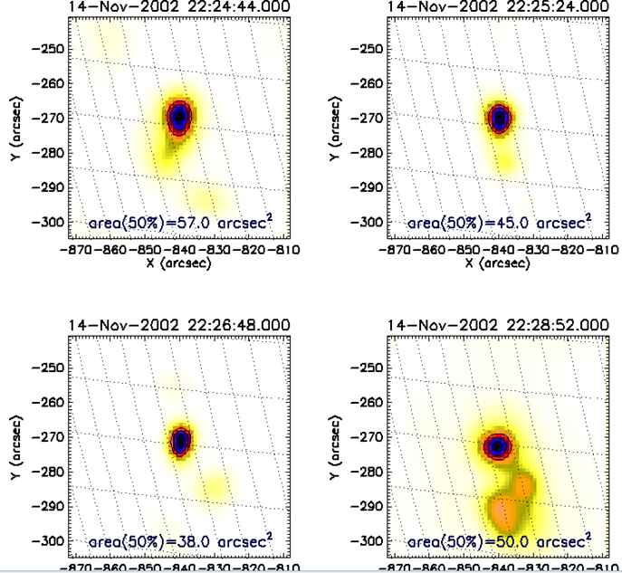
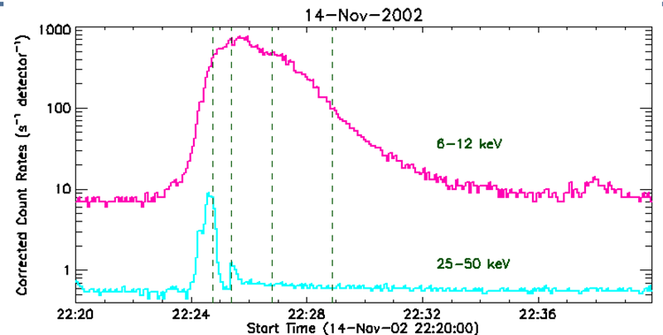
RHESSI images: source dimension
Cooler component is unlikely to significantly contribute to 6-7 keV RHESSI emission so we can assign the estimated dimension to hot temperature component and determine the density of hot plasma from EM.
Average dimension (50% isophote) as obtained based on 49 PIXON reconstructed images covering whole flare evolution is: 3.7 arcsec (5.8 x 10⁸ cm)

Slide 16
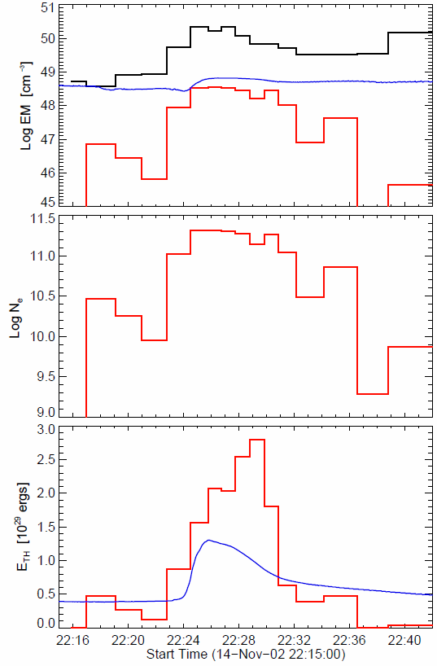
Flare thermodynamic
Top: The time evolution of the total emission measure for the cooler (T < 9 MK, black) and hotter (T > 9 MK, red) plasma. The blue solid line is the emission measure EM_{GOES} from the flux ratio of the GOES bands.
Center: Electron densities derived from the emission measure of the hotter component and average size of the RHESSI images. For peak EM for hot component→
Bottom: thermal energy E_{th}, estimated from the expression:
E_{th} reaches a max. of ~3 x 10²⁹ erg, rather typical for a medium-class flare such as the one analysed.

Slide 17
Take home message
RESIK spectra constitute the base for the coronal abundance analysis and also for Differentaial Emission Measure (DEM) calculations as they contain lines belonging to several elements (including those with low and high FIP). Performed analysis have been made using 15 spectral intervals from the observed range 3.3 Å and 6.1 Å.
The abundance optimization (AbuOpt) leads to revised (in comparison with an isothermal approach) abundances of silicon and sulfur in the analyzed flare plasmas: A(S) = 6.94±0.06 and A(Si) = 7.56 ± 0.08.
Determination of abundances for the elements contributing to RESIK spectra and calculations of DEM distributions are possible based on RESIK spectra. The DEM models obtained for analysed flare are usually two-component indicating for the concentration of plasma in two temperature regions: colder component (T < 9 MK) and hotter one with T > 9 MK. The amount of hotter plasma is much lower in comparison with cooler one (~ two orders for flare maximum). This small amount of hot plasma is necessary to adjust the observed and calculated fluxes in individual spectral bands.
With the additional knowledge of emitting region dimension (RHESSI images) the density and thermal energy of hot emitting plasma can be estimated.

Slide 18
THANK YOU

