Slide 1



ChemiX – the soft X-ray Bragg spectrometer under development for the Interhelioprobe Mission.
J. Sylwester,
M. Siarkowski, Z. Szaforz, J. Bąkała, O. Dudnik
V.D. Kuznetsov, & I.V. Zimovets, S. Kuzin
and the
Team of SRC PAS in Wrocław, Poland

Slide 2
Why we designed & build ChemiX (Chemical composition in X-rays)
Continue important observations of spectra in the softer X-ray range (SMM FCS, BCS, RESIK) T>2 MK
Isolate spectra from individual targets on the Sun
Construct fluorescence-free spectrometer
Improve on signal/noise (several x better than RESIK)- allow reliable continuum flux determination
Preserve 1 s cadence
Determine turbulent widths and line Doppler shifts
Determine coronal abundances to the accuracy equivalent/better as the photospheric ones

Slide 3
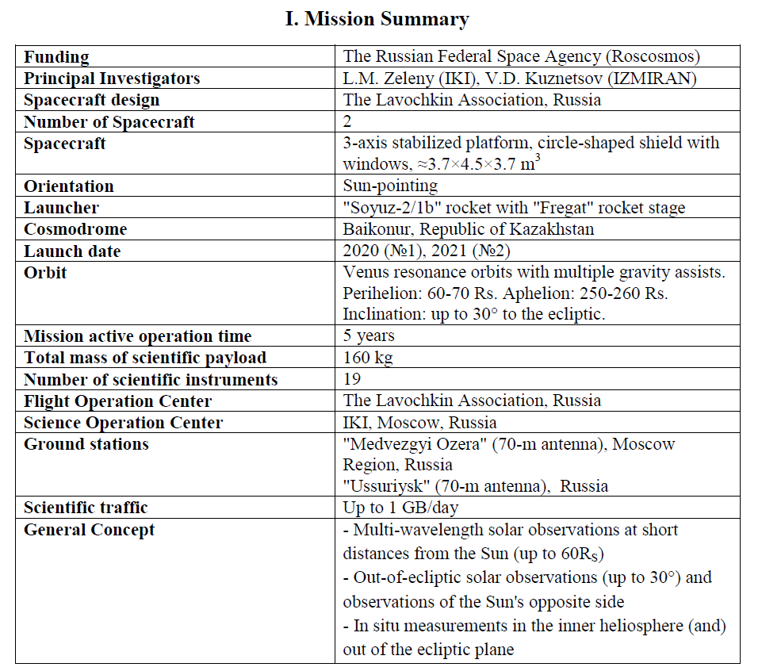
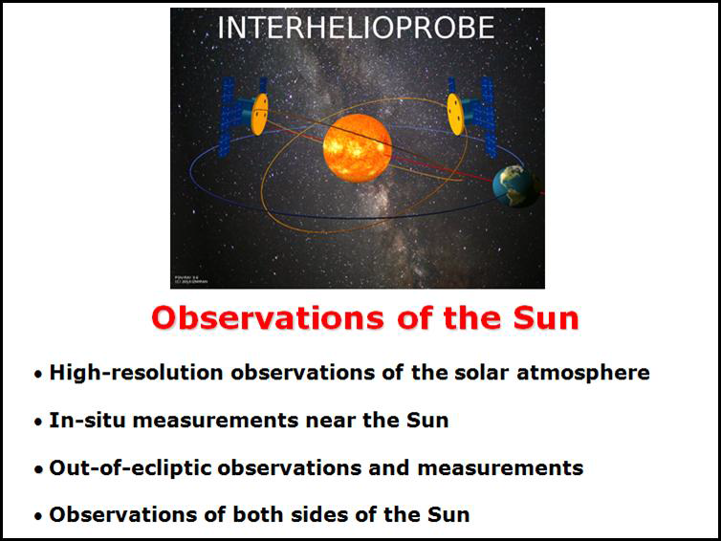
Interhelioprobe-Интергелио-Зонд the analogue of Solar Orbiter
Actually two missions planned (2020 & 2021)
Funding of spacecraft in-force
Phase B of instrument development ongoing

Slide 4
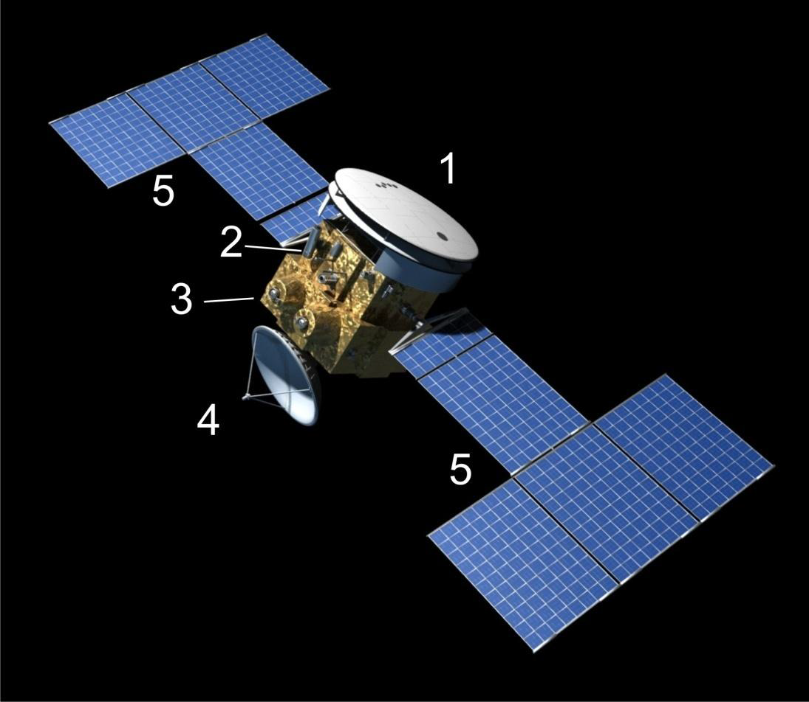
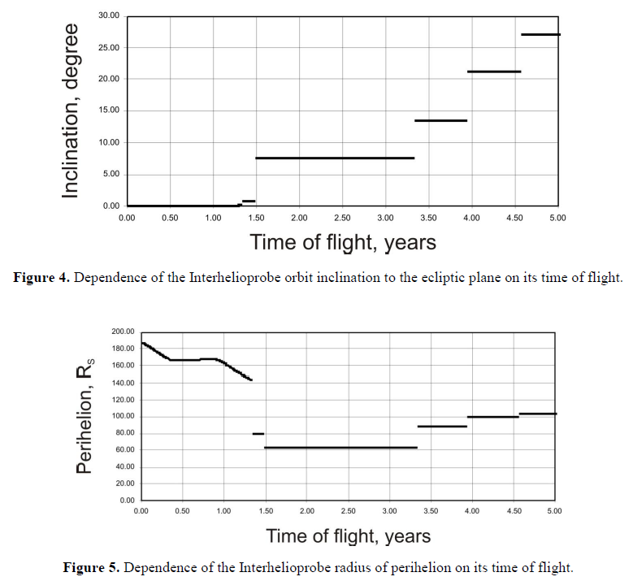
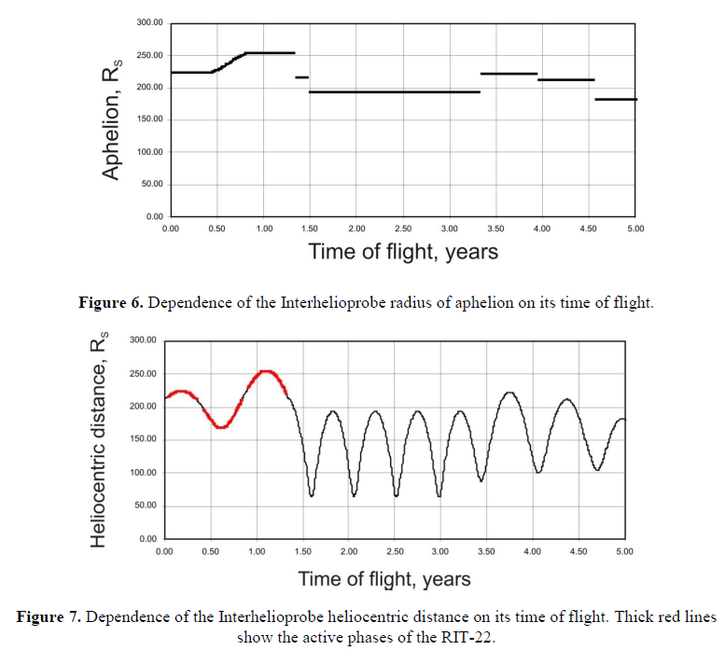
Spacecraft & orbit
Thermal shield & windows
Payload
Plasma
Engines
High gain
Antenna
Solar
Panels

Slide 5
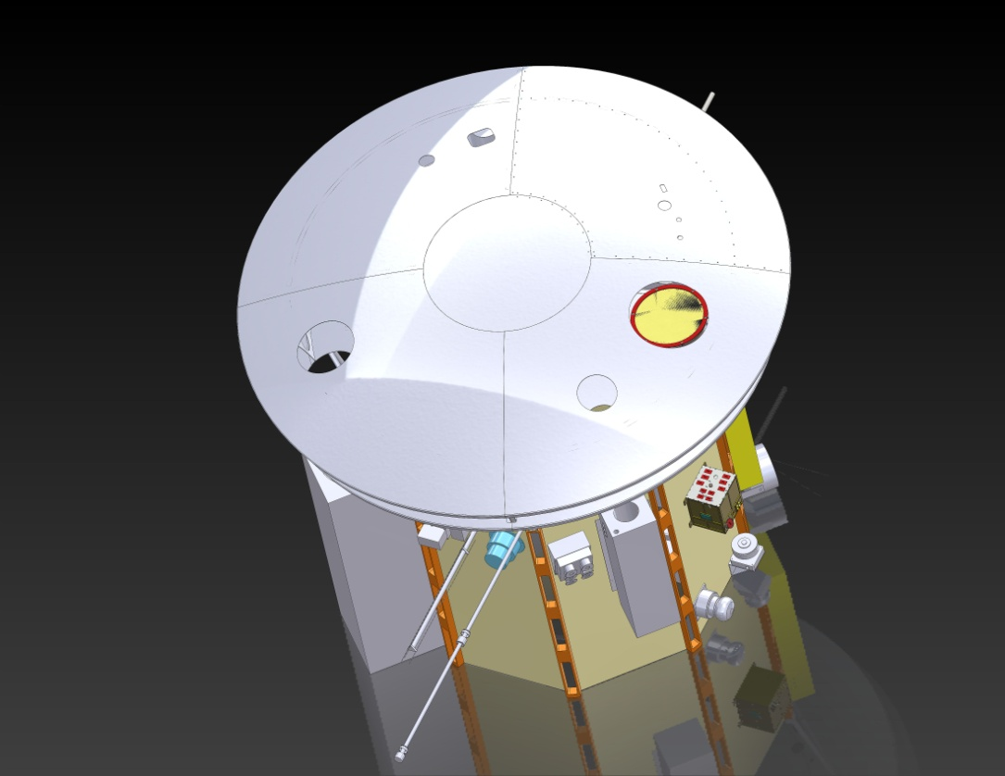
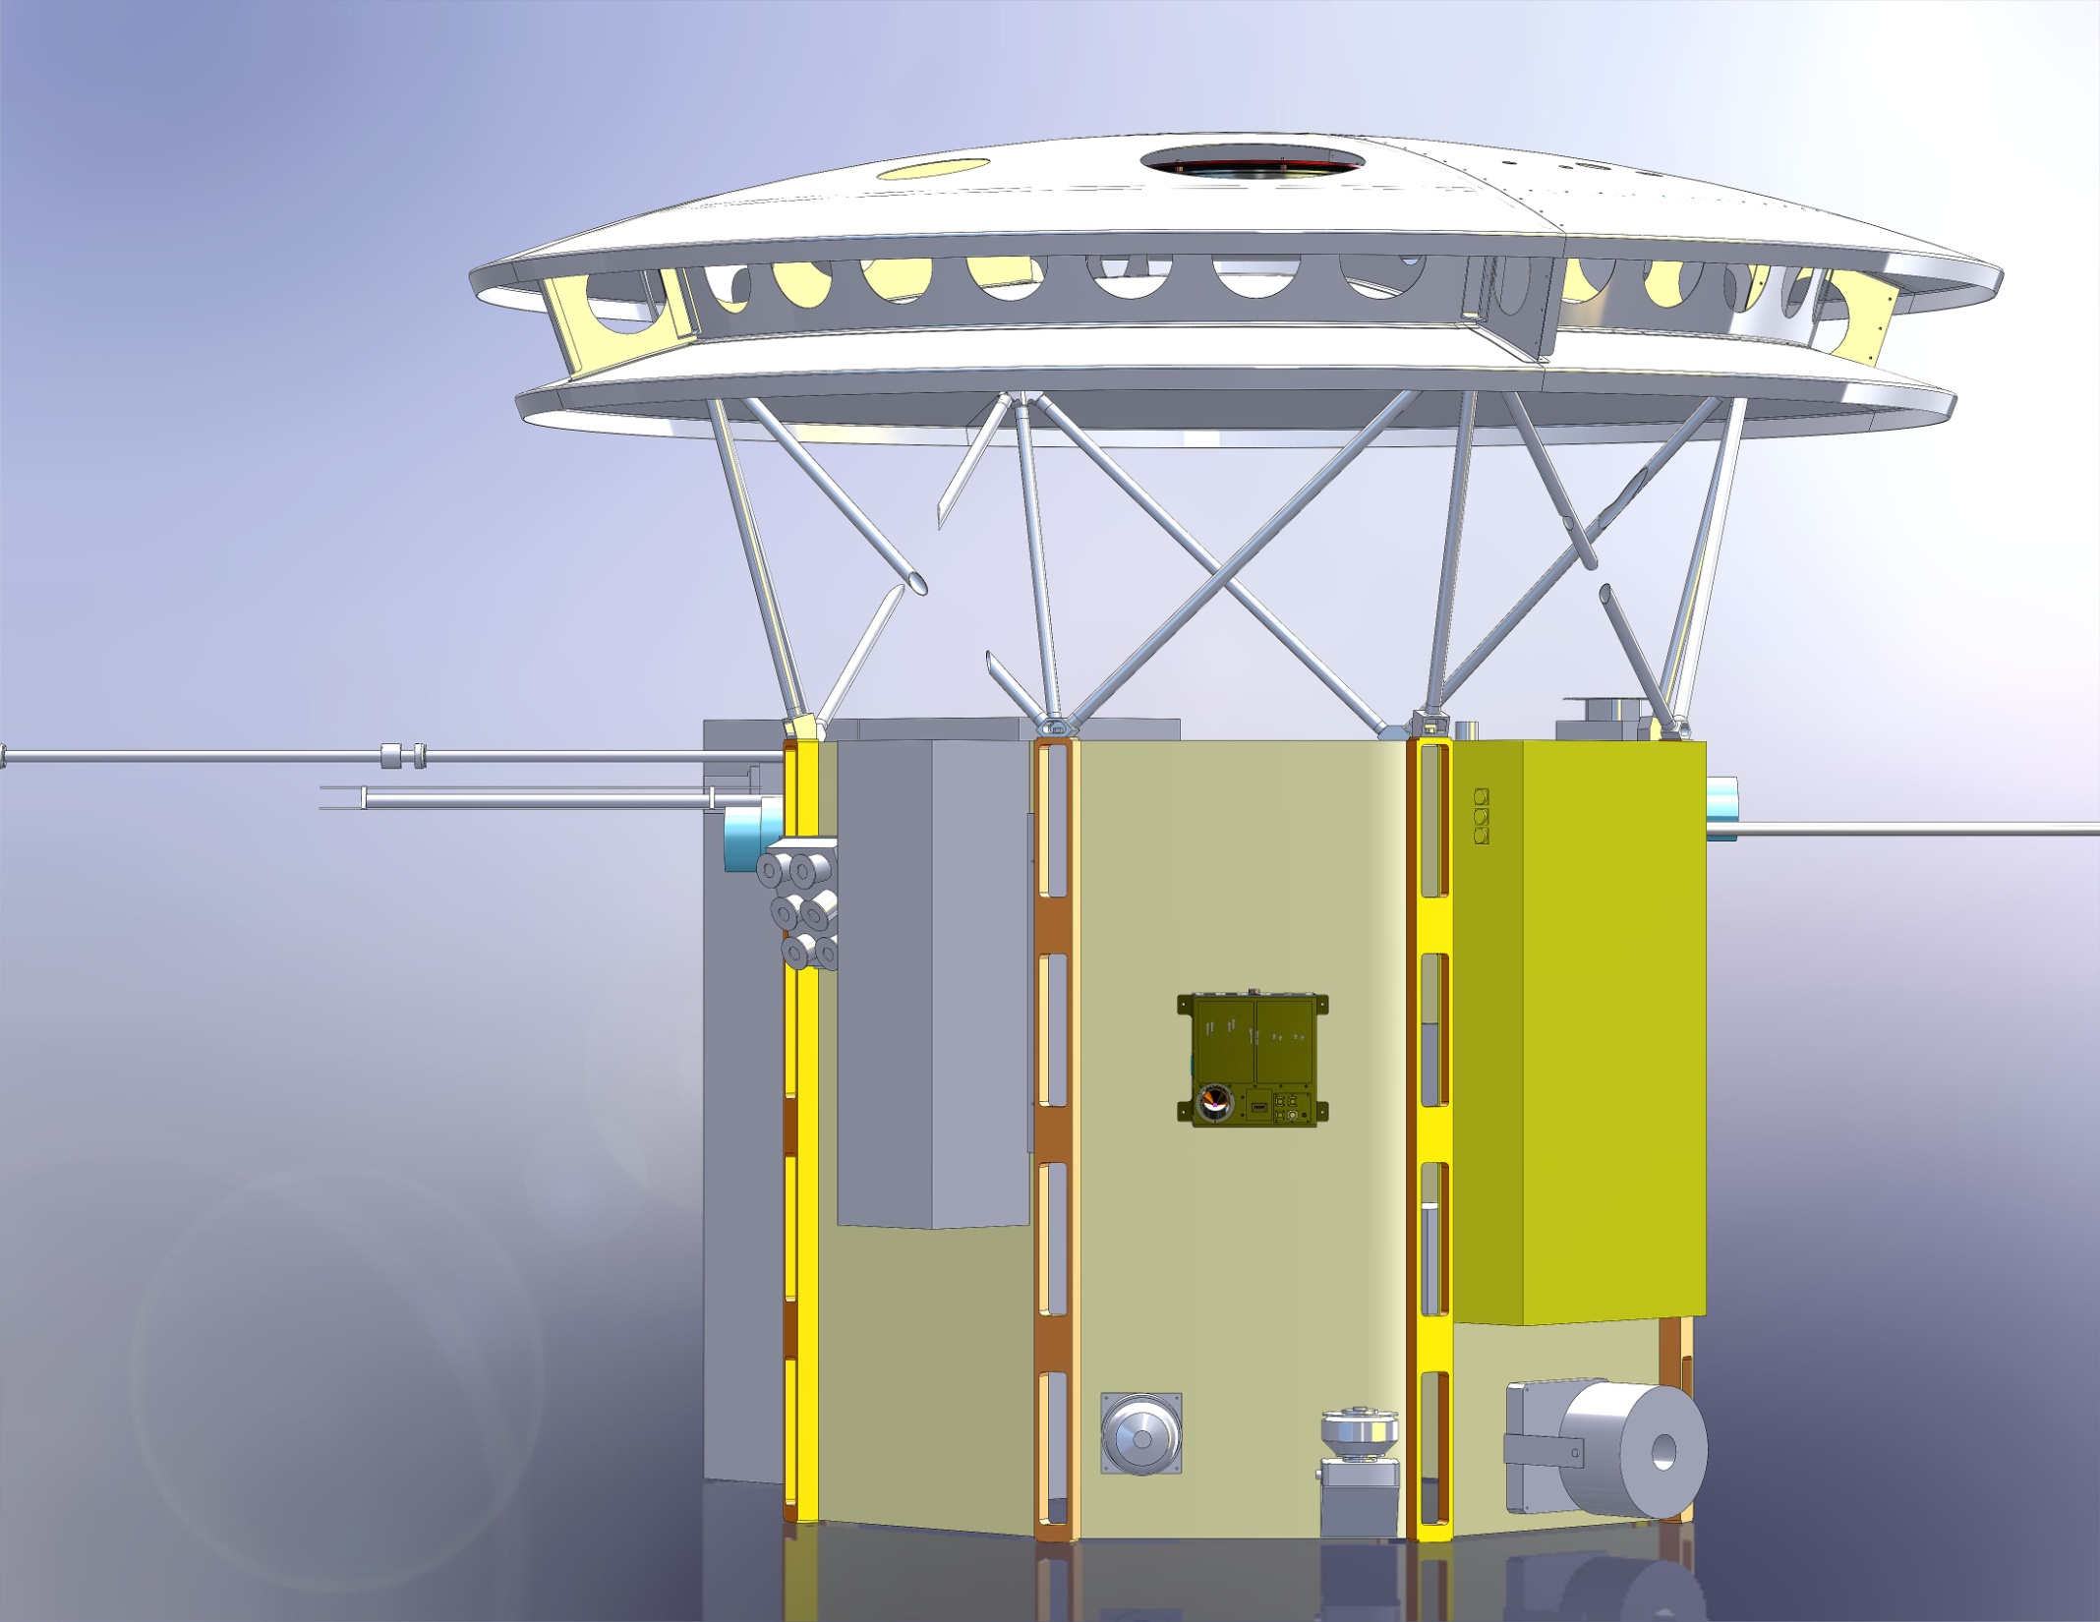
ChemiX on IHP
Large entrance window
11 CCD’s
Unit to detect particles
ChemiX
ChemiX

Slide 6
Subsystems of ChemiX
Particle detector (provides „own” instrument safety)
Issue flag to switch-OFF entire instrument or selected blocks in case of emergency (SEP, CME front passages)
Takes „standard” measurements of particle spectra otherwise
(Very) soft pin-hole CCD X-ray imager ~ 1 arcmin resolution
Detect pointing based on the limb-brightening ring - provides detailed pointing (few arcsec accuracy)
Localize ARs important in X-rays & follow their (separate) lightcurves
Identify flares within individual AR →provide target data to the pointed table
Internal Target pointing platform carrying all crystals & CCDs
Within second lock the spectrometer on target
Spectral atlas spectrometer
Takes spectra in the range 1.5-9 Å regularly within selected FOV on the disk. DGI depends on the intensity- statistically defined threshold say 10 000 counts in the spectrum
Provides spectral line & continuum intensities with unprecedented accuracy (2 x RESIK at perihelion)
Dopplerometer
Looks toward „differential” spectral line positions at the very high spectral resolution
Provides selected spectral line shapes at several points over the line profile
All spectra are being taken instantaneously at all wavelengths

Slide 7
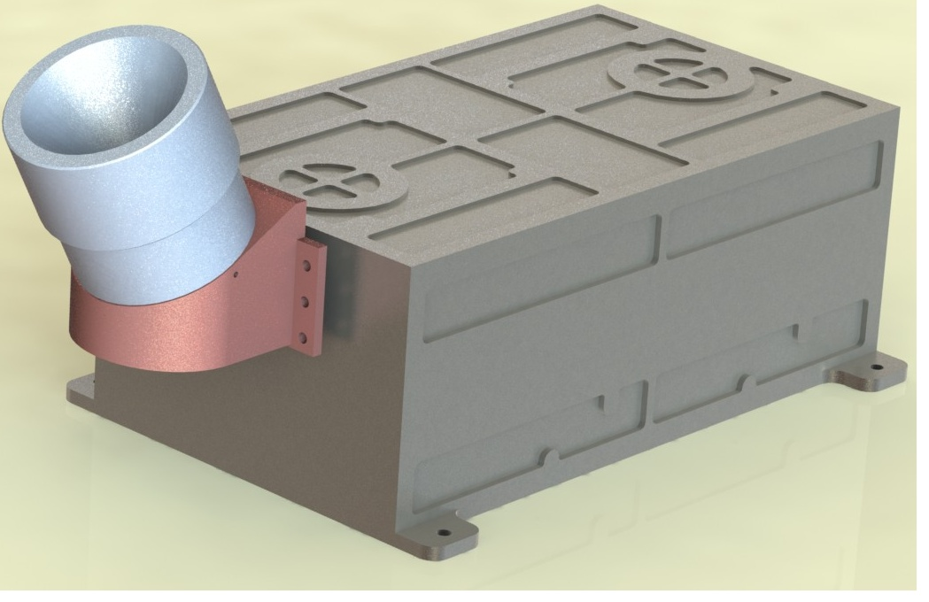

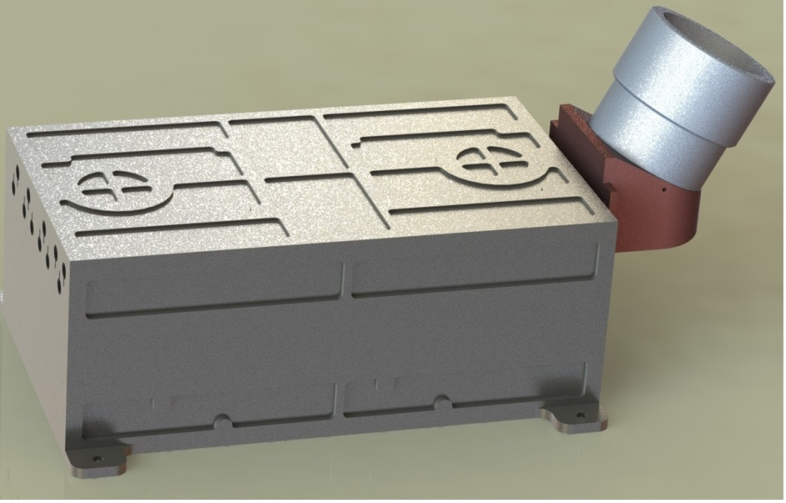
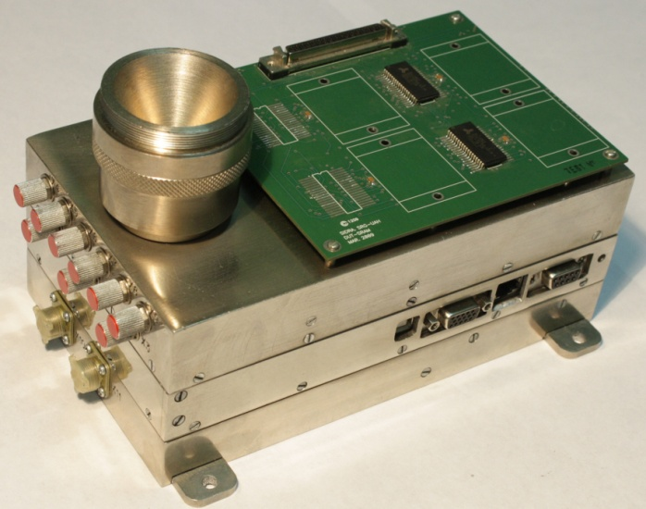
Background energy particle detector of ChemiX instrument
Kharkiv National University Group (dr. Dudnik)
Energy ranges of registered particles
№ | Particle sort | Energy range, MeV
1 | Electrons - е | 0.06 ― 2.4
2 | Protons - р | 1.2 ― 14
3 | Deuterons - d | 1.6 ― 18 (0.8 – 9 MeV /nucleon)
4 | Alpha-particles | 5 ― 52 ( 1.3 ― 13 MeV/nucleon)
Past inspected version of the breadboard model

Slide 8
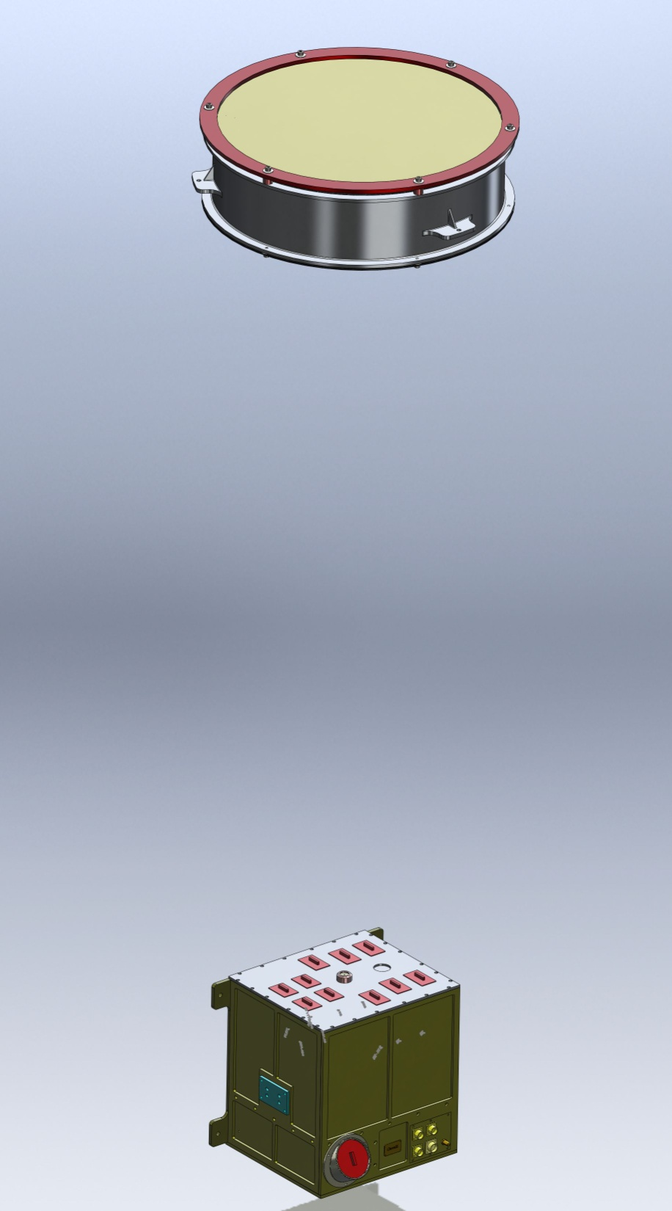
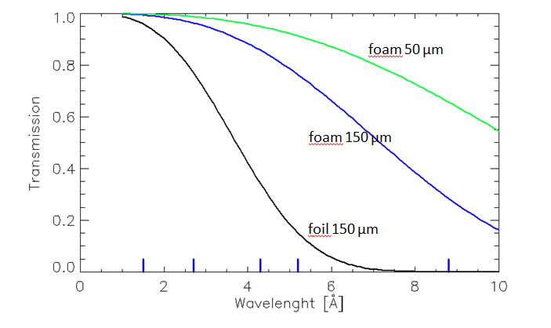
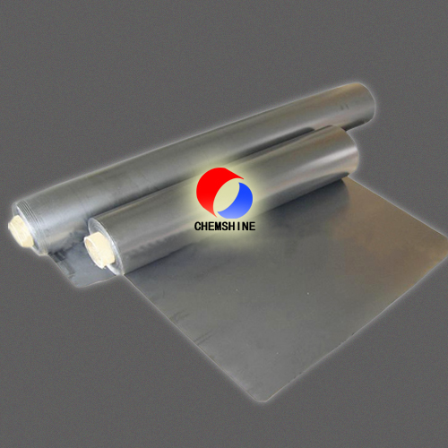
Entrance window – graphite foil/foam
http://www.chemshine.com/EproductShow.aspx?id=8
450mm
TUVF
Weight:
TUVF - 1.5 kg
MB - 4.5 kg
~2m
Technical Graphite foil can work at
-200 ÷ 650℃ air condition,
-200 ÷ 3000℃ vacuum or inert environment.
MB
280mm

Slide 9
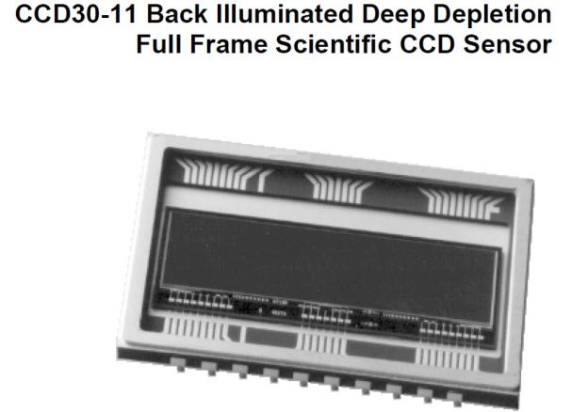
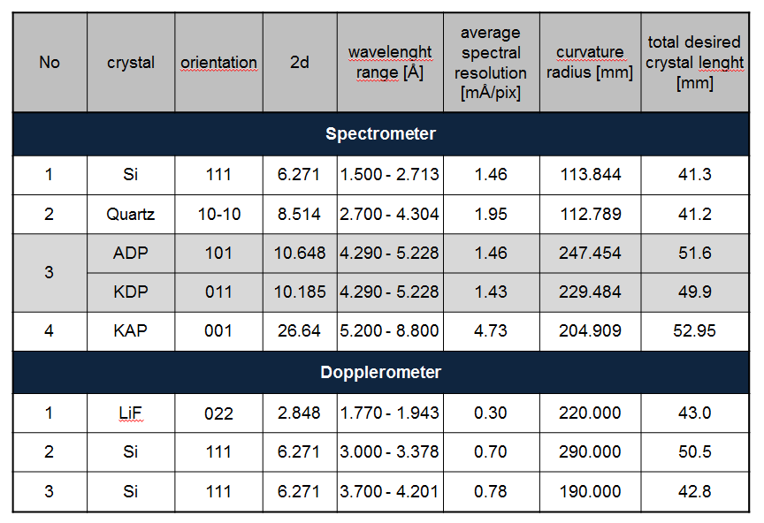
Detectors & crystals
11 identical units
Detectors - large enough to have sensitivity similar to RESIK on LEO
Crystals made of materials not contributing to fluorescence within the measurement region
E2V
1024 x 256 pixels
Image area 26.6 x 6.7 mm
Pixel size 26 x26 μm

Slide 10
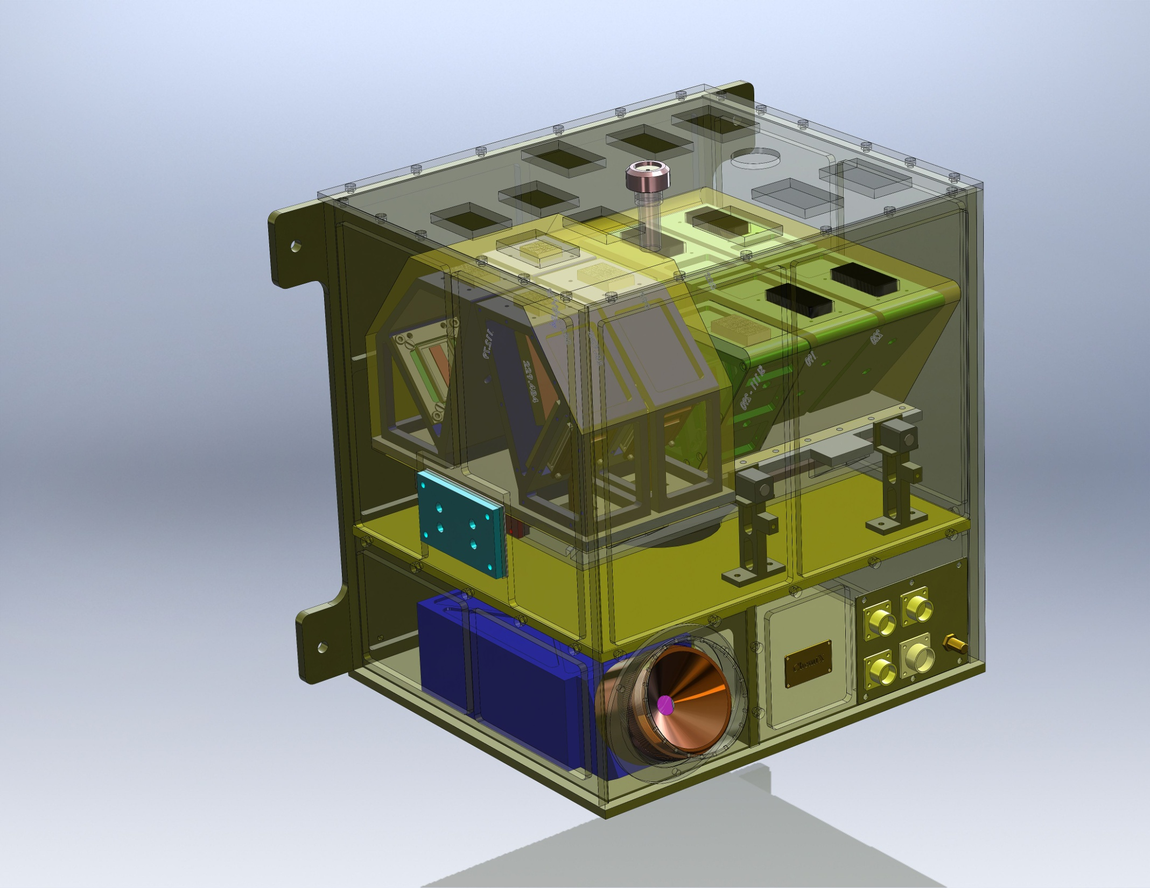
MB
Measurement Block
Pinhole collimator
Dopplerometers System
Spectrometers
System
Linear Solenoid
Actuator
CFI
Cold Finger Interface
Bonding Stud
Connectors
Micro-positioning
Table System
BPM
Background Particle Monitor

Slide 11
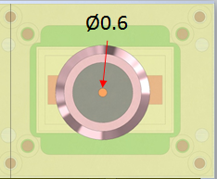
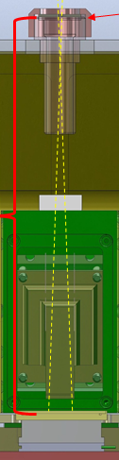
Pin-hole imager will observe also limb-brightening E ~0.5 keV
mm (SphinX D2)
CCD
Main functionalities:
Locate the solar disk within the orientation frame of S/C
Follow the brightness evolution of individual pixels/AR/Flares & detect flares
Provide coordinates of the target(s) to the pointing system of crystal-detector units (within IDPU) one pixel = 38 arcsec
At perihelium Sun diameter = 177 pixels (see the corona up to 5 – 7 solar radii above limb)
At aphelium Sun diameter = 42 pix
(early in the mission) At 1 a.u. Sun diameter = 54 pix Diffraction smearing at the CCD distance
for 5 A = ~ 8.3 um = 0.4 pixel for 10 A =~ 11.8 um = 0.5 pixel for 20 A =~ 16.7 um = 0,6
good for deconvolution & point source location (flares)
140 mm

Slide 12
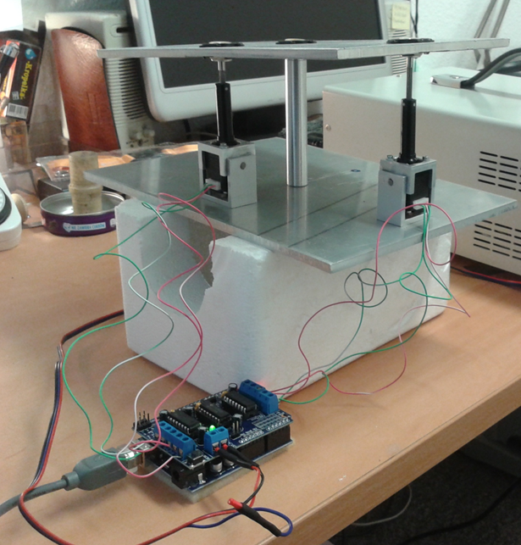
Pointed platform- provides fast (<1s) repointing within the area of 3° x 3°
Very lightweight & fast
Takes known coordinates of the source from on-board controller
Movie of the action available
Larger off-sets possible
Will be locked for launch

Slide 13
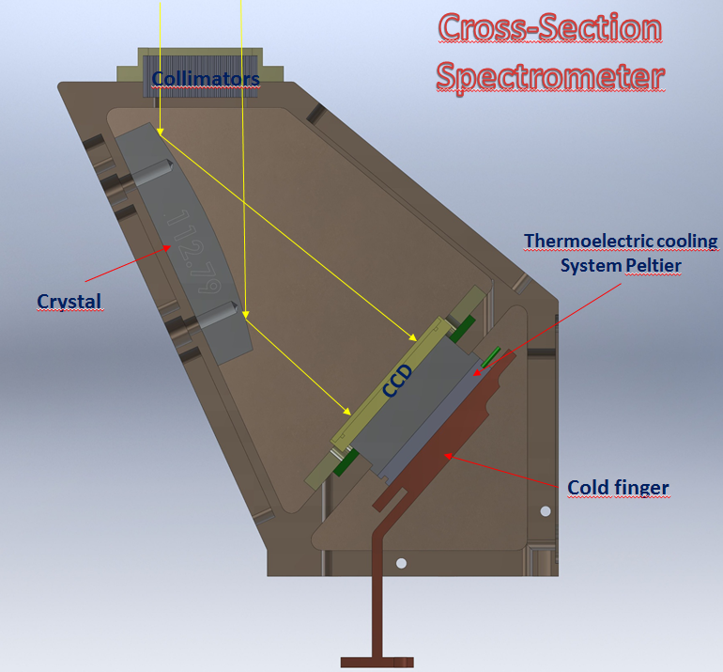
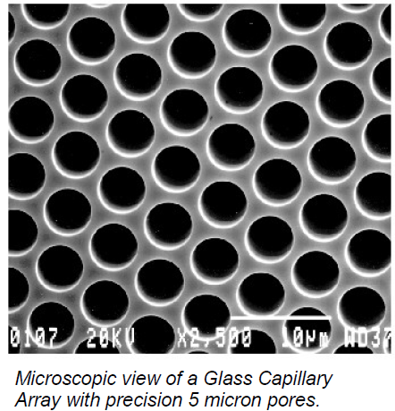
2D collimation with spectrometer capillary arrays
Motivation: limit the FOV to a single AR
Prevent spectral overlapping from multiple sources
Allow to study variability of line profiles

Slide 14
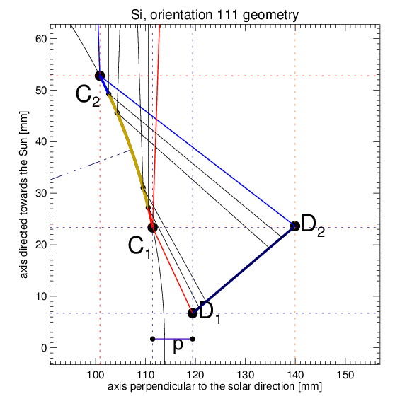
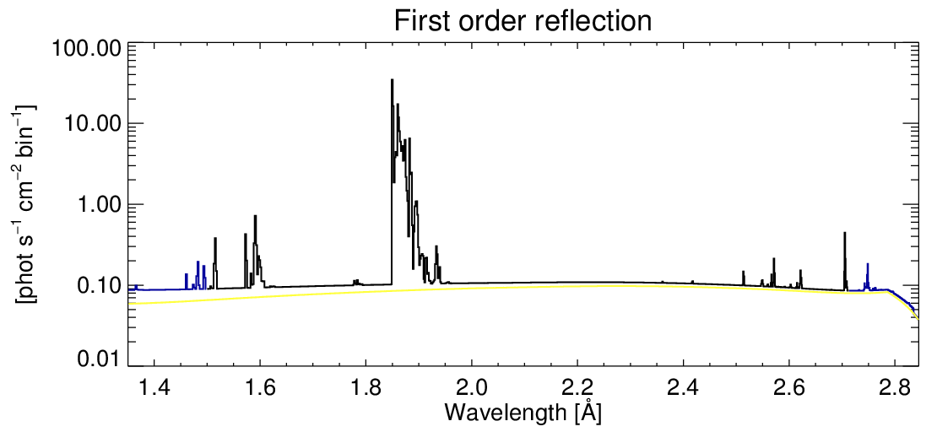
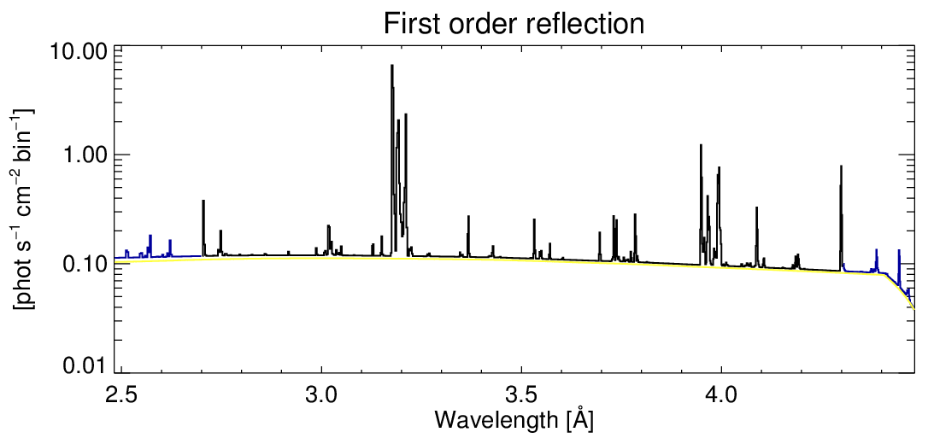
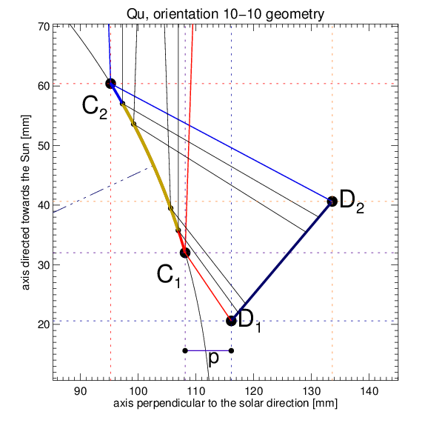
Crystal geometry & Synthetic spectra for 1st order reflection M5.5 flare 1a.u.
Rates to be multiplied by
a factor appropriate to actual
distance: up to 13 x

Slide 15
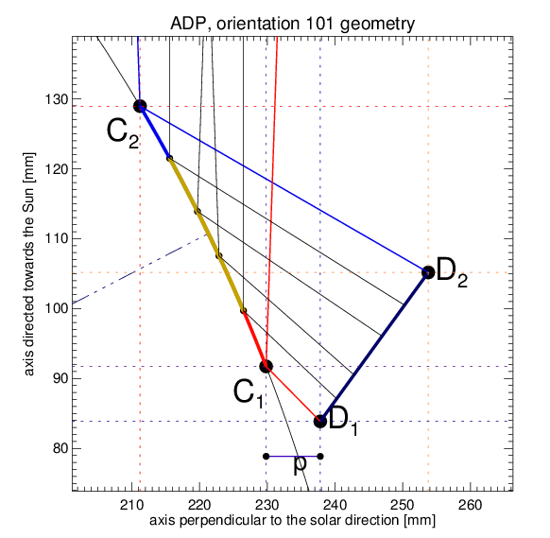
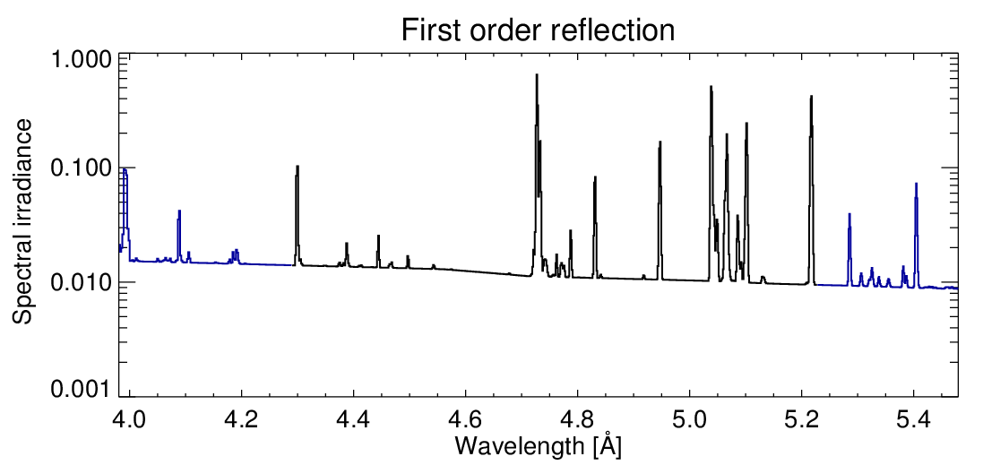
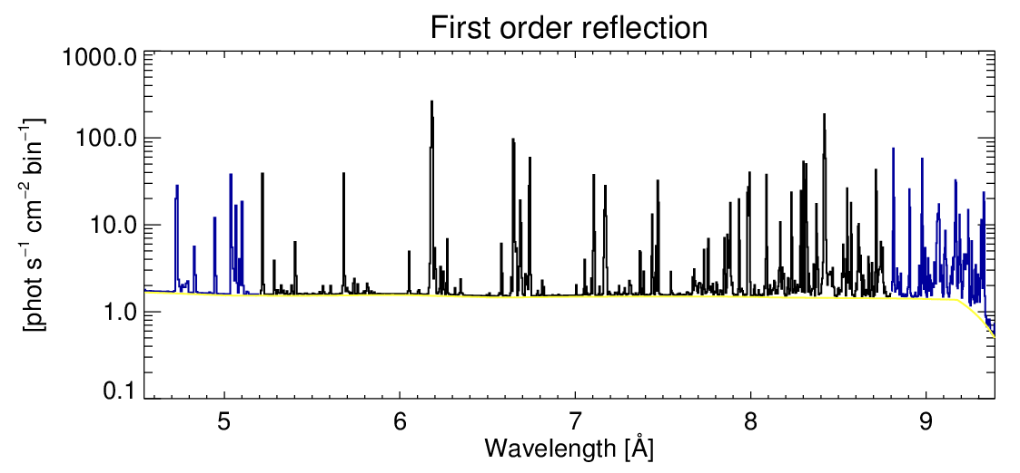
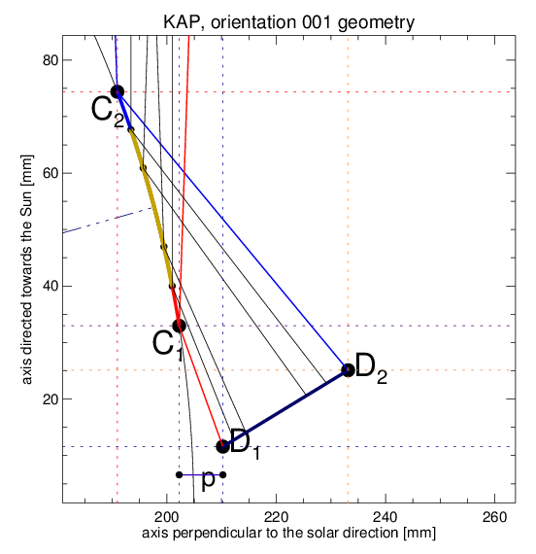
Crystal geometry & Synthetic spectra for 1st order reflection M5.5 flare 1a.u.

Slide 16
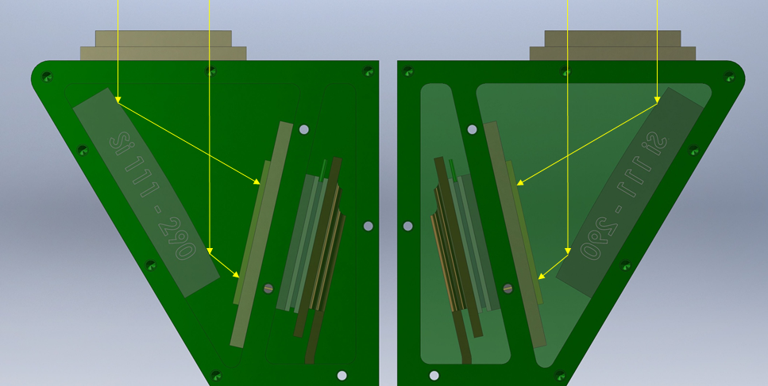
3 double sections of Dopplerometer
Lines selected:
Fe XXV T ~20 MK
Hot flare
Ca XIX T ~10 MK
Evaporated material
Ar XVII T ~4-5 MK
AR plasmas
Dispersion senses opposite
Identical crystals and detectors
This system allows to disentangle between transwersal and radial motions

Slide 17
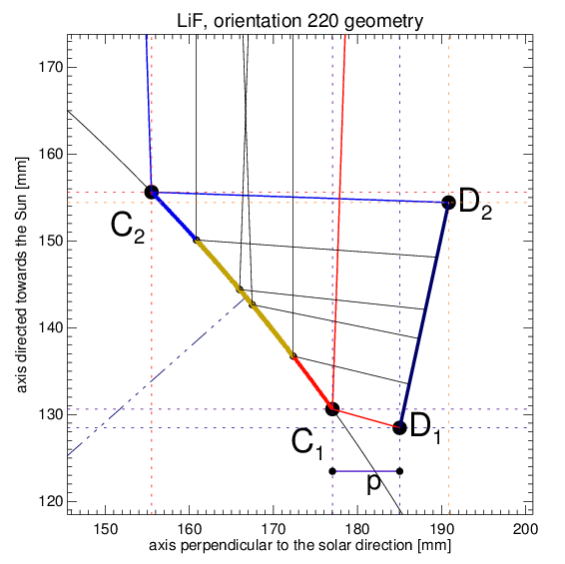
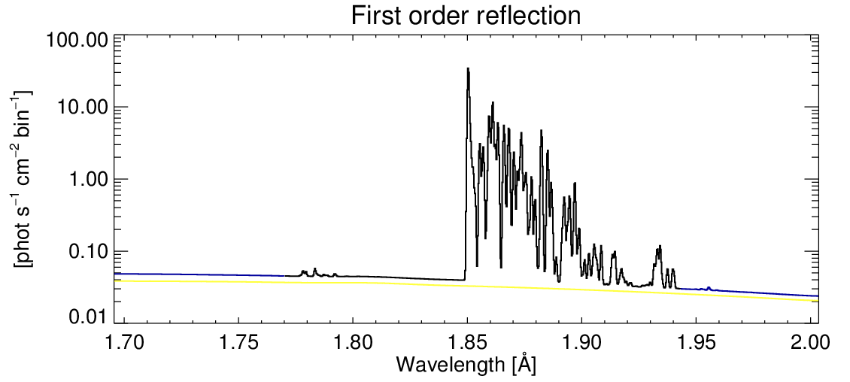
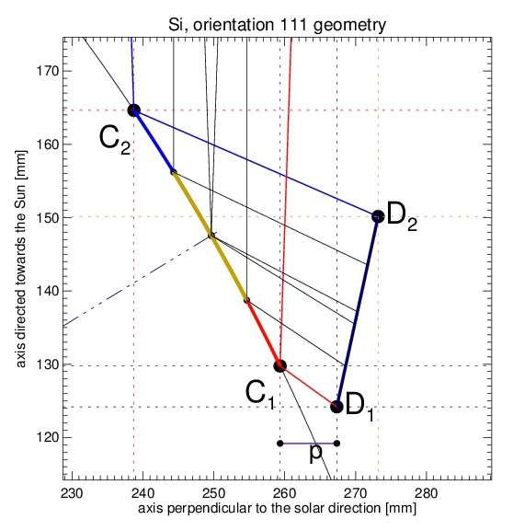
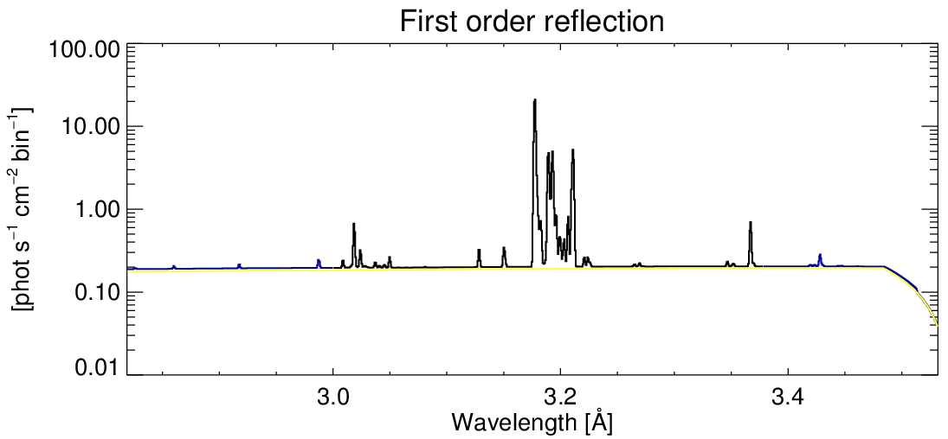
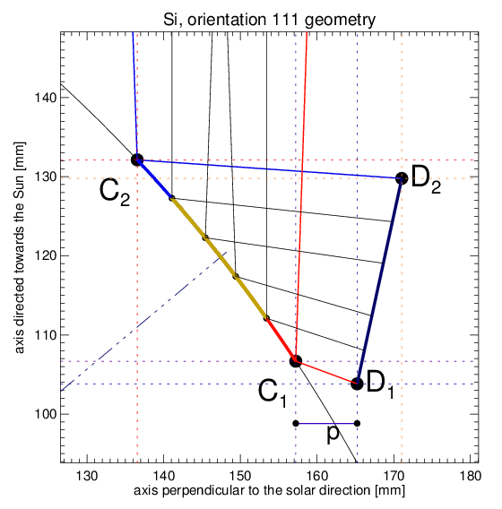
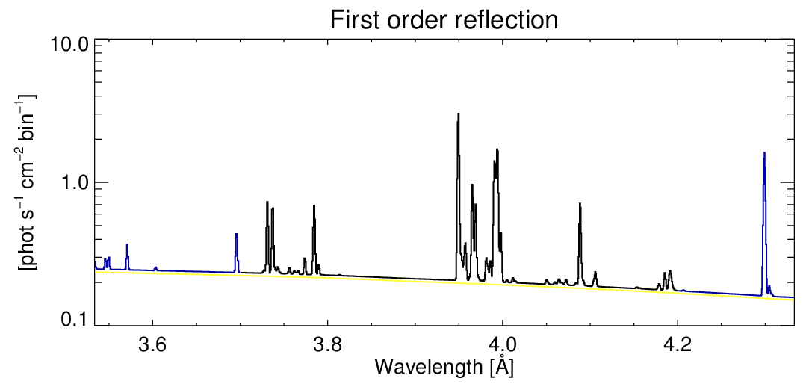
Wavelength ranges for Dopplerometer
Fe XXV T ~20 MK
Kα
Ca XIX T ~10 MK
Ar XVII T >4 MK

Slide 18
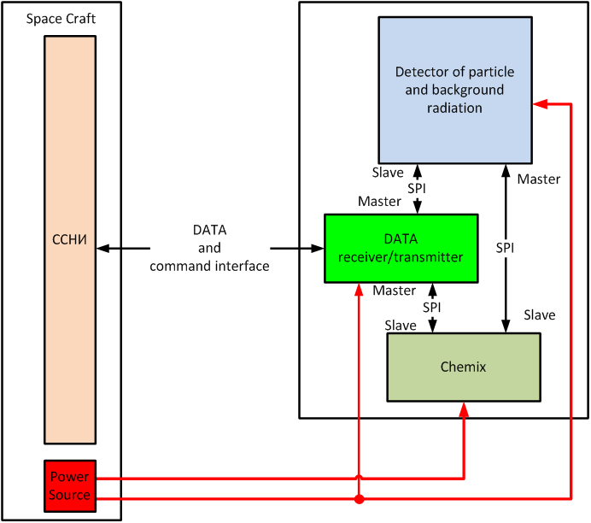
Electronics & logic
Particle monitor outcomes as the first defense for the instrument health.
Always on, except really dangerous particle intrusions detected internally by the IDPU.
Delayed S/C commanded reset brings spectrometer to life.

Slide 19
Instrument philosophy
Take measurements of soft X-ray spectra at the highest rate possible (every ~0.5 s)
Store the results into a large instrument internal data bank (256 GB)
Beam-down essential characteristics of measurements (lightcurves in selected spectral ranges), source coordinates
Downlink (when possible) „interesting” portions of data from the onboard memory

Slide 20
Collaborations possible
Crystals
Testing radiai of curvature & reflecting properties
BESSY II is envisaged
Simulations of non-classical flaring scenarios
Non- Maxwellian (kappa plasmas)
Transient ionisation plasmas
Abundance differentiation processes
Instrument end-to-end testing

