Slide 1
Wrocław Solar Physics Division report for 2013 (raport ZFS CBK) Janusz Sylwester
Staff: increase of the group, now 19 + ZK
Projects: new collaboration NASA + LASP Boulder
Main results:
AbuOpt,
Location of hotter plasma in non-active corona
Properties of particle environment
Plans for 2014 and forward: SOLPEX

Slide 2
Staff: 19 on permanent positions (av. 46 y) 4 below 35 y, 2 phd (SRC, IAUwr) + one PhD opened Warsaw Techical U.
Scientists: 2 x dr. hab., 4 x dr, 1 assistant, 1 phd student + 1 full professor
Engineering staff: 1 physicist, 1 mech. Constructor, 4 electronic/software + 2 modellers
Support: 2 (one hired last March only, after 2y negotiations with headquarters…)

Slide 3
Running grants:
ChemiX (Interhelioprobe) NCN funded,
lead: Marek Siarkowski, ends 2014
STIX (Solar Orbiter) NCN funded,
lead: Tomek Mrozek formally Janusz Sylwester, ends 2014
STIX PECS :
Wroclaw lead: Mirek Kowalinski, engineering part f unded in collaboration with SRC main body
RESIK (Coronas-F) NCN funded,
lead: Barbara Sylwester, ends, 2014
eHeroes (7FP),
lead: Szymon Gburek formally Janusz Sylwester, ends 2014
+ respective SPUB ends 2015 March
ISSI (Bern): Non-Equilibrium Processes in the Solar Corona and their Connection to the Solar Wind Team 276 ,
lead: Barbara & Janusz Sylwester

Slide 4
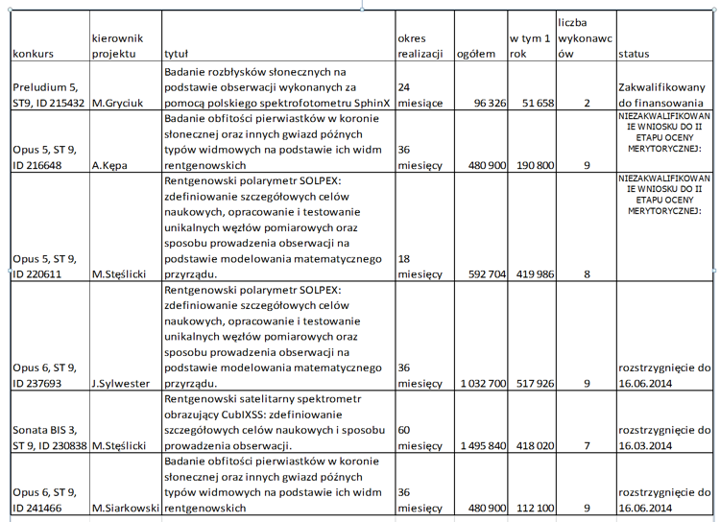
New grant application submitted:

Slide 5
Data under present analysis:
Our:
RESIK – 20 % of good flare spectra analysed (out of 2mln) http://www.cbk.pan.wroc.pl/experiments/resik/RESIK_Level2/index.html
DIOGENESS- FITS database created (Eheroes)
SphinX – list of events (Eheroes)
NASA:
Messenger XRS, soft X-ray spectra
Hinode XRT, soft x-ray images
RHESSI hard x-ray spectra & images (good understanding)
Russian measurements of particle environment
Skobeltsyn Institute (MGU)

Slide 6
International collaborations:
Russia:
IZMIRAN: Coronas-F: RESIK, CHEMIX
FIAN:
Coronas-F data,
RESPECT Spectrophotometr,
SOLPEX-KORTEZ,
Skobeltsyn Institute (MGU), RESIK particle data
Czech Rep.:
AI CAS: Diogeness
Italy
AO Palermo: SphinX data analysis, PH modelling
Ukraine:
Kharkiv University: SphinX particle data interpretation, ChemiX particle detector unit
UK,
UCL :RESIK data interpretation
Poland:
AI WrU: common data interpretation, PH modelling
STIX collaboration
CERN (Patras Consortium): SphinX & XRT in Axion detection context

Slide 7
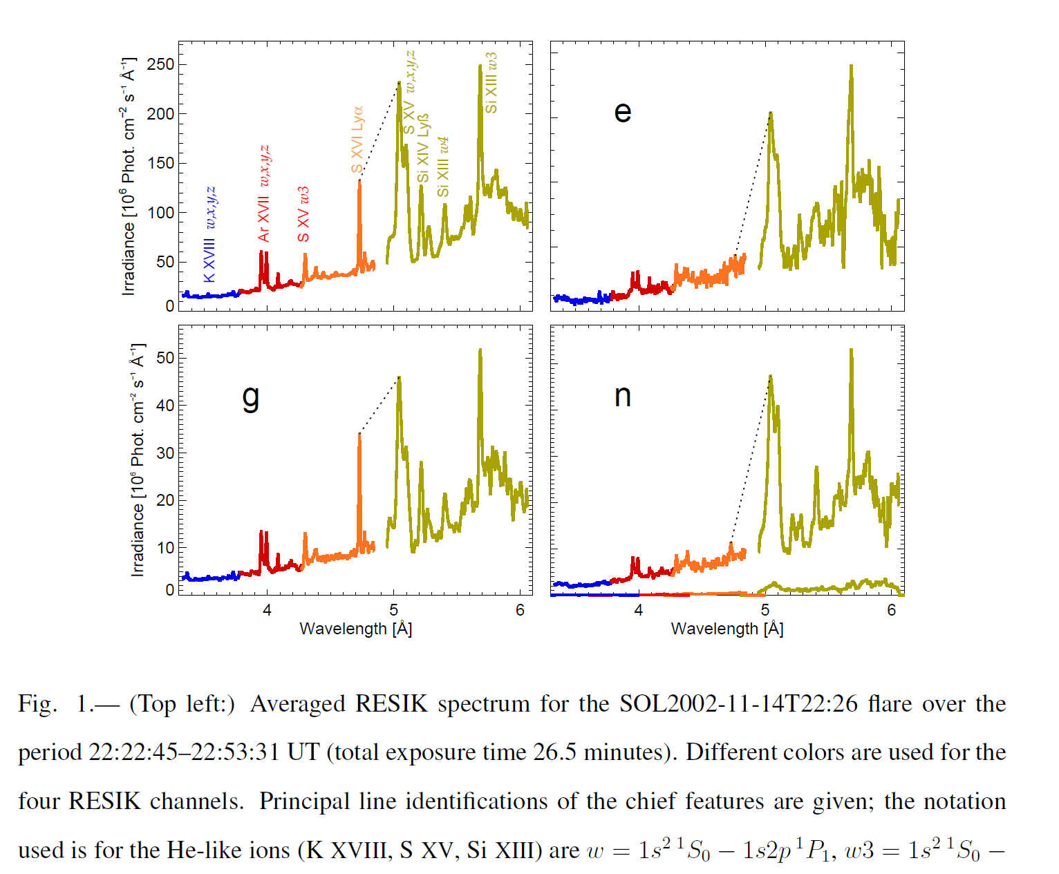
RESIK data analysis results (Barbara & Janusz Sylwester)

Slide 8
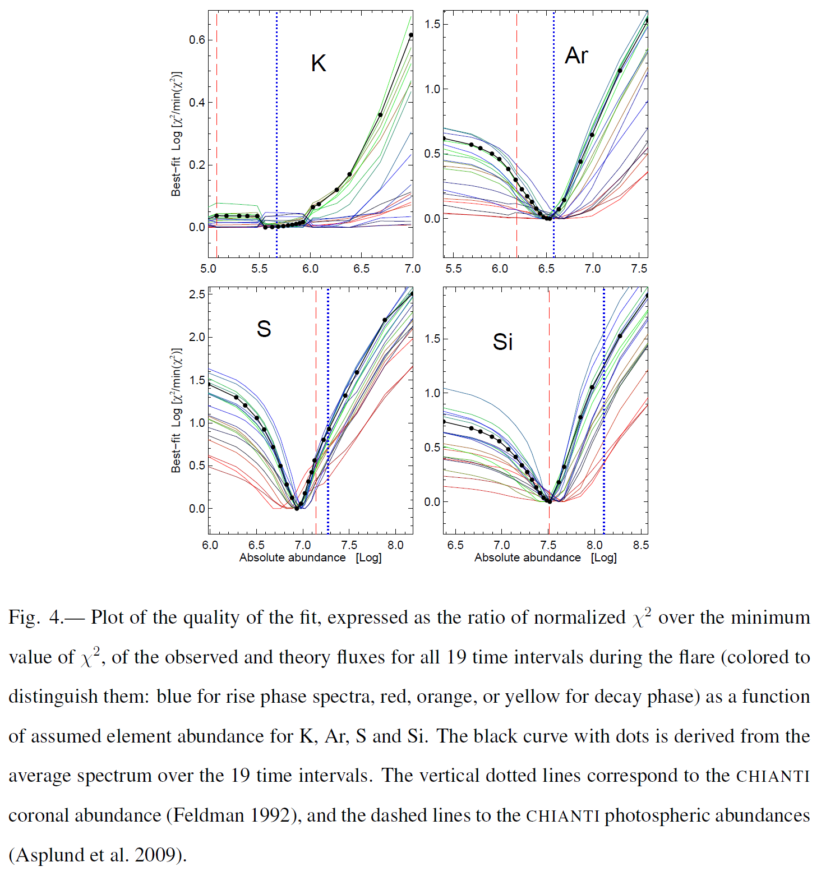
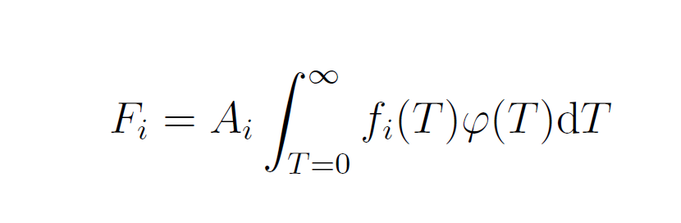
AbuOpt essentially new approach & tool

Slide 9
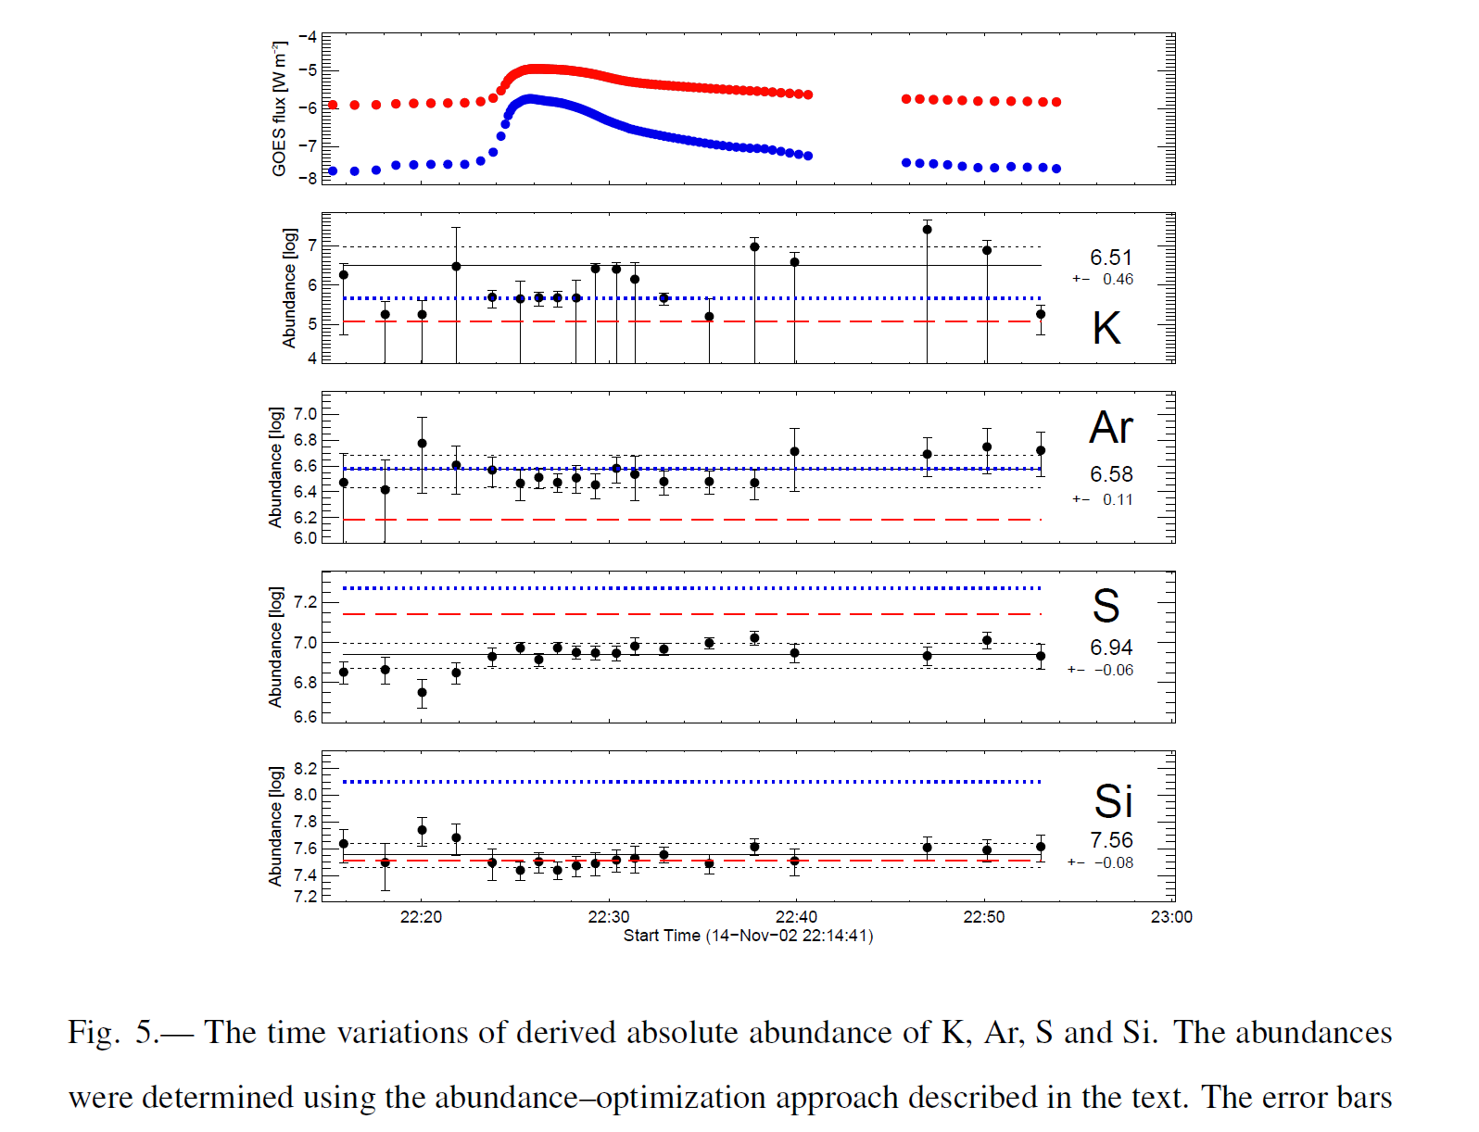
That allows to study time-dependence of plasma composition

Slide 10
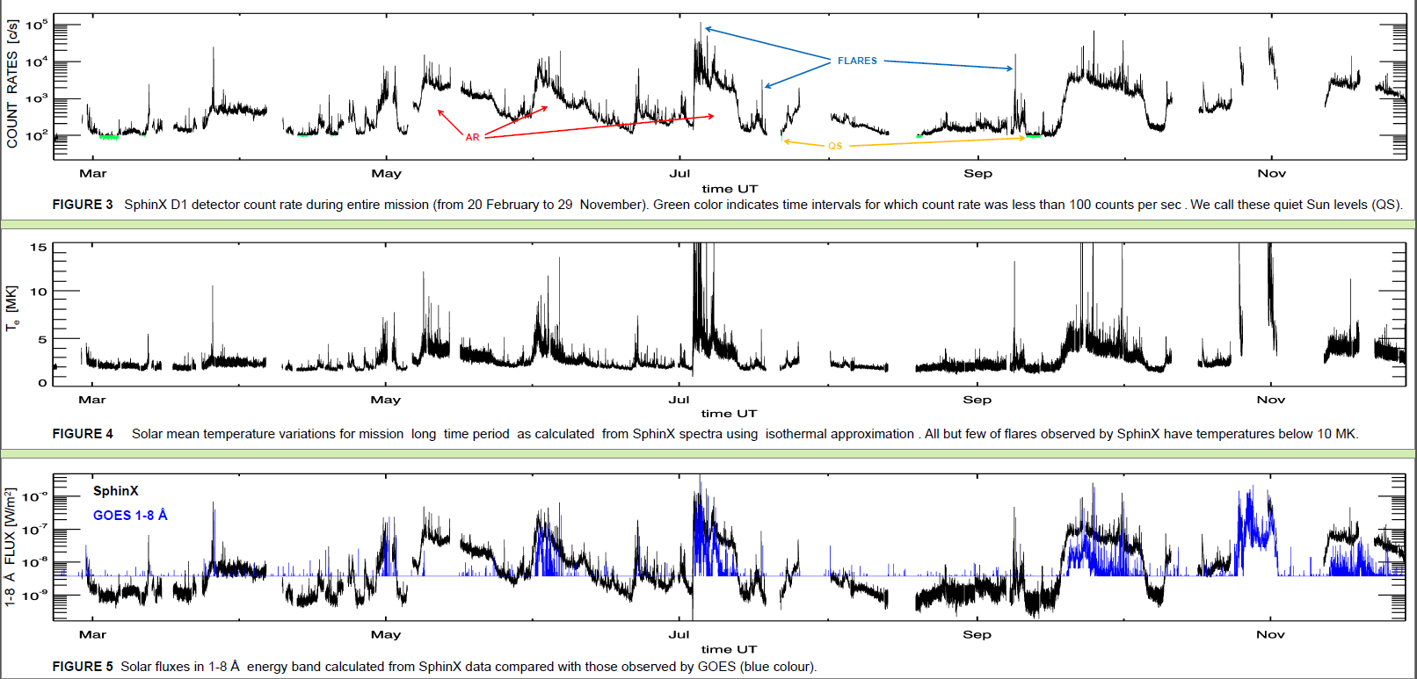
SphinX: zapis poziomu pr. rentgenowskiego w głębokim minimum aktywnosci ~2 mln widm
2009

Slide 11
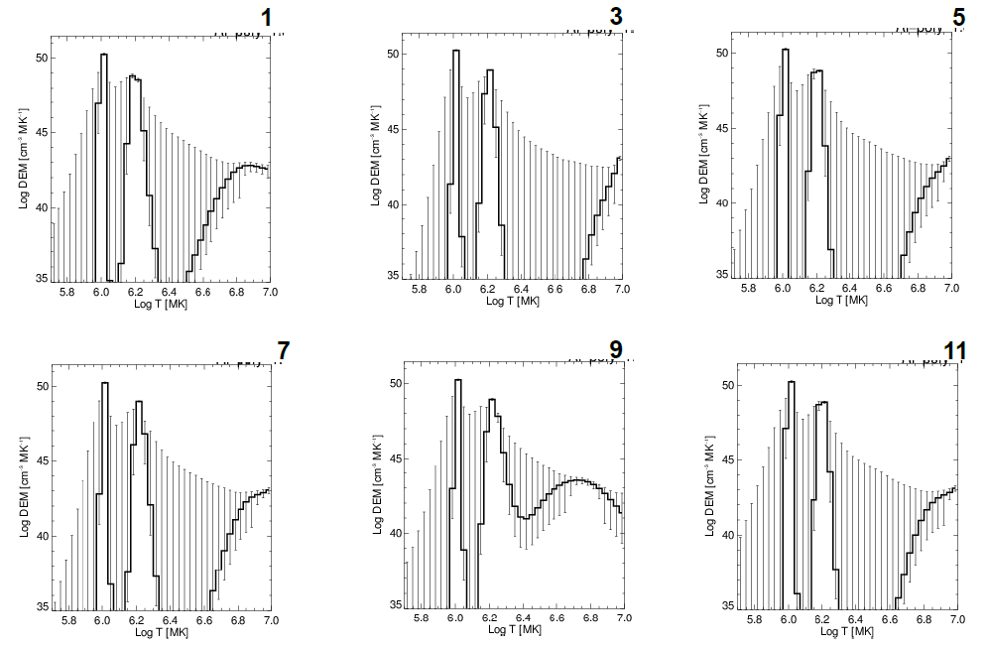
Combination of SphinX & XRT observation: 3 components on EM @ various times at the minimum level of activity

Slide 12
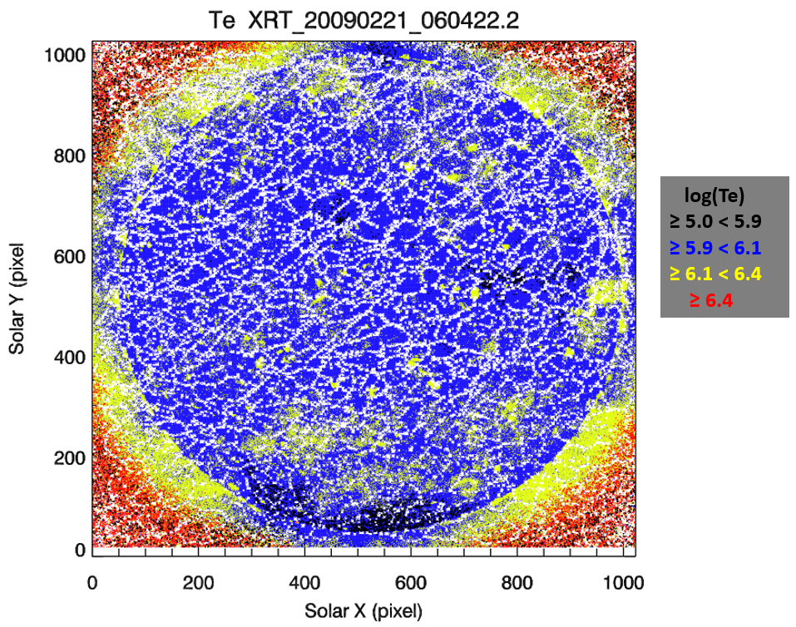
XRT filter ratio analysis results (Marek Siarkowski) under consideration for Nature

Slide 13
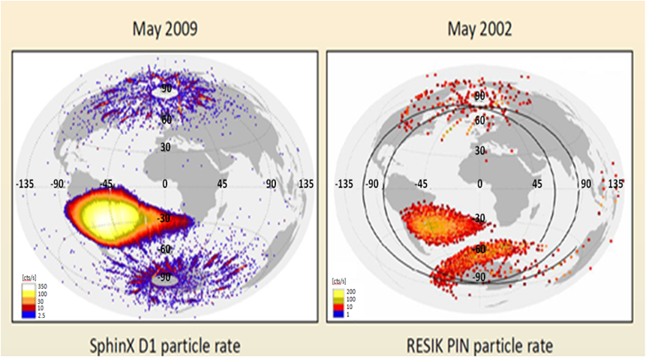
Particle environment on polar orbits (Kowalinski, Podgorski, Gburek)

Slide 14
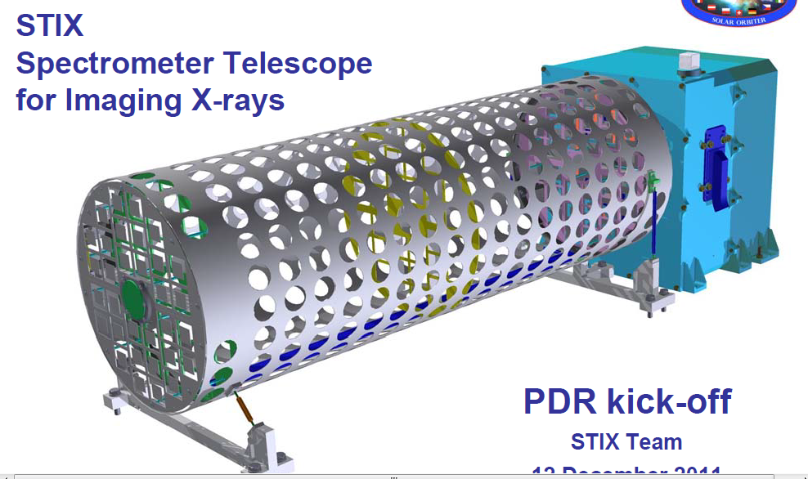
STIX for Solar Orbiter
4 kg, 4 Watt
400 bits/s
~1 m

Slide 15
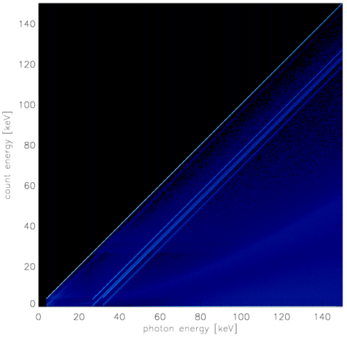
Enineering & Hardware modelling
STIX:
EGSE – to be used for testing at various test places and test beds, contains cold finger simulator & power supply
DSS (data simulator system)- to be used for IDPU & overall response tests- the most advanced simulator designed for X-ray studies: 320 channels, will access collection of data generated for a number of artificial sources
Geant4 modelling of detectors → important upgrade of the software environment for STIX: the instrument matrix response

Slide 16
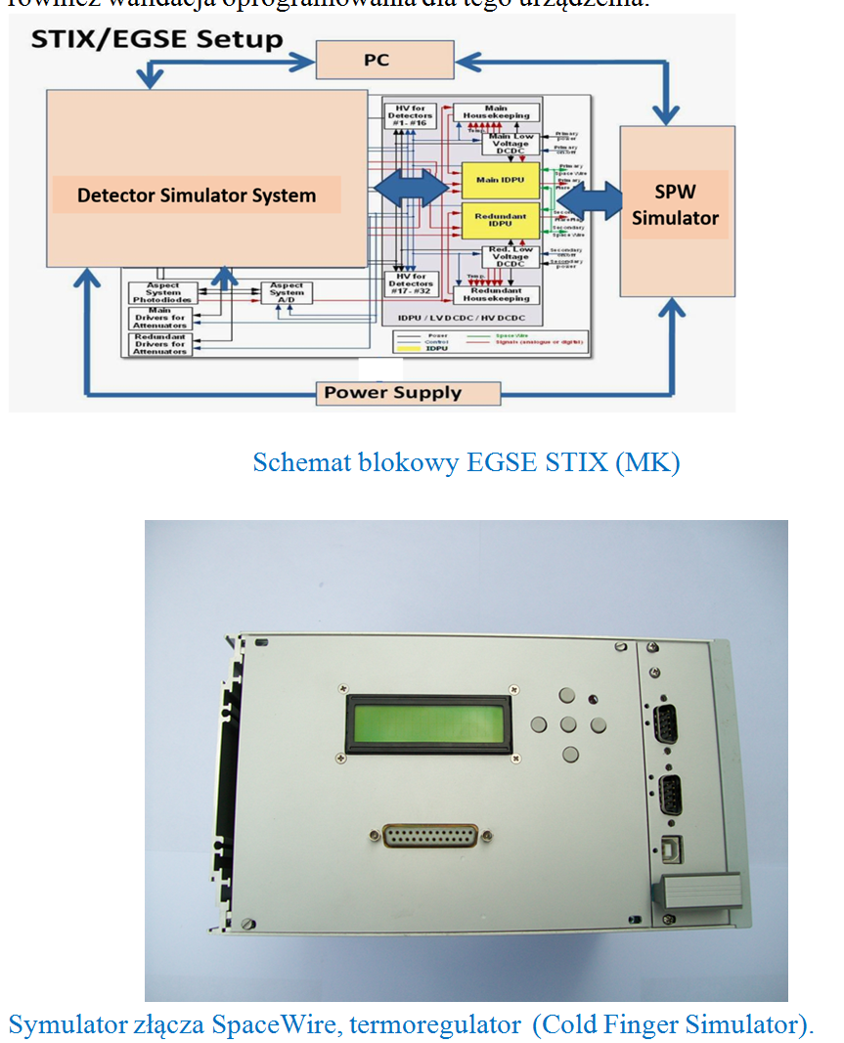
EGSE for STIX (ESA) (Mirek Kowalinski)
To be used on every important step of subsystem and instrument tests. (PL, CH, DE, CZ)
Provide access/control to subsystems & data as coming from telemetry

Slide 17
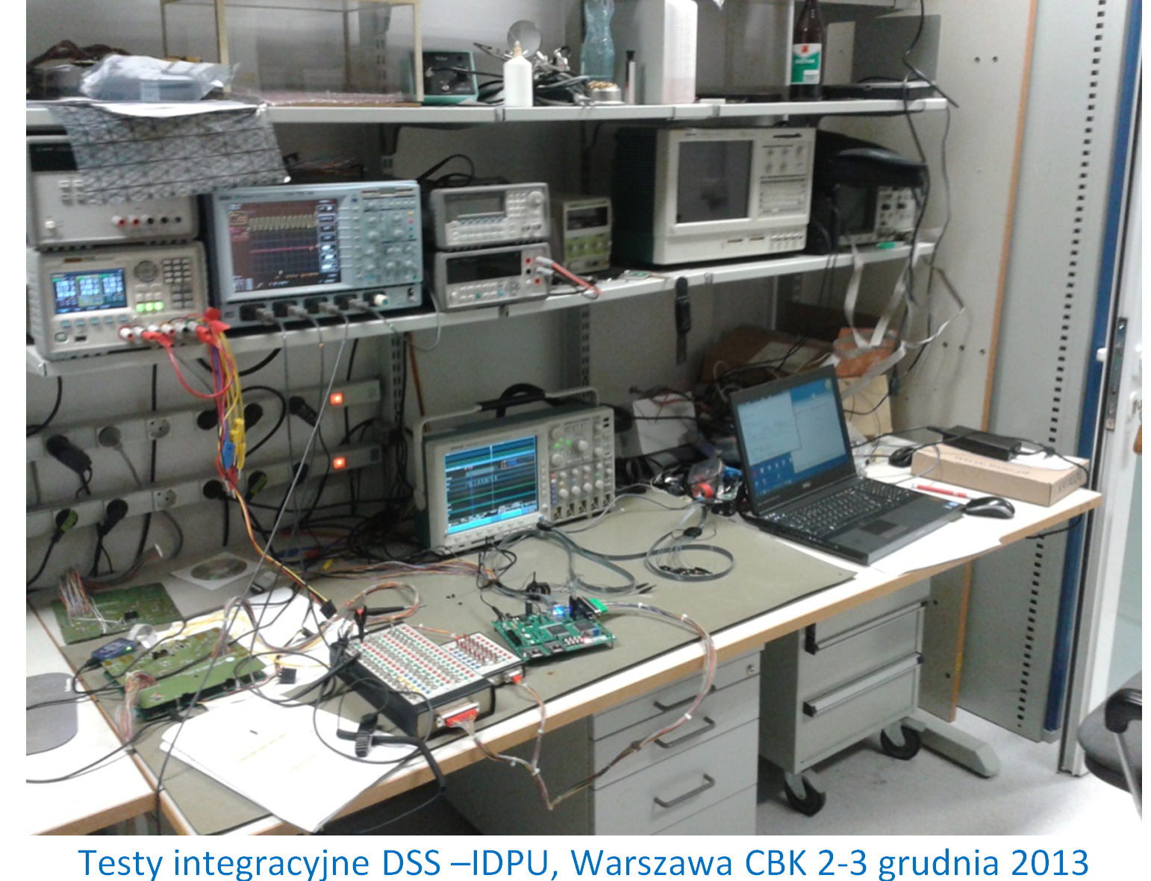
Hardware: Detector Simulator system (STIX)

Slide 18
Overall summary for 2013
Papers Published:
Ranked journals (filadelfijskie) – 12
Other international – 3
Submitted - 5
Presentations:
Invited: 5
Oral: ~30
Posters: see outside
International Conferences – 2
Technical documentation – 7 (Eng. Rus. 500 pages)

Slide 19
Plans:
STIX (2017) and ChemiX (2020) as the most important activity of the Wroclaw Team in strong collaboration with Warsaw engineering staff
Diogeness & RESIK + HXT & RHESSI data interpretation as a main source of publications (ApJ class):
SOLPEX on ISS as a testbed of science principle and new technology (2015): X-ray polarisation & non-equilibrium effects
RESPECT (FIAN collaboration, 2015) – unusual use of CCD’s for X-ray event timing
CubiXSS- prospective collaboration with US GSFC and LASP (Boulder) laboratories
AI UWr- flare hydrodynamic modelling using PH code

Slide 20
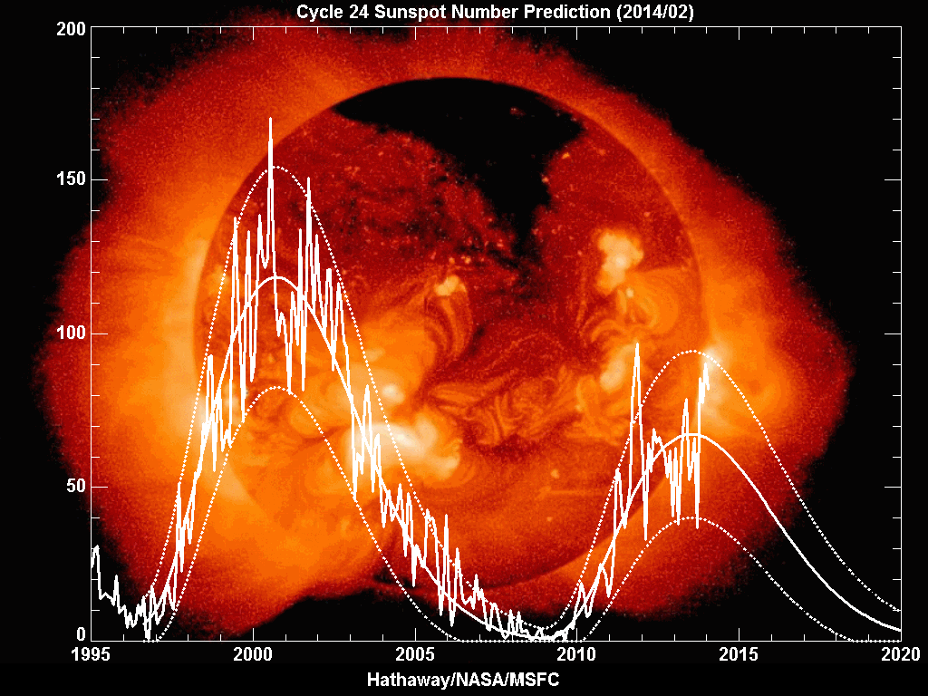
Rozkład jazdy
RESIK
STIX CHEMIX
ChemiX
SOLPEX
Solpex
STIX
SphinX

Slide 21
Podsumowanie
Dziękuję za uwagę
ZFS w ramach CBK ma „pełen portfel” projektów w zakresie rentgenowskich badań Słońca
Finansowanie projektu STIX wydaje się zagwarantowane, teraz poprzez PRODEX? Starac się będziemy w NCN o nowy grant
Finansowanie SOLPEX – czekamy na decyzje
budowane są spektrometry na rosyjskie misje
Respect
Będziemy powtarzac inicjatywe CubIXSS z USA

