Slide 1
Low energy payload of
Solar X-ray Spectrometer (SOXS) mission:
instrument description and first results
Dr. Tomasz Mrozek
Astronomical Institute
University of Wrocław

Slide 2
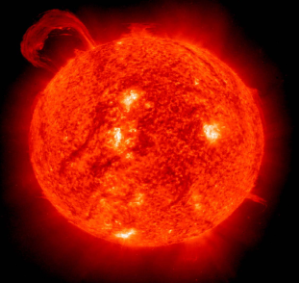
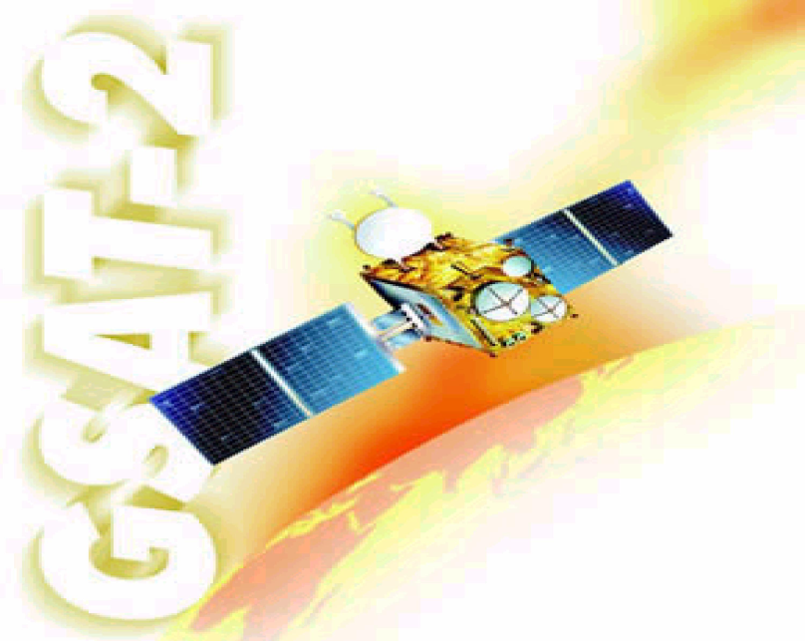
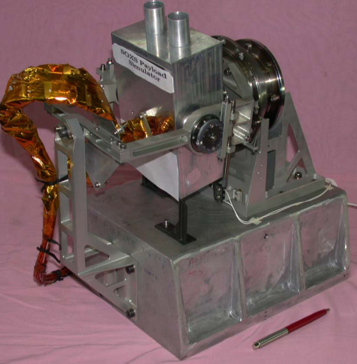
Solar X-ray Spectrometer (SoXS)
First Indian space-borne solar
physics experiment
Launched on 8 May 2003 by
GSLV-D2 rocket
„Payload of opportunity” onboard the
geostationary satellite GSAT-2
It is composed of two independent
modules:
- SOXS Low-energy Detector (SLD)
- SOXS High-energy Detector (SHD)
T. Mrozek Wrocław 31.05.07 First SphinX Workshop

Slide 3
The SLD module
Consists of four subsystems:
- Low Energy Detector (SLED)
- Sun Tracking Mechanism (SSTM)
- Low Energy Processing
Electronics (SLE)
- Common Electronics (SCE)
T. Mrozek Wrocław 31.05.07 First SphinX Workshop

Slide 4
The SLED package
SOXS Low Energy Detector package:
two solid state detectors – CZT and Si PIN
(hermetic TO-8 package
from AMPTEK)
collimators – aluminium nickel tubes
filters – Be windows plus aluminium
and kapton polyamide to cut
photons below 4 keV
T. Mrozek Wrocław 31.05.07 First SphinX Workshop

Slide 5
The SLED package
Characteristics | CZT | Si PIN
Material | Cadmium-Telluride crystal doped with zinc | N type silicon wafer doped with P type material
Size | 5 mm x 5 mm x 2 mm | 3.6 mm x 3.6 mm x 0.3 mm
Collimator (3.4◦ FOV) | 81.5 mm | 56 mm
Be window thickness | 0.25 mm | 0.025 mm
Energy range | 4-60 keV | 4-25 keV
Energy resolution | 1.2 keV at 5.9 keV | 700 eV at 5.9 keV
Dark counts | < 5 x 10⁻³ cts s⁻¹ at 10 keV < E < 1 MeV | < 3 x 10⁻³ cts s⁻¹ at 2 keV < E < 150 keV
Operating voltage | 300-400 V DC | 100 V DC
Operating temperature | -30◦C to -10◦C | -30◦C to -10◦C
Pedigree | Never flown in space | Flown on Mars Pathfinder
T. Mrozek Wrocław 31.05.07 First SphinX Workshop

Slide 6
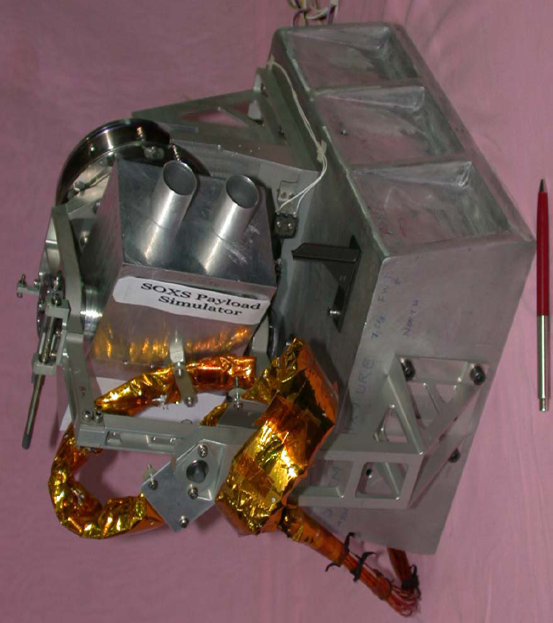
The SSTM package
SOXS is a payload of opportunity
mounted on the anti-earth view
side of the spacecraft.
Sun tracking mechanism is needed
since the FOV is limited
It have single drive module
which enables tracking in both
right ascension and declination
Observations are possible each
day between 3:40 UT and 6:40 UT
T. Mrozek Wrocław 31.05.07 First SphinX Workshop

Slide 7
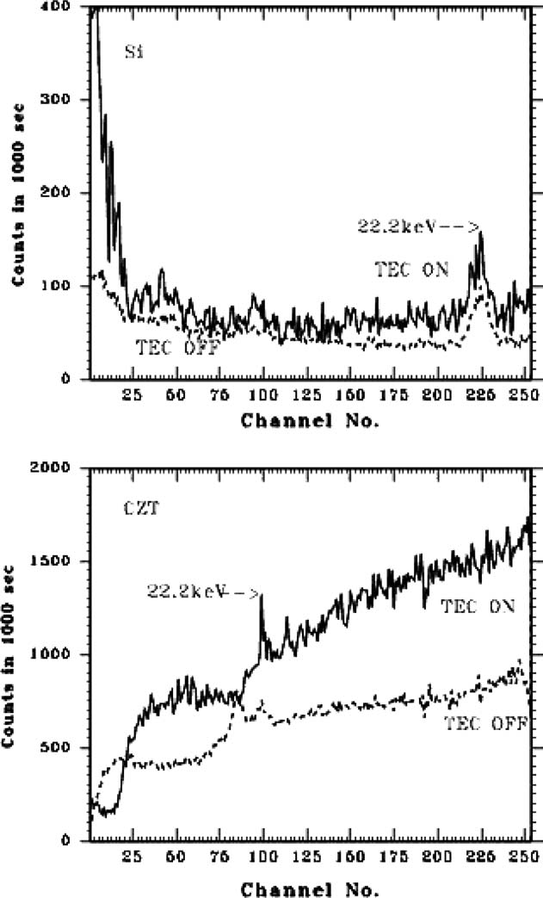
In-orbit calibration
Onboard radioactive source :
Cd¹⁰⁹ emitting lines at 22.2 keV and 25 keV
Thermoelectric cooler (TEC) ON and OFF
Temperature of the detectors: -15 and -25◦C
Si PIN shows 22.2 keV line irrespective of TEC
ON or OFF condition
The CZT shows a shift of 14 channels as
the TEC is ON
This anomaly reduces the dynamical range
of CZT. It is now 4-56 keV instead of 4-60 keV
T. Mrozek Wrocław 31.05.07 First SphinX Workshop

Slide 8
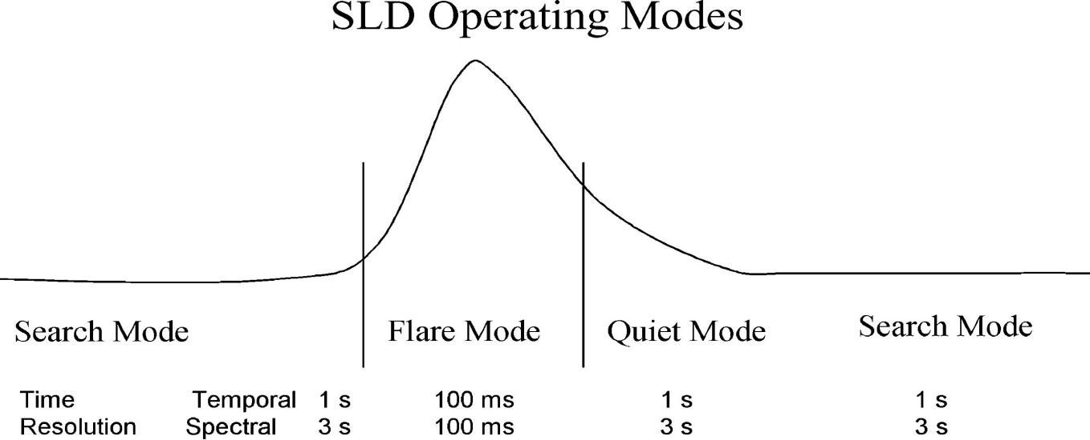
SLD operating modes
Survey Mode – observes preflare background used further for determinig the
threshold for flare trigger. Usually the threshold is equal to 5 times
measured background in two energy windows: 10-20 keV (Si)
and 20-30 keV (CZT)
Search Mode – observations in these energy windows are made with 100 ms
cadence but are recorded every 1 s.
T. Mrozek Wrocław 31.05.07 First SphinX Workshop

Slide 9
SLD operating modes
Flare Mode – is turned on when five consecutive 100 ms observations in any of
energy window exceeds the threshold. This mode lasts 287.5 s.
Observations are recorded with 100 ms cadence.
Quiet Mode – turned on after flare mode. Lasts 2274 s. Observations are made
with cadence 1 s (temporal data) and 3 s (spectral data). These
limitations are due to the limited onboard memory and
telemetry rate.
T. Mrozek Wrocław 31.05.07 First SphinX Workshop

Slide 10
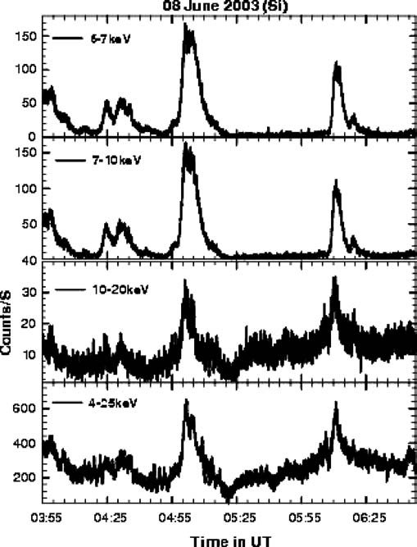
First light
First light was obtained on 08 jun 2003
Both detectors are very sensitive to
observe even very weak flares.
T. Mrozek Wrocław 31.05.07 First SphinX Workshop

Slide 11
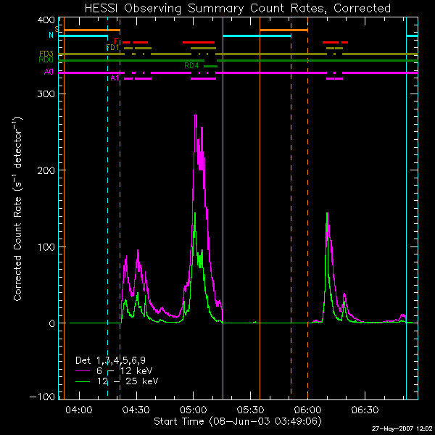
RHESSI lightcurves
T. Mrozek Wrocław 31.05.07 First SphinX Workshop

Slide 12
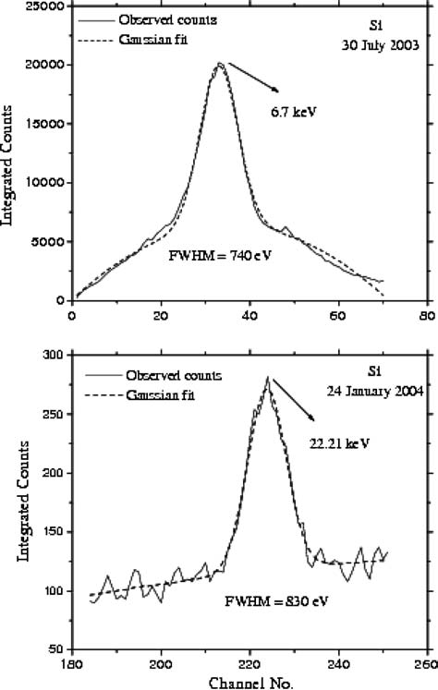
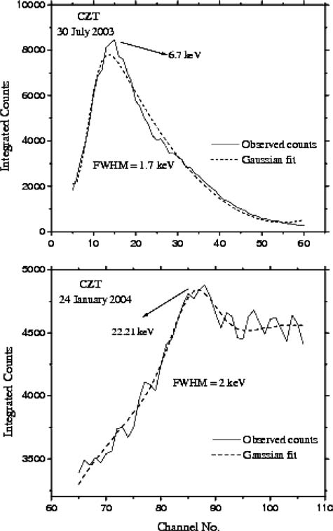
Energy resolution
Si
CZT
Gaussian fits to observed
count spectra
Si reveals sub-keV (.7-.8 keV)
energy resolution
CZT have energy resolution
of 1.7 keV (at 6.7 keV) and
2 keV (at 22.2 keV)
These values are in agreement
with pre-flare calibrations
T. Mrozek Wrocław 31.05.07 First SphinX Workshop

Slide 13
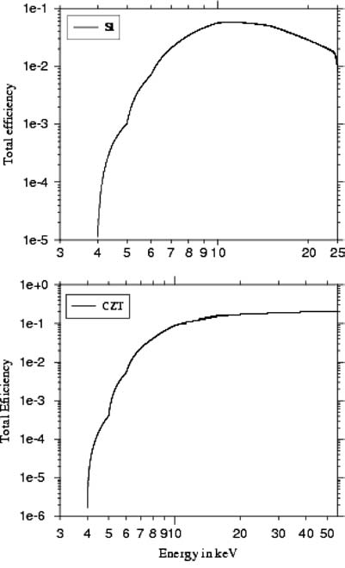
Other issues
Instrumental response is diagonal (no Compton
scattering etc.)
Preflare background was estimated
to be <3000 cts s⁻¹. In-situ observations shows
that it significantly lower i.e. <1500 cts s⁻¹
Developed electronics rejects pileup problem
for moderate count rates (<20 000 cts s⁻¹).
For high count rate events there is software
technique developed which helps avoid
the problem of pileup.
T. Mrozek Wrocław 31.05.07 First SphinX Workshop

Slide 14
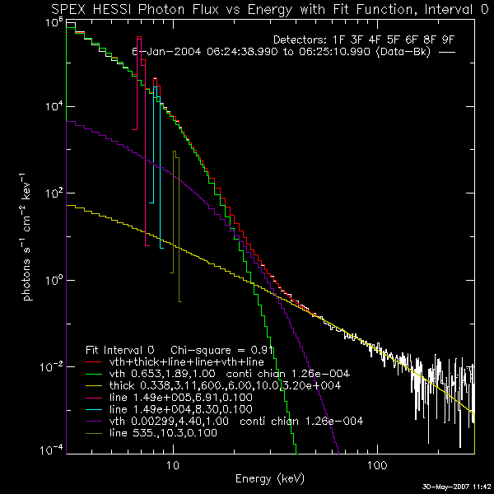
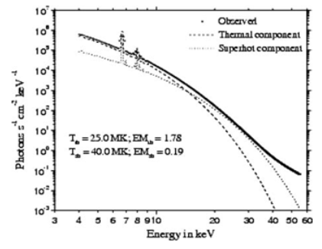
Photon spectra
 | T [10⁶ K] | EM[10⁴⁹ cm⁻³]
RHESSI | 21 | 0.6
 | 49 | 0.003
SOXS | 25 | 1.8
 | 40 | 0.2
T. Mrozek Wrocław 31.05.07 First SphinX Workshop

Slide 15
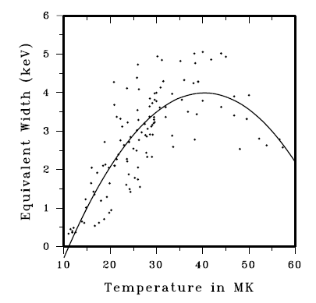
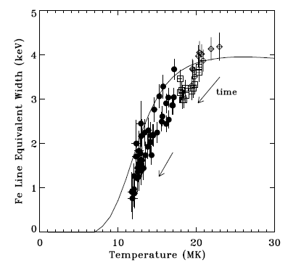
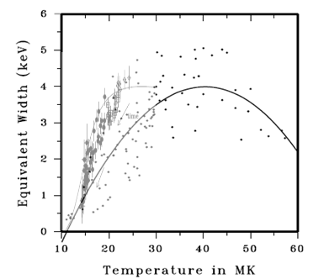
Relation between the equivalent
width of Fe line and temperature
Phillips 2004, ApJ 605, 921
Jain 2006, J. Astrophys. Astr. 27, 175
T. Mrozek Wrocław 31.05.07 First SphinX Workshop

Slide 16
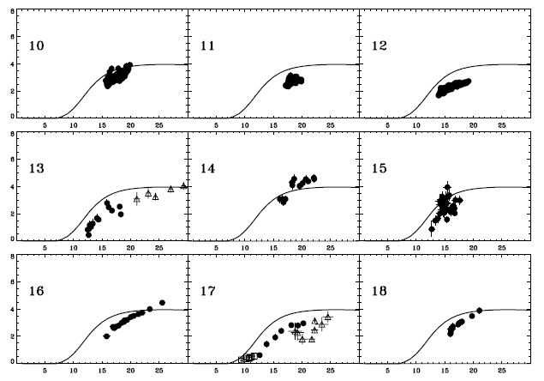
Relation between the equivalent
width and temperature
Phillips 2004, ApJ 605, 921
T. Mrozek Wrocław 31.05.07 First SphinX Workshop

Slide 17
Conclusions
PIN detector works fine in the geostationary orbit
Senstitivity is enough for measuring flux of weak flares.
Temporal and energy resolutions are consistent with expectations
Several issues suggesting problems with absolute calibration. Photon
sepctra seem to be overestimated of an order of magnitude
T. Mrozek Wrocław 31.05.07 Wrocław First SphinX Workshop

