Slide 1
RESIK spectra for flares on
14/15 April 2002 flares
Anna Kępa

Slide 2
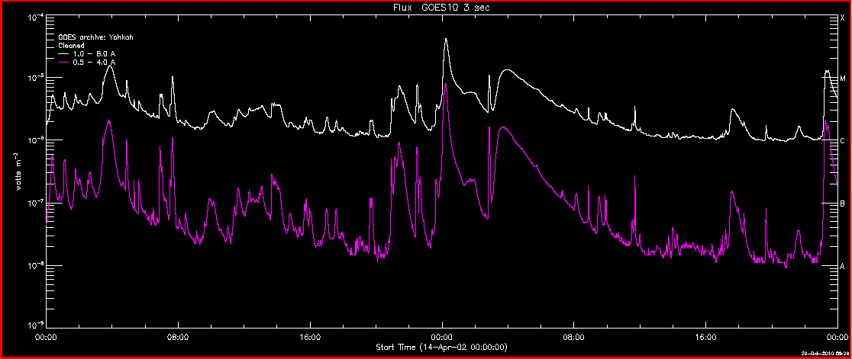
GOES observations
14 Apr 2002 15 Apr 2002

Slide 3
List of events
1. 2002/04/14 01:02:00 01:12:00 01:07:00 C5.5 S02E48
2. 2002/04/14 03:21:00 04:09:00 03:51:00 M1.4 N21W47
3. 2002/04/14 04:48:00 04:56:00 04:52:00 C8.6 N20W56
4. 2002/04/14 06:50:00 07:06:00 07:01:00 C5.3 S03E44
5. 2002/04/14 07:28:00 07:44:00 07:39:00 C9.6 N19W64
6. 2002/04/14 13:37:00 14:15:00 13:50:00 C3.8 S16E06
7. 2002/04/14 19:36:00 19:50:00 19:45:00 C2.0 N05E75
8. 2002/04/14 20:51:00 21:03:00 20:56:00 C4.4 N19W59
9. 2002/04/14 21:04:00 21:43:00 21:25:00 C7.3 N19W59
10. 2002/04/14 22:22:00 22:33:00 22:29:00 C7.2 N19W62
11. 2002/04/14 23:34:00 00:25:00 00:14:00 M3.7 N20W60
12. 2002/04/15 02:46:00 02:55:00 02:51:00 C9.8 N21W68
13. 2002/04/15 03:05:00 05:06:00 03:55:00 M1.2 N21W57
14. 2002/04/15 08:49:00 08:54:00 08:52:00 C3.0 S25E84
15. 2002/04/15 11:39:00 11:44:00 11:42:00 C3.0 N18W75
16. 2002/04/15 17:22:00 18:01:00 17:36:00 C3.1 S15W62
17. 2002/04/15 23:05:00 23:41:00 23:24:00 M1.2 N20W75

Slide 4
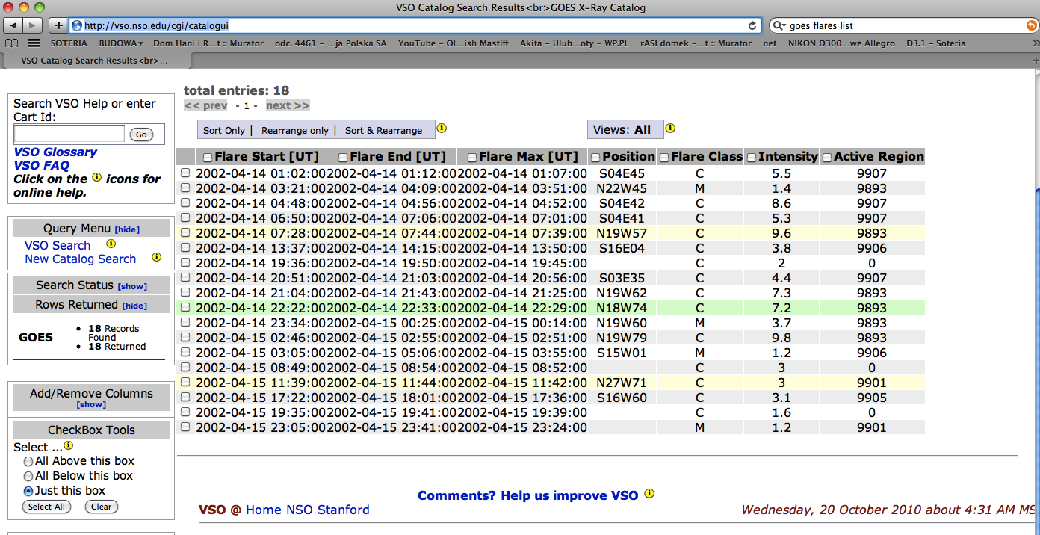

Slide 5
2002-04-14 01:02:00 2002-04-14 01:12:00 2002-04-14 01:07:00 S04E45 C5.5 9907
2002-04-14 03:21:00 2002-04-14 04:09:00 2002-04-14 03:51:00 N22W45 M1.4 9893
2002-04-14 04:48:00 2002-04-14 04:56:00 2002-04-14 04:52:00 S04E42 C8.6 9907
2002-04-14 06:50:00 2002-04-14 07:06:00 2002-04-14 07:01:00 S04E41 C5.3 9907
2002-04-14 07:28:00 2002-04-14 07:44:00 2002-04-14 07:39:00 N19W57 C9.6 9893
2002-04-14 13:37:00 2002-04-14 14:15:00 2002-04-14 13:50:00 S16E04 C3.8 9906
2002-04-14 19:36:00 2002-04-14 19:50:00 2002-04-14 19:45:00 - C2.0
2002-04-14 20:51:00 2002-04-14 21:03:00 2002-04-14 20:56:00 S03E35 C4.4 9907
2002-04-14 21:04:00 2002-04-14 21:43:00 2002-04-14 21:25:00 N19W62 C7.3 9893
2002-04-14 22:22:00 2002-04-14 22:33:00 2002-04-14 22:29:00 N18W74 C7.2 9893
2002-04-14 23:34:00 2002-04-15 00:25:00 2002-04-15 00:14:00 N19W60 M3.7 9893
2002-04-15 02:46:00 2002-04-15 02:55:00 2002-04-15 02:51:00 N19W79 C9.8 9893
2002-04-15 03:05:00 2002-04-15 05:06:00 2002-04-15 03:55:00 S15W01 M1.2 9906
2002-04-15 08:49:00 2002-04-15 08:54:00 2002-04-15 08:52:00 C3.0
2002-04-15 11:39:00 2002-04-15 11:44:00 2002-04-15 11:42:00 N27W71 C3.0 9901
2002-04-15 17:22:00 2002-04-15 18:01:00 2002-04-15 17:36:00 S16W60 C3.1 9905
2002-04-15 19:35:00 2002-04-15 19:41:00 2002-04-15 19:39:00 C1.6
2002-04-15 23:05:00 2002-04-15 23:41:00 2002-04-15 23:24:00 M1.2 9901

Slide 6
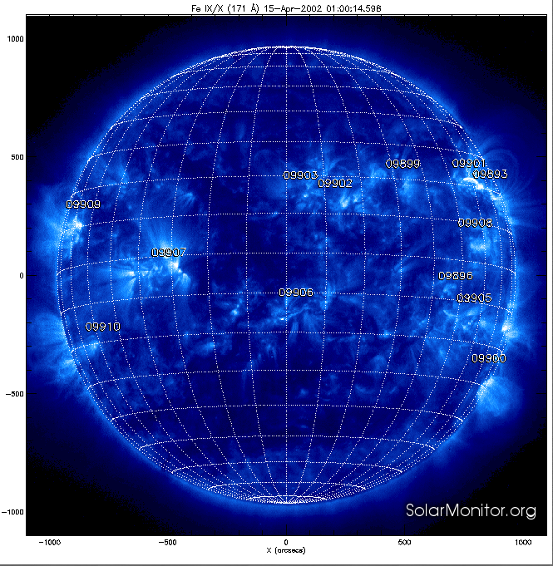
Active regions on 15 Apr 2002

Slide 7
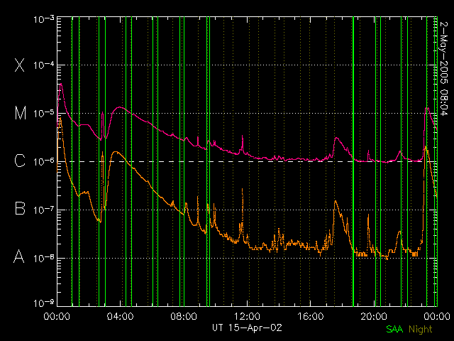

Slide 8
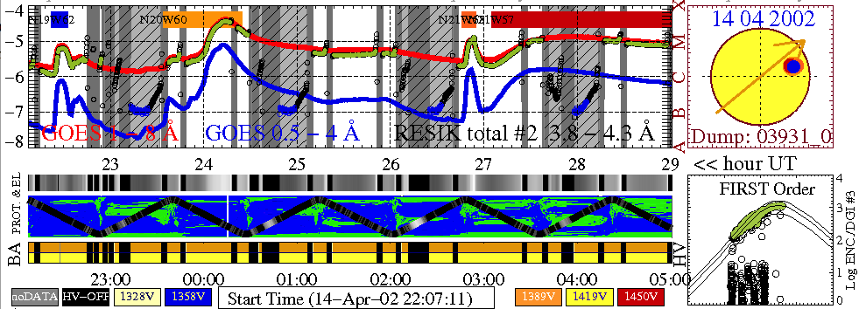
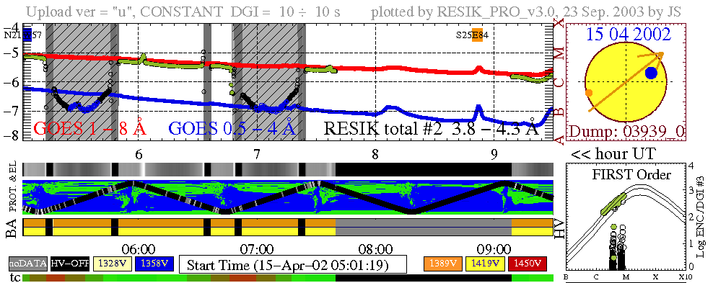
RESIK observations

Slide 9
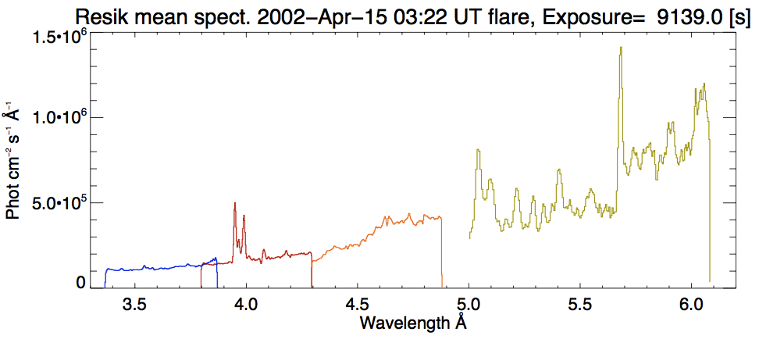
RESIK spectra
891 spectra, time intervals: 10 s

Slide 10
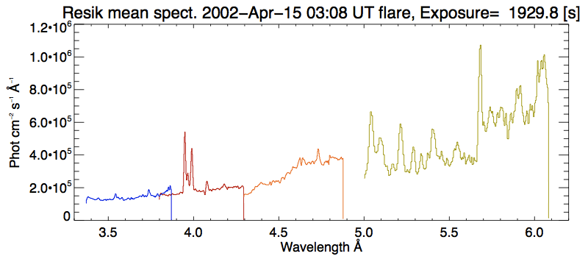
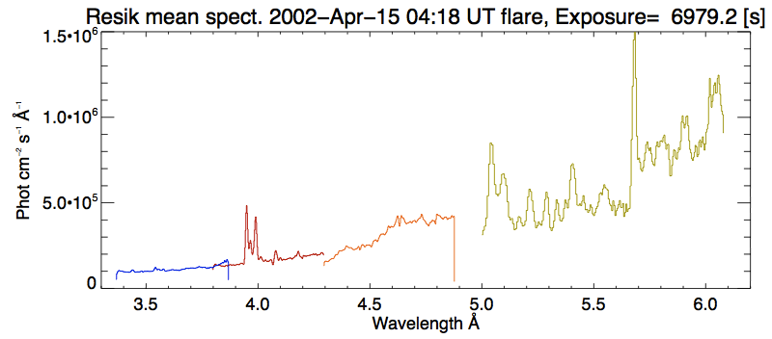
Resik spectra
Rise phase
193 spectra
03:00:00.045
03:37:49.799
Decay phase
698 spectra

Slide 11
“We have done extensive search of common RESIK and SPIRIT data.Unfortunately the only common observation of a flare is on 15th April2002 - we have observations at 04:23:51+37 s (long-duration M-classflare).”
04:24:32 + 150s
RESIK spectra:
1 ['2002-Apr-15 04:22:59.505','2002-Apr-15 04:23:09.505’]
2 ['2002-Apr-15 04:23:09.505','2002-Apr-15 04:23:19.503’]
3 ['2002-Apr-15 04:23:19.503','2002-Apr-15 04:23:29.502’]
4 ['2002-Apr-15 04:23:29.502','2002-Apr-15 04:23:39.501’]
5 ['2002-Apr-15 04:23:39.501','2002-Apr-15 04:23:49.499’]
6 ['2002-Apr-15 04:23:49.499','2002-Apr-15 04:23:59.499’]
7 ['2002-Apr-15 04:23:59.499','2002-Apr-15 04:24:09.497’]
8 ['2002-Apr-15 04:24:09.497','2002-Apr-15 04:24:19.497’]

Slide 12
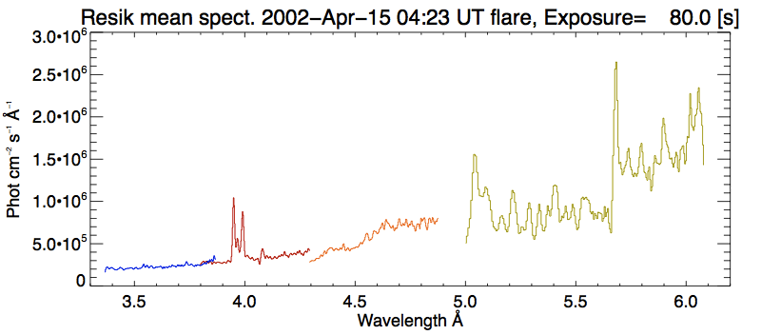
RESIK spectra 04:23 UT – 04:24 UT

Slide 13
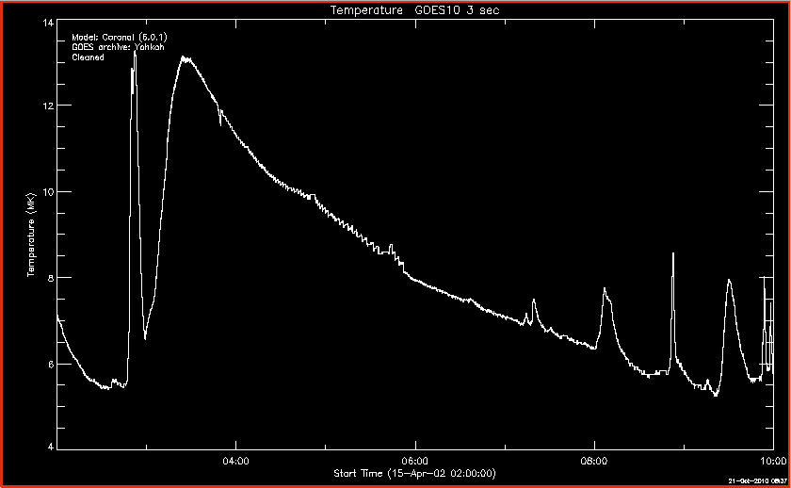

Slide 14
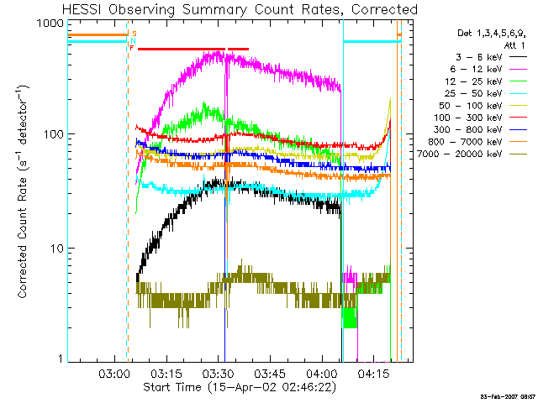
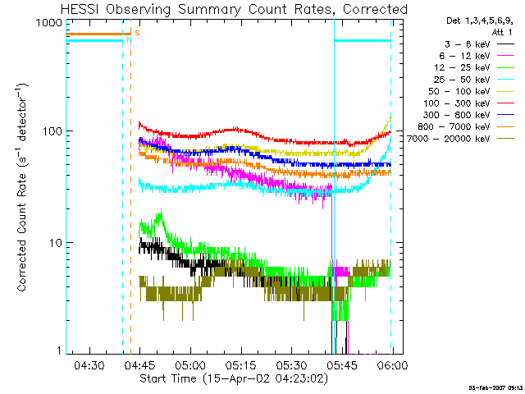
RHESSI

